Slide 1





Informative Webcast Event 2024
Thursday December 19th, 2024
12:00-14:00 EET

Slide 2

Today’s Agenda
12:00 -13:00
“EIT RawMaterials KAVA Call 13: Opportunities for new projects”
Dr. Anastasia Alexandratou, Project Manager, EIT RawMaterials RIS Hub Greece
13:00 – 13:30
“EIT RawMaterials Business Creation Landscape: Opportunities to launch and scale up your start-up”
Vasilis Athanasiadis, Business Creation & Strategy Manager, Mantis Beyond Innovation
13:30 – 14:00
Q&A

Slide 3
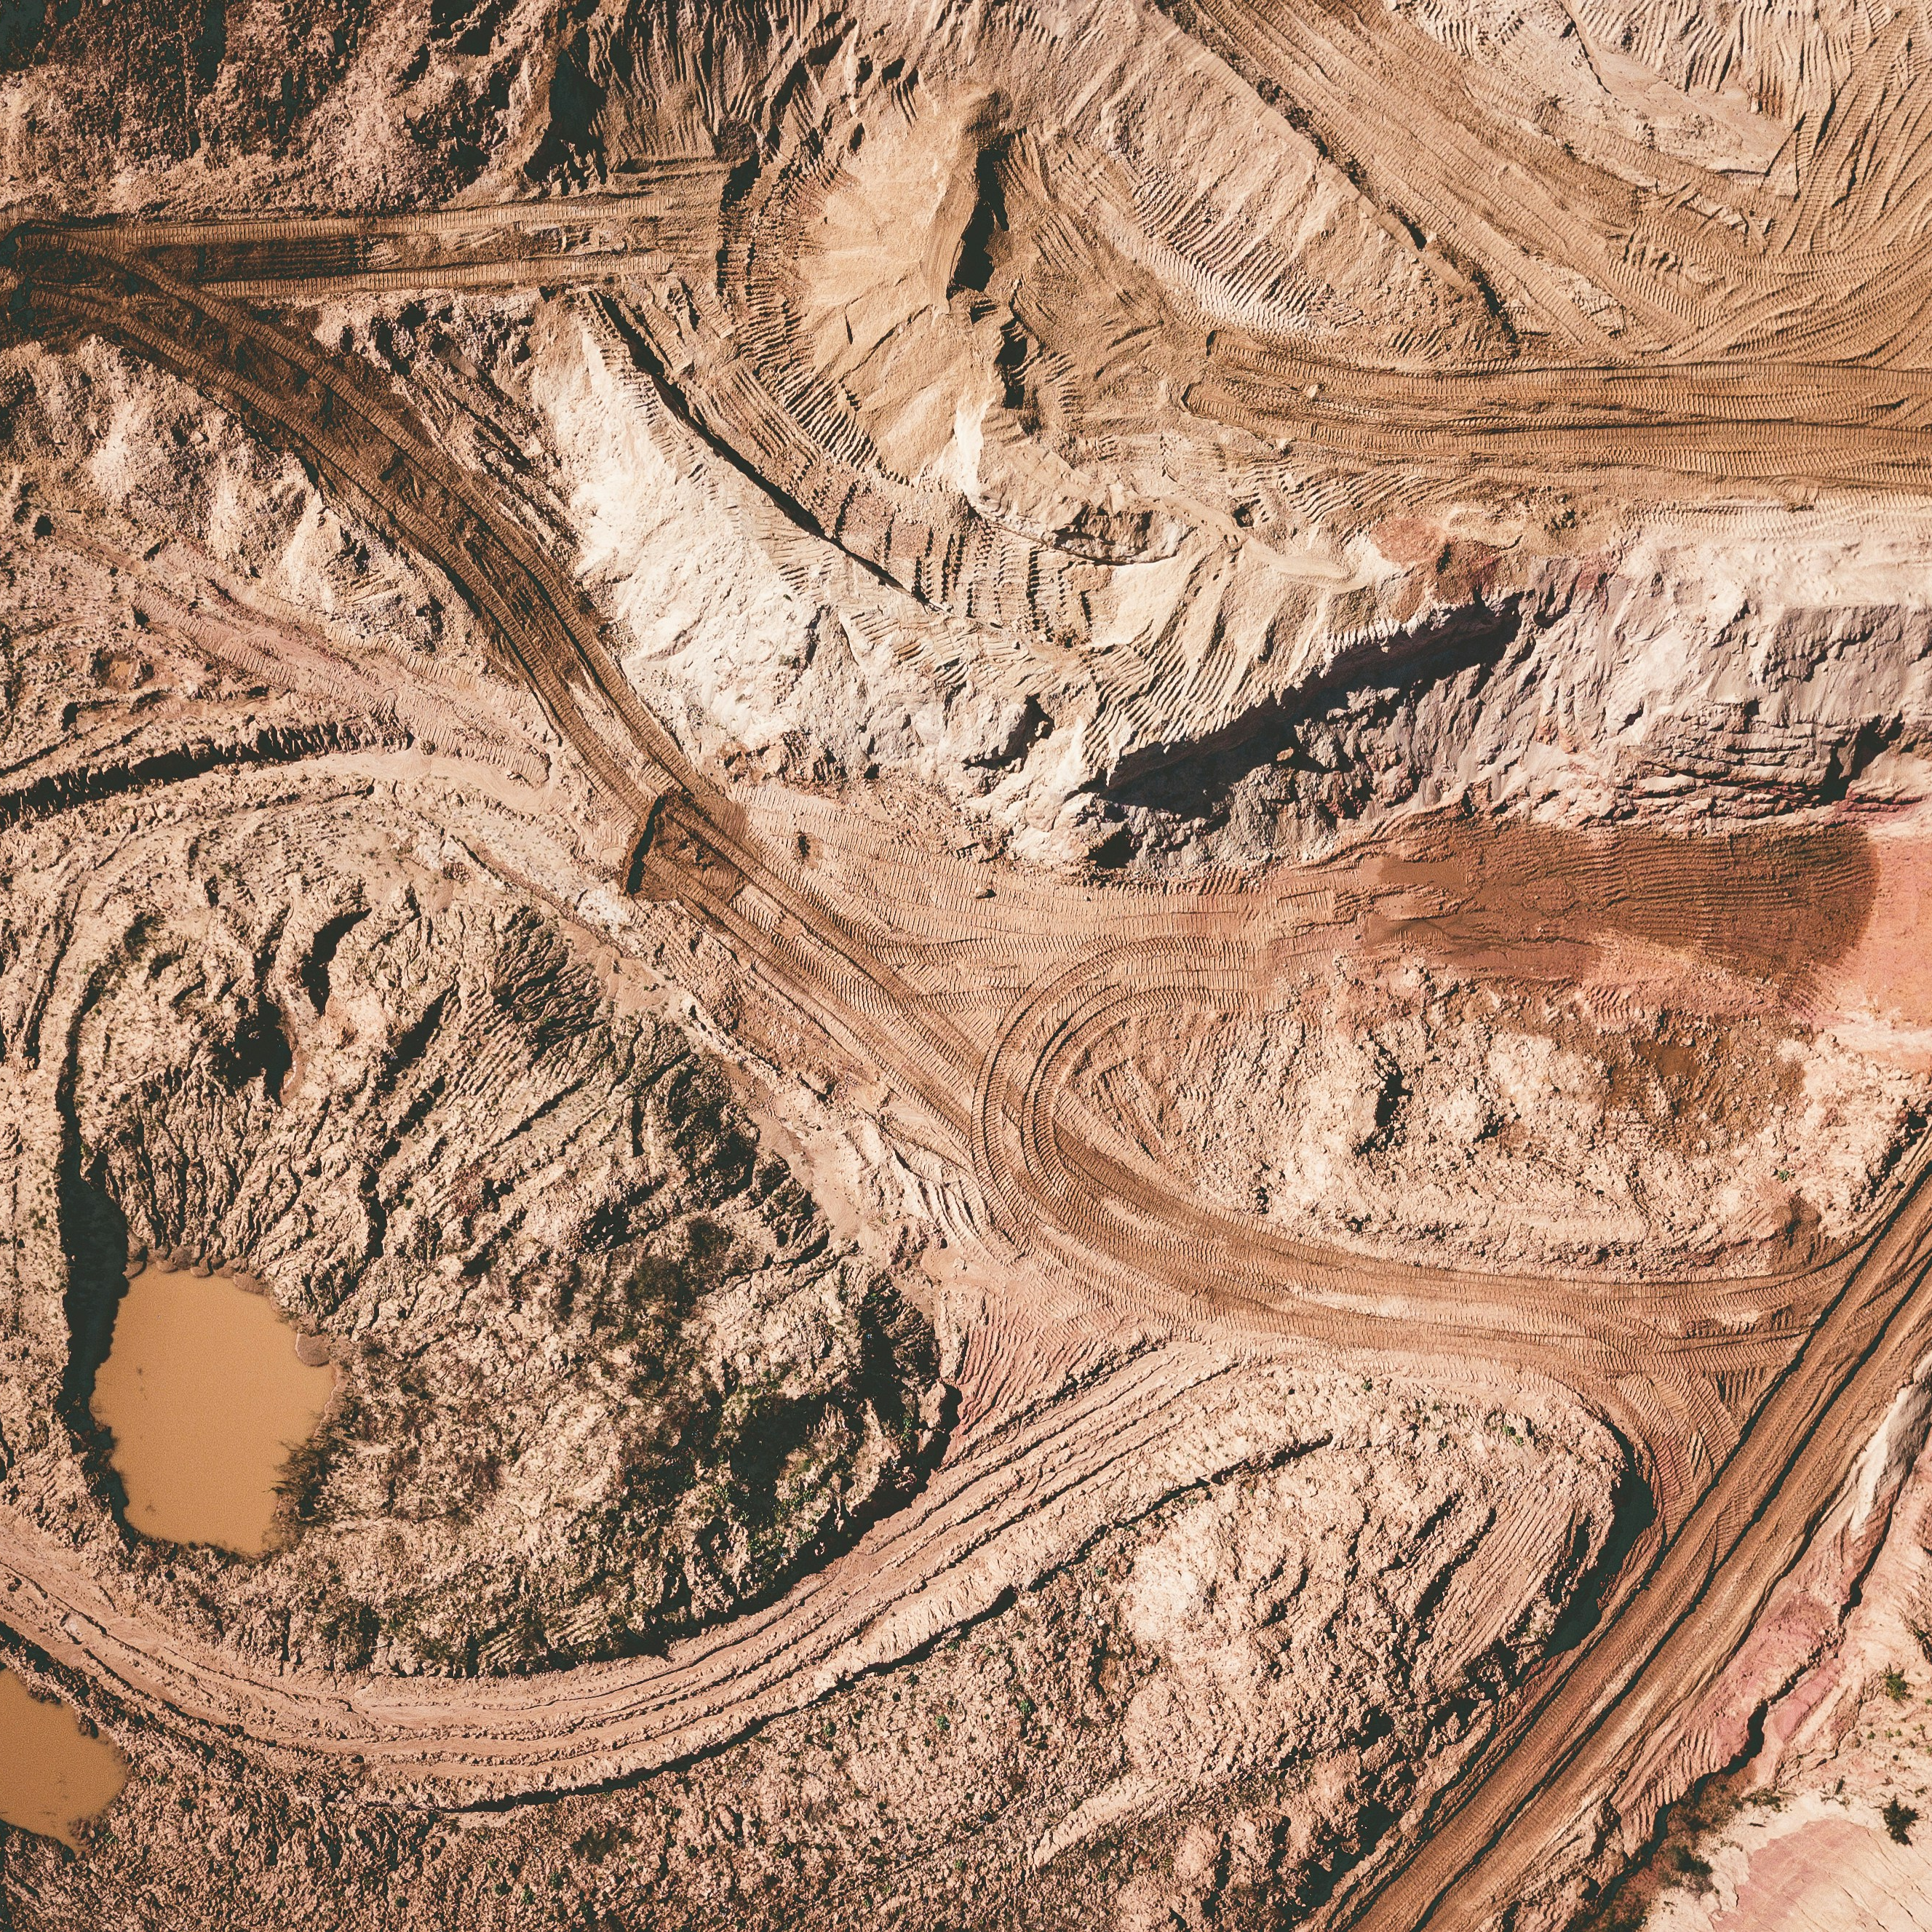
Contents
EIT RawMaterials
EIT RawMaterials RIS Hub Greece
KAVA Call 13 Upscaling
KAVA Call 13 RIS Projects
KAVA Call 13 Education

Slide 4
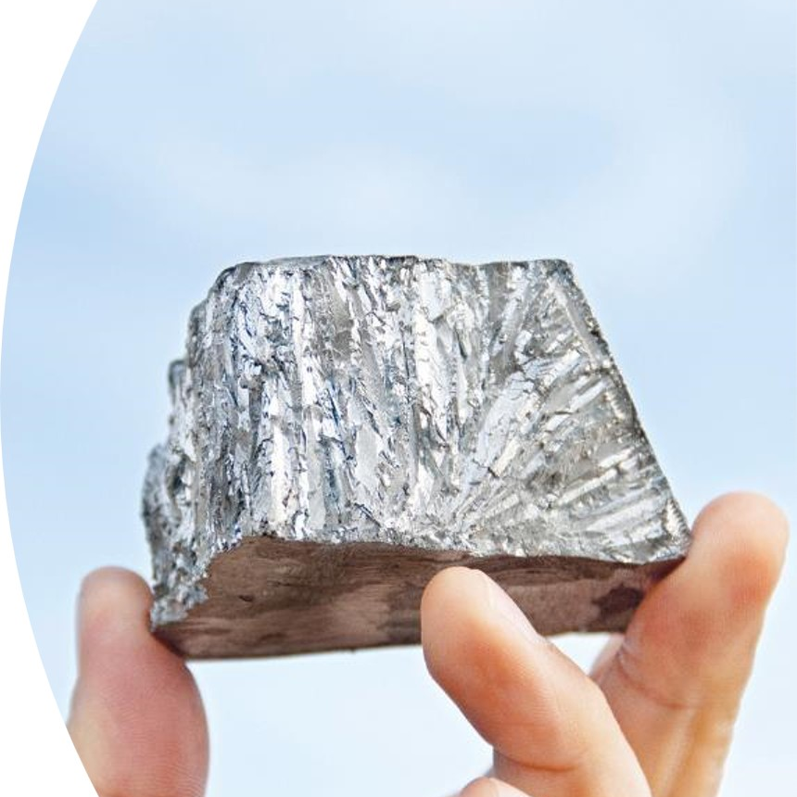

EIT RawMaterials
Vision & Mission
At a glance
Community
Value Proposition to Partners Partnership
4
5
6
7
8

Slide 5

The Vision
To make the Raw Materials sector a major strength for Europe.
The Mission
To enable the sustainable competitiveness of the European minerals, metals, and materials sector across their whole value chain by driving innovation, education, and entrepreneurship.
Notes:
Focusing on EIT RM…its vision is to make the RM sectors a significant strength in Europe and its mission is to enable the sustainable competitiveness of European minerals, metals and materials sector across their while value chain, by enhancing innovation, education and entrepreneurship.

Slide 6
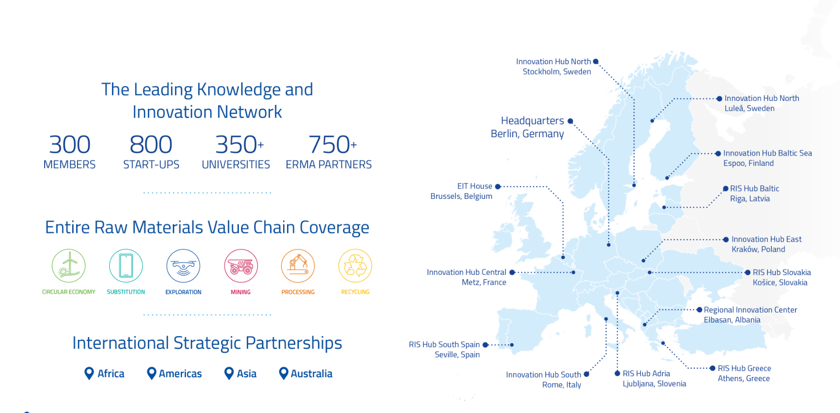
At a glance

Slide 7

World’s largest RM Innovation Community
INDUSTRY
RESEARCH & TECHNOLOGY
HIGHER EDUCATION
149 members
11 Greek partners
53 members
2 Greek partners
72 members
1 Greek partner

Slide 8
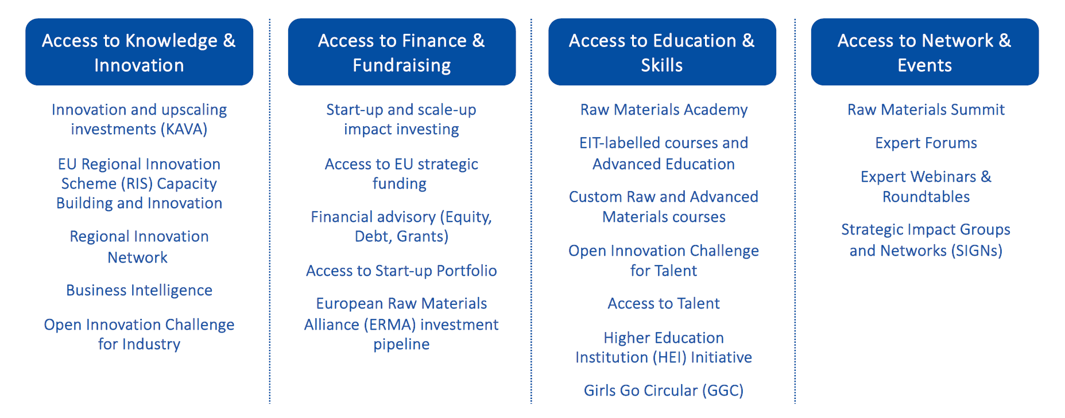
Value Proposition to Partners

Slide 9
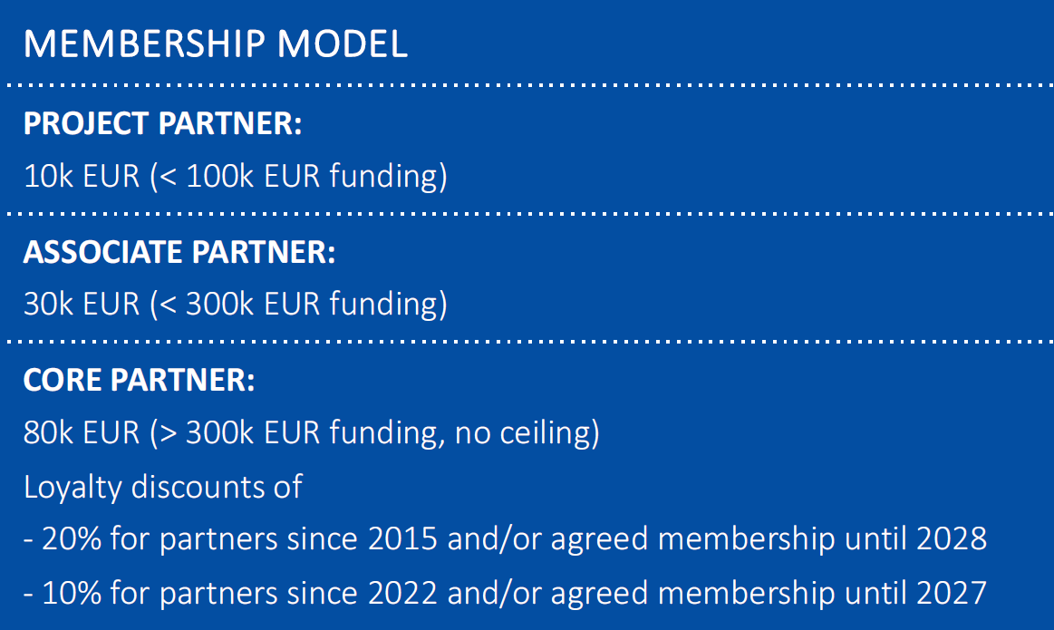
EIT RawMaterials - Partners and Membership
Partner levels
Core Partner
Associate Partner
Project
Partner
> 140 core and associate partners
130 project partners
Notes:
EIT RawMaterials comprises of more than 120 core and associate partners and over 180 project partners of leading businesses, universities, research & technology organisations from over 20 EU countries.
By becoming an EIT RM partner, there are a lot of advantages, including: support of innovation and education projects, getting access to networking and matchmaking events, having the opportunity to meet with experts, as well as getting access to digital collaboration and networking platforms, and benefit from preferred access to the network and servicing components,
There are 3 levels of partnership:
Core partner: full access to strategy and governance, amount of membership fees: 100.000 euros/year and no funding limit
Associate partner: shared access to strategy and governance, amount of membership fees: 30.000 euros/year and up to 300.000 euros of EIT funding
Project partner: shared access to strategy and governance, amount of membership fees: 10.000 euros/year and up to 100.000 euros of EIT funding
Non-members can be included in consortia, although in the case of positive evaluation and funding of the proposal, by the time the project starts they should have become members.

Slide 10
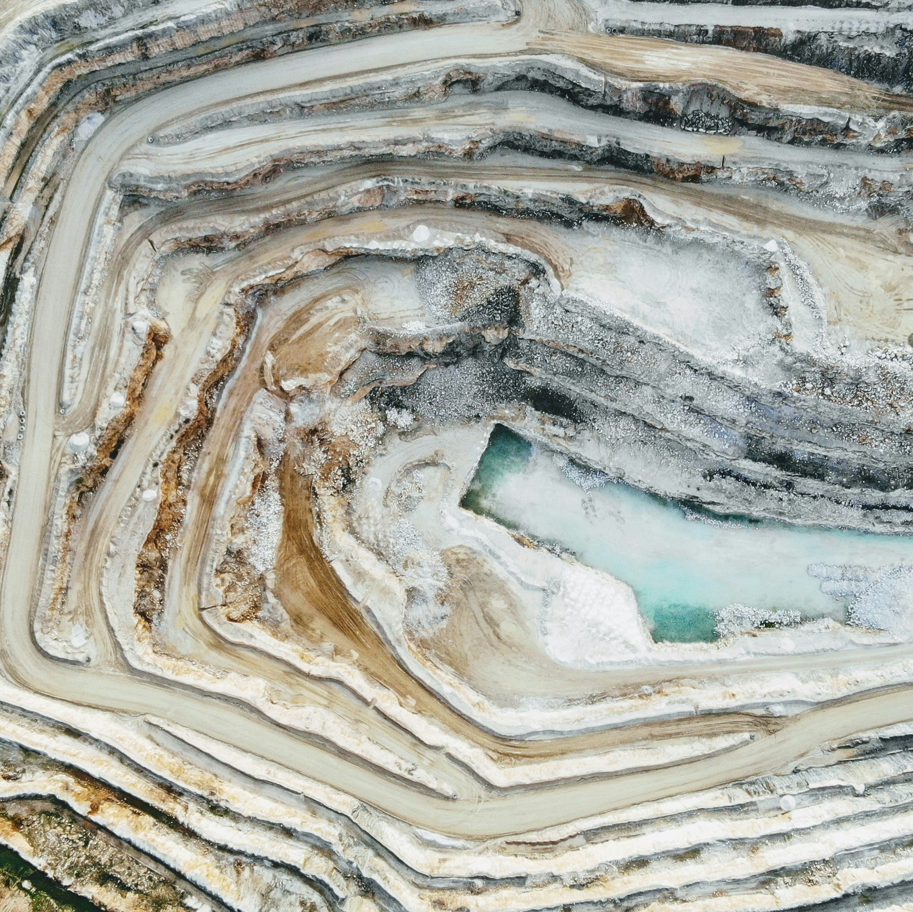
EIT RawMaterials RIS Hub Greece
10
11
12
13
14
15
Our Vision
About Us
Our Mission
Our Activities & Network Our Projects
What we offer

Slide 11
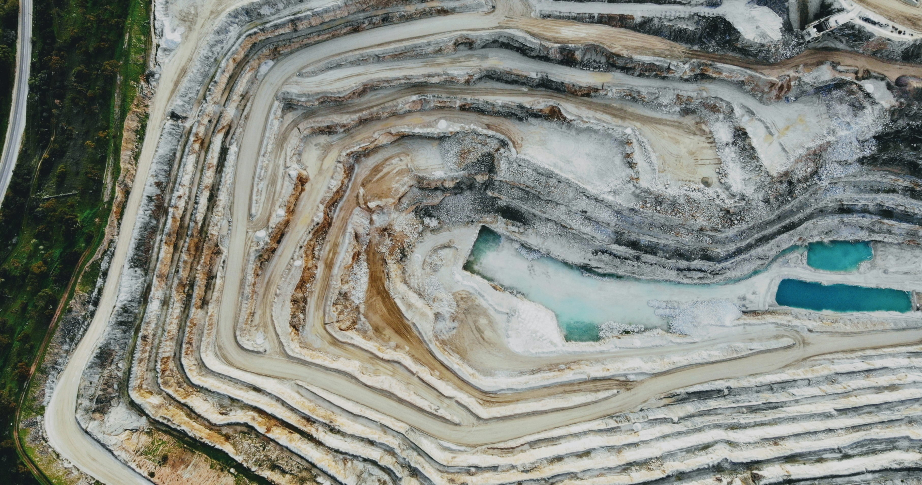

Bridging Innovation, Industry & Education in the Greek Raw Materials Sector.
“
”
11

Slide 12

About Us
In 2017
Since then
And in 2022
Established in 2017 by the NTUA with the support of EIT RawMaterials.
The operational activities of the Hub fall under the oversight of NTUA's School of Mining and Metallurgical Engineering.
The Greek Hub partnered with MANTIS BI in the business creation activities.

Slide 13
Our Mission
Boosting Innovation Capacity
Mobilizing national actors and fostering European cooperation in the Greek Raw Materials sector.
Enhancing Education
Increasing entrepreneurial and innovation capacity in Higher Education across Greece.
2
1
3
Regional Support
Assisting neighboring RIS countries in improving their innovation capacities.
4
Supporting Business Creation
Encouraging the establishment and growth of businesses within the sector.

Slide 14
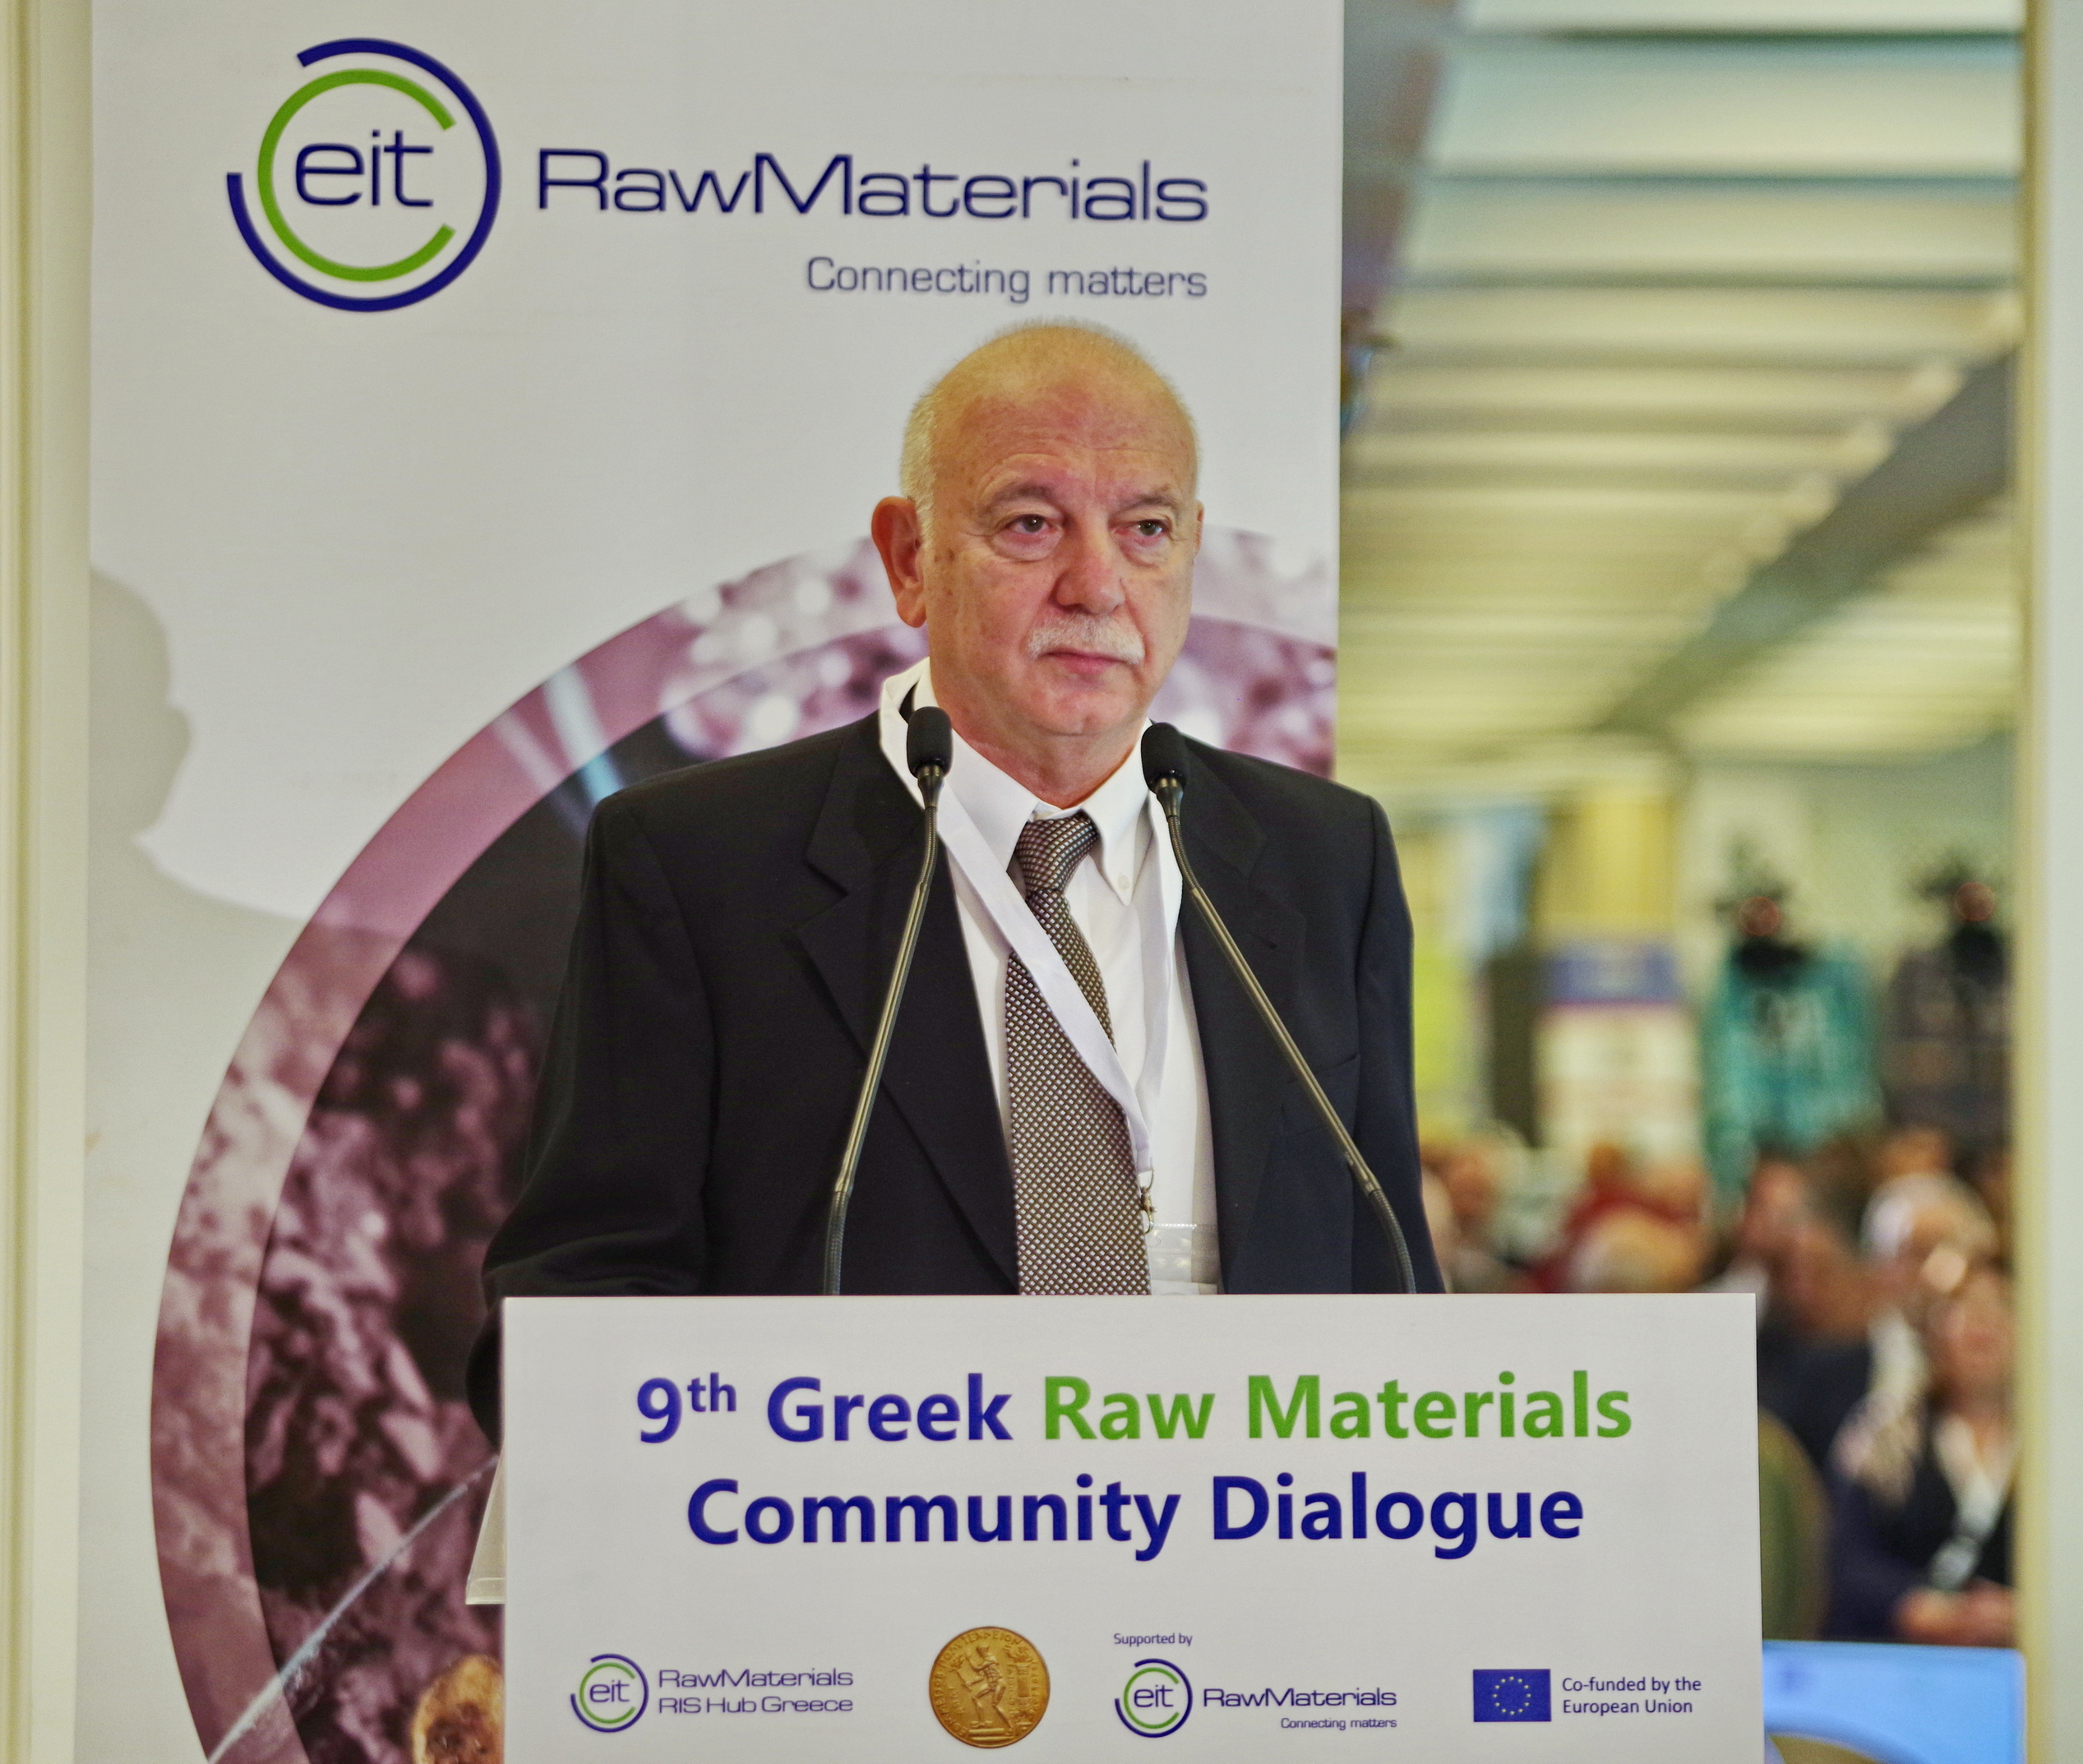
Our Activities & Network
RIS Hub Greece Ecosystem (2024)
160+ Attendees Greek RM Community
20+ Innovation Projects
8 Sponsors

Slide 15

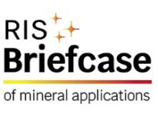




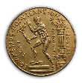
Our Projects
2017 – Today
Participation in 27 projects in Upscaling, Innovation and Education.
20 projects completed and 7 ongoing
Our Ongoing Projects

Slide 16


What we offer
KAVA Proposal Writing & Consortium Set-Up
Participation in KAVA Projects
Industry Services (sustainability reporting)
Networking Activities
Business Creation Opportunities

Slide 17

KAVA CALL 13
Lighthouses
Upscalling
Regional Innovation Scheme (RIS)
RIS Innovation
RIS Capacity Building
Education
Submission timeline
17
18
23
26
29
33
41

Slide 18
EIT RawMaterials - Lighthouses
Lighthouses are high-impact, long-term innovation activities that address the economic, societal and environmental challenges of the RM sector in Europe.
Responsible sourcing
Lighthouses are implemented through actions such as:
Innovation and Education Projects,
Matchmaking events, and
Business creation activities.
Sustainable materials
Circular societies
Notes:
Lighthouses are large-scale and long-term coordinated innovation initiatives that address critical and specific raw materials challenges for Europe. They are mission approaches to innovation and education challenges and target to generate solutions for societal challenges related to raw materials. In doing so, they will raise awareness about their role and importance and create a positive perception about raw materials and their associated industries.
Those key thematics for 2024 projects are: Responsible Sourcing, Sustainable Materials and Circular Societies and are implemented though guided activities and funding tools of EIT RM such as call for innovation and Education proposals

Slide 19
KAVA CALL 13
Upscaling Call 2024/2025

Slide 20
Aim of the call and Topics addressed
To promote innovation in the raw materials sector via financing technology upscaling projects: Circular Societies, Sustainable Materials, Responsible Sourcing
To support technologies validated in the lab that need additional step(s) for testing, demonstration, proof of concept and up-scaling prior to commercialization - TRL transition: TRL 5 → TRL 8 (or higher)
Projects must aim for market introduction and/or commercial use within 2 years or less after the end of the Project
Projects need to be based on a solid market analysis: risk assessment, market studies, and intellectual property exploration. Proposals need to include a preliminary market analysis.
KEY REFERENCE DOCUMENTS (SeedBook Platform)
EIT RawMaterials Strategic Agenda 2021-2027: project Core KPIs defined
Lighthouse Appendix: key technology areas highlighted

Slide 21
Eligibility Criteria
Alignment with the EIT RM Strategic Agenda 2021-27 and the Lighthouse Appendix (topics)
Co-funding: min. 30% of total funding
No more than 80% of the grant can go to one of the partners
Consortium structure:
max. 5 project participants
min. 2 project participants from a minimum of two different countries eligible for Horizon Europe funding
Participants: from at least 2 sides of the Knowledge Triangle
Lead project participant: Core or Associate Partner (by the time the project starts)
Strategy and Tentative Plan for the financial sustainability mechanism: equity, revenue sharing, hybrid (E:RS ratio to be defined in the proposal)
Workplan:
Detailed for each year of the project
Mandatory WPs: Project Management, Dissemination & Communication Plan, Go-to-Market Strategy, and potentially LCA
Notes:
Knowledge triangle: education, research, business creation

Slide 22
Funding and Financial Sustainability
Funding
Expected budget (EIT funding + co-funding): no less than 500k EUR per year & not higher than 2.5M EUR for the total project duration
Co-funding by the Project Consortium: minimum of 30% of the total funding to be defined in the proposal
Project duration: max. 2.5 years
Funding: disbursed on a yearly basis, with a certain percentage of pre-financing being paid as a lump sum during the course of the year, and a balance payment being paid during the following year on an actual cost basis
Financial Sustainability Mechanism
Equity: EIT RawMaterials receives a percentage of the share capital of the project company
Revenue sharing: EIT RawMaterials receives a percentage of the revenue generated from the project in the event of success. The amount of backflow can be capped to an amount equaling the EIT funding received.

Slide 23
Timeline and Proposal Registration
Submission cut-off dates
Friday 29th November 2024 at 13.00 CET for cut-off 1
Friday 28th February 2025 at 13.00 CET for cut-off 2
Friday 30th May 2025 at 13.00 CET for cut-off 3
Friday 29th August 2025 at 13.00 CET for cut-off 4
Friday 28th November 2025 at 13.00 CET for cut-off 5
Evaluation and project start
Mid-March: Evaluation by external experts (subsequently 3 months after for cut-offs 3-5)
Apr 2025: Approval of the list of projects by KIC Managing Board and communication to partners (subsequently 3 months after for cut-offs 3-5)
May 2025: earliest starting date for selected projects (subsequently 3 months after for cut-offs 3-5)
Proposal Registration
SeedBook Platform: https://seedbook.eitrawmaterials.eu/
1–Stage submission and evaluation process

Slide 24
KAVA CALL 13
Regional Innovation Scheme (RIS)

Slide 25
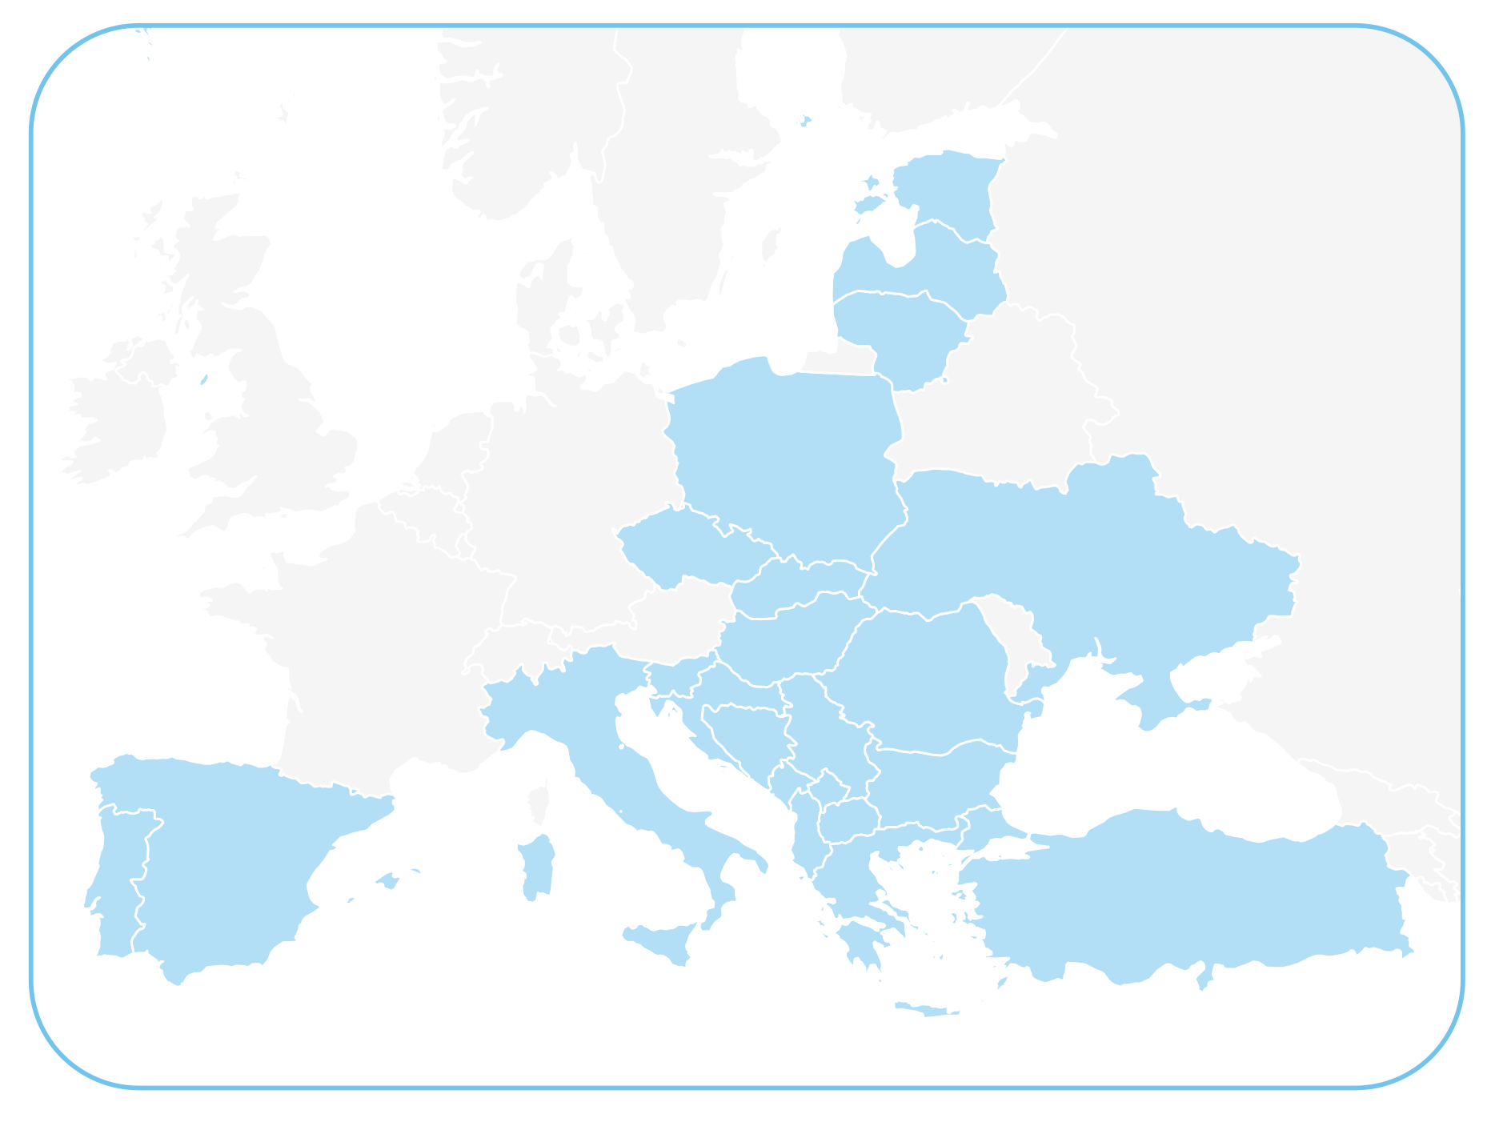
Regional Innovation Scheme (RIS) – objectives and purpose
RIS Eligibility based on:
European Commission’s Innovation Scoreboard
Objective and purpose of RIS:
Contribute to the advancement of the innovation performance of RIS countries
Help raise the capacity of local actors to apply to become full KIC partners
Promote the knowledge triangle integration (KTI) model
Use as a bridge towards relevant RISs & leverage additional private and public funding
Support KIC’s financial sustainability
Disclaimer
The designations employed and the presentation of material on this map do not imply the expression of any opinion whatsoever on the part of the European Union concerning the legal status of any country, territory, city or area or of its authorities, or concerning the delimitation of its frontiers or boundaries. Kosovo*: This designation is without prejudice to positions on status, and is in line with UNSCR 1244/1999 and the ICJ Opinion on the Kosovo declaration of independence.
***Source: https://sciencebusiness.net/news/european-institute-innovation-and-technology-consolidate-support-less-innovative-regions

Slide 26
EIT RawMaterials RIS KAVA Projects specifics
Proposals need to comply with the following conditions of Regional Innovation Scheme (RIS):
Majority of RIS Proposal's activities are executed in RIS countries
Activities need to provide benefits for RIS countries
Activities need to raise the innovation level of entities in RIS countries
Activities must be coordinated by a partner from a RIS eligible country
Activities contribute to at least a reasonable and preferably significant amount of EIT Core KPIs (reported as achieved in a RIS eligible country);
RIS eligible countries are (from 1 Jan 2025): a) EU Member States: Bulgaria, Croatia, Czechia, Estonia, Greece, Spain, Italy, Cyprus, Latvia, Lithuania, Hungary, Malta, Poland, Portugal, Romania, Slovenia, Slovakia; b) Horizon Europe Associated Countries: Albania, Bosnia and Herzegovina, Montenegro, North Macedonia, Serbia, Türkiye, Ukraine, Israel and c) Outermost Regions: Guadeloupe, French Guiana, Réunion, Martinique, Mayotte and Saint- Martin (France), the Azores and Madeira (Portugal), and the Canary Islands (Spain)

Slide 27
KAVA CALL 13
RIS Innovation Call 2024/2025

Slide 28
RIS INNOVATION KAVA Projects
Innovation Projects based on validated technologies that need additional step(s) for testing, demonstration, proof of concept and up-scaling prior to commercialization. The purpose of these Projects is to support good technologies, products, and services that are currently under development in RIS countries to reach market entry.
Consortium (No. of partners) | min. 2 - max. 4 (from min. 2 RIS countries)
Lead project participant | must be a Core or Associate Partner (or Linked Third Party to a Core or Associate Partner) of EIT RawMaterials by the time the project starts
TRL level at start/end | min. 6 → 8 (or higher)
RIS Task Partners | Yes, can have (but must be selected via open call)
Budget Size | Phase 1: max. 500k EUR of EIT Funding and in case of successful interim evaluation and continuation to Phase 2: additional 300-500k EUR of EIT Funding (max. total EIT Funding: 1M EUR/project)
Min. Co-funding (% of Total project funding) | 20%
Duration | 2 / max. 2.5 years (will be implemented in 2 phases, but the consortium applies only once for both phases (Phase 1= 1 year - review and go/no-go decision - Phase 2=1 year, max. 1.5)
Core KPI target mandatory | Yes
Notes:
Support of proven technologies/products/services within the RM sector in RIS countries.
Focus on testing, demonstration, or upscaling for commercialization.
Lower TRL at the start of the project (TRL 6 = technology demonstration in relevant environment)
**If the TRL criteria in RIS Innovation Call are too high for a certain applicant, they can apply to the Upscaling Call.

Slide 29
RIS INNOVATION KAVA Projects
 | More than 50% of EIT funding requested by the Consortium must be allocated to RIS partners.
Commercialisation | Must aim for market introduction and/or a commercial use within 2 years (or less) after the end of Phase 2 of the Project, and Proposal of shorter duration for market introduction and/or commercial use will be favourably evaluated.
Financial Sustainability Mechanism | EIT RawMaterials funds a project by requesting ROI in the event of the project’s success. Backflow mechanisms: a) Equity (obtaining a percentage of the share capital of the Project company), b) Revenue Sharing, c) Hybrid, d) alternative funding structures - only be considered on an exceptional basis and for specific reasons.
Market Analysis | Preliminary and solid Market Analysis must be included in the Proposal.
Go-to Market Strategy | All Proposals must include into their activities plan a Go-to-market Strategy as a mandatory Deliverable at the end of Phase 1 of the Project (M12)
Market introduction and/or a commercial use | Within 2 years (or less) after the end of Phase 2 of the Project, and Proposal of shorter duration for market introduction and/or commercial use will be favourably evaluated.
Notes:
ROI = return on investment

Slide 30
KAVA CALL 13
RIS Capacity Building Call 2024/2025

Slide 31
RIS CAPACITY BUILDING KAVA Projects
This call supports capacity-building projects to boost raw materials innovation in RIS countries and solve raw materials sector-related challenges. It focuses on regional impact and sustainable ecosystem expansion. Can be defined on a case-by-case basis, i.e., Cooperation with innovative groups that work on and have developed tools and technologies that can be tested in RIS regions with the aim of solving raw materials value chain-related challenges. (Other examples in the Call)
Consortium (No. of partners) | min. 2 project participants (at the time of proposal submission) and min. 3 KIC Core, Associate or Project Partners (at the time of the Project’s start), coming from a minimum of 2 countries
Lead project participant | must be a Core or Associate Partner (or Linked Third Party to a Core or Associate Partner) of EIT RawMaterials by the time the project starts
TRL level at start/end | min. 4 → 6 (or higher)
RIS Task Partners | Yes, can have (but must be selected via open call)
Budget Size | Not defined in Call text
Min. Co-funding (% of Total project funding) | 10% (Co-funding above the mandatory minimum will be evaluated positively)
Duration | 1 - 2 years
Core KPI target mandatory | Yes
Notes:
Capacity Building projects: the aim is to transfer technology and knowledge from more advanced countries (in terms of innovation level) to RIS countries
KIC partners: project participants who are not EIT members have to become by the time of the project’s start (not a prerequisite at the time of proposal submission)
Eligible applicants include universities, research institutions, SMEs, and local/regional authorities (also eligible under Horizon Europe funding)

Slide 32
RIS CAPACITY BUILDING KAVA Projects
 | More than 70% of EIT funding requested by the Consortium must be allocated to RIS partners.
Financial Sustainability Mechanism | Not defined in the call text, but Financial sustainability mechanism potential/ or even indicated will be evaluated positively.
Market Analysis | Not defined in the call text. A basic market analysis should be part of the Final proposal.

Slide 33
RIS Proposals Registration and Submission for KAVA Call 13
RIS Innovation and RIS Capacity Building Proposals
Submission cut-off dates
Friday 17th January 2025 at 13.00 CET for cut-off 1
Friday 28th February 2025 at 13.00 CET for cut-off 2
Friday 30th May 2025 at 13.00 CET for cut-off 3
Friday 29th August 2025 at 13.00 CET for cut-off 4
Friday 28th November 2025 at 13.00 CET for cut-off 5
Evaluation and project start
Mid-Feb: Evaluation by external experts (subsequently 3 months after for cut-offs 2-5)
End Feb 2025: Approval of the list of projects by KIC Managing Board and communication to partners (subsequently 3 months after for cut-offs 2-5)
Apr 2025: Earliest starting date for selected projects (subsequently 3 months after for cut-offs 2-5)
Proposal Registration
SeedBook Platform: https://seedbook.eitrawmaterials.eu/
1–Stage submission and evaluation process

Slide 34
KAVA CALL 13
Projects in Education
New Initiatives addressing skills shortages

Slide 35
Live Education Calls
4 Calls for Education Projects for Higher Education Institutions, RTOs and Industry
Target: Students, Professionals, and Executives in the RM sector
Digital Transformation Learning Portfolio
Social License to Operate (SLO) Hub
Raw and Circular Economy Expedition (RACE)
Global MBA in Materials Management
Consortium Requirements:​
At least two pillars of the EIT Knowledge Triangle: academia, research, and industry.​
At least three countries associated with the EU’s Horizon Europe Program or the Regional Innovation Scheme (RIS).​
The lead partner must be an EIT RawMaterials Core or Associate Partner by the time the project starts. Non-partners are encouraged to apply!
More information: https://eitrawmaterials.eu/education-skills#live-calls

Slide 36
1. Social License to Operate (SLO) Hub
Objective: Το foster Social License to Operate (SLO) and deliver training and consulting services on community engagement and sustainability in the RM sector. Support the implementation of the CRMA.
Importance: Support the SLO topic among exploration and mining companies and along the whole RM value chain. The correct approach will also support the implementation of the Critical Raw Materials Act CRMA.
Target Call Audience: Companies, universities, or RTOs with experience in shared value and social/local stakeholder engagement projects experienced learning content developers.
Implementation:
Phase 1 (12 months, objective of this call): Development of learning content, organizational plans, and a pilot program
Phase 2: Implementation of the project, in the future project period (not part of this call)
Targets of Phase 1: 10k EUR revenue, 150 participants within 12 months
Funding: Up to 800k EUR, provided on an actual-cost basis
Submission Deadline:
Friday 24th January 2025 at 13.00 CET (Berlin time)

Slide 37
2. Digital Transformation Learning Portfolio
Objective: To develop a cutting-edge learning portfolio designed to equip professionals in the RM sector with the essential skills needed to navigate and adapt to the increasing impact of digital technologies.
Eligible Topics:
Artificial Intelligence and Machine Learning
Virtual and Augmented Reality
Automation and Autonomous Design
IoT and Digital Infrastructure
Data Security and Societal Impact
Digital Natives
Offerings (detailed examples are provided in the Call text):
Introductory and advanced courses
Micro-credentials and LLL programmes
Development and incorporation of digital modules & teaching tools for existing Academy’s programmes (i.e., Master, PhD, WSL)
Notes:
Micro-credentials certify the learning outcomes of short-term learning experiences, for example a short course or training.

Slide 38
2. Digital Transformation Learning Portfolio
Importance: Enhance innovation, sustainability, and industry competitiveness
Target Call Audience:
Experts in cutting-edge technologies in the RM sector
Leaders in digital tools, and learning content developers – especially with experience developing self-paced virtual courses
Implementation:
Phase 1 (12 months, objective of this call): Development of the course/module contents and pilot training courses
Targets of Phase 1: 10k EUR revenue, 150 users within 12 months
Phase 2: Implementation of the project, in the future project period (not part of this call)
Funding: Up to 1.5M EUR, provided on an actual-cost basis
Submission Deadline:
Friday 24th January 2025 at 13.00 CET (Berlin time)

Slide 39
3. Raw & Circular Economy Expedition (RACE) – for Executives
Objective: To design and deliver a powerful package of industry tours, inspiring talks, and collaborative group work, aiming to reshape perceptions of the RM sector as dynamic, innovative, and full of opportunity and, thus, drive the sector’s transformation.
Activities: Lectures, visits to industrial facilities, innovation workshops, and networking sessions.
Participants: Industry leaders, entrepreneurs, and senior managers working in the RM and related industry
Course Topics: Blockchain, AI, IoT, Digital Twins, and more.
Target Call Audience: Leaders in executive education, companies, universities, or RTOs with extensive networks across all areas of the RMs value chain.
Implementation:
Phase 1 (12 months, objective of this call): Development of package and pilot training courses
Targets of Phase 1: 10k EUR revenue, 150 users within 12 months
Phase 2: Implementation of the project, in the future project period (not part of this call)
Funding: Up to 1.5M EUR, provided on an actual-cost basis
Submission Deadline:
Friday 24th January 2025 at 13.00 CET (Berlin time)

Slide 40
4. Global MBA in Materials Management
Objective: Το establish a Global MBA in Materials Management to cultivate the next generation of leaders and innovators within the RM value chain, providing them with advanced business and strategic leadership skills, covering:
Responsible practices and stakeholder management
The role of raw materials in the global economy
Practical application and hands-on experience
Business skills and wealth creation in raw materials
Business strategies for the modern, technological age
Leadership, management, and organisational success
Format: Hybrid learning with in-person residencies and online options
Target Call Audience: Business schools and leading RM companies
Implementation:
Period: 12-24 months with practical internships and industry placements. Option to continue the project into implementation phase if development is successful.
Goal: Financial sustainability by 2026; attract global participants and build reputation.
Funding: Up to 2Μ EUR, provided on an actual-cost basis
Submission Deadline:
Friday 24th January 2025 at 13.00 CET (Berlin time)

Slide 41
Next Steps – Education Calls
Contact the Education Team before submitting the Proposal: benjamin.maloney@eitrawmaterials.eu
Proposal registration: through SeedBook platform https://seedbook.eitrawmaterials.eu/
Deadline for the 4 Education Calls: Friday 24th January 2025 at 13.00 CET
Following registration, the Proposal will be assigned to an EIT RM Project Officer who will be the primary point of contact with the Consortium represented by its Project Coordinator throughout the submission process.
All Consortia must have one Lead partner who appoints the individual acting as the Project Coordinator
The Lead partner (Project Coordinator), must be a Core or Associate Partner of EIT RawMaterials by the time the Project starts.
1–Stage submission and evaluation process

Slide 42
Submission timeline
RIS Innovation
& Capacity Building
Upscaling
Education
17/1/2025, 13.00 CET (cut-off 1)
28/2/2025, 13.00 CET (cut-off 2)
4 calls
24/1/2025, 13.00 CET

Slide 43

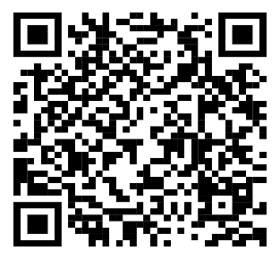



Connect with us!
https://rishubgreece.ntua.gr/
rishubgreece@metal.ntua.gr
EIT RawMaterials RIS Hub Greece
@RISHUBGR

