Slide 1




Hyperspectral Imaging(HSI) from Exploration to Mineral Classification
Georgios Tsimiklis
Head of Smart Integrated Systems, Isense-Group/ICCS
Managing Partner - COGNISENSUS

Slide 2
Contents
Introduction to ICCS
HSI and potential for new applications
HSI for mineral exploration
HIS for mineral classification
Overall Potential of sorting based on HSI

Slide 3

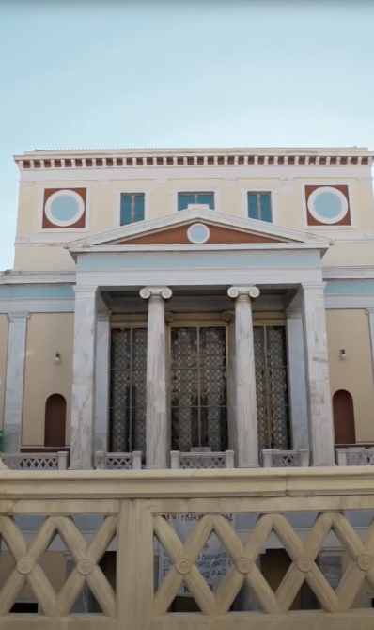
Ιnstitute of Communication & Computer Systems (ICCS)
Promoting Innovation at the intersection of disciplines
By combining our strong disciplines, our research groups develop basic science, explore new scientific areas of interdisciplinary research and enable promising innovations in the light of societal challenges.
33 years Creating Impact
Founded as the research branch of the School of Electrical and Computer Engineering of the National Technical University of Athens (NTUA).
Developing the Τechnologies of the future
Advancing Basic and Applied Research
AI and Smart Systems | Hardware and Software | Computer Networks | Mobile Communications | Control and Automation | Power Production, Transport and Distribution | Energy, Transport, Climate Research | Biomedical and Biomechanics | Information Systems | Management and Desicion Support
ICCS today ranks among the top 3 Research Institutions in Greece and among the first 20 in EU
-in terms of research funding.
Notes:
Image used in the preview file : https://unsplash.com/photos/iMvS-ft_xK4

Slide 4


Sample text goes here
“Over the last 20 years, I-SENSE Group has succeeded in providing an environment where innovation can arise guided by the values of circular and green economy, openness and smart citizenship”.
Dr Angelos Amditis, R&D Director ICCS, I-SENSE Founder & Director
With a vision
Towards the Smart Societies of the future
184+ Research Projects
180+ Researchers
420+ Scientific Publications
10 Research Divisions
3 Spin offs
I-SENSE is one of the most active Research Groups of the Institute of Communication and Computer Systems (ICCS) of the National University of Athens in Greece (NTUA). Founded in 2002, I-SENSE is committed to the highest standards of academic excellence and research innovation in the field of electrical, electronic and computer engineering & technologies.
Notes:
Image used in the preview file : https://unsplash.com/photos/KtI5aQU9Pzo
3 Spin-offs: Cibos, EKI, pnet

Slide 5
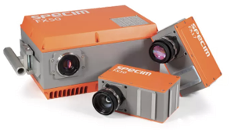
HSI and applications
Hyperspectral imaging (HSI) or imaging spectrometry is a spectral sensing technique in which an object is scanned using several well-defined optical bands in broad spectral range
Application Areas
Food Quality and Safety Assessment
Medical Diagnosis
Precision Agriculture- Environmental Monitoring
Water Resource and Flood Management
Cultural Heritage - Artwork Authentication
Defense and Homeland Security
Mining and material classification
And many more.

Slide 6
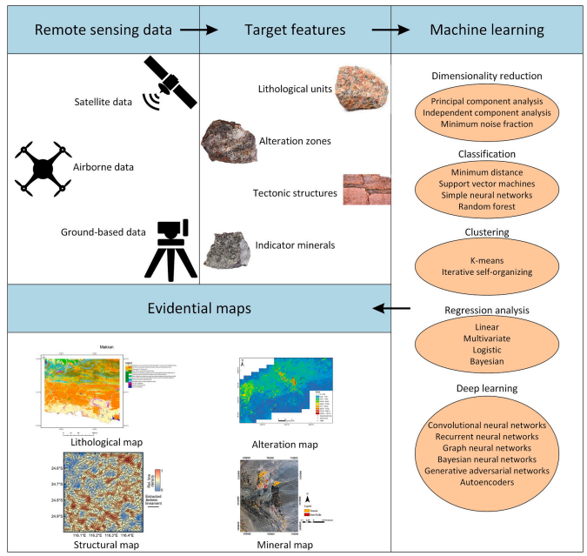
Raw materials exploration
Spectral library: Spectral data and related information scattered in various spectral libraries will be harmonized in a common format to establish a comprehensive spectral library
Characteristic Geological Feature Mapping: Various geological features will be identified using remote sensing data with knowledge-based and data-driven methods.
Prospectivity Mapping: Predict the likelihood of finding mineral deposits.
Notes:
Spectral library: Spectral data and related information scattered in various spectral libraries will be harmonized in a common format to establish a comprehensive spectral library to be used for mapping rock types, hydrothermal alteration zones and indicator minerals.
Characteristic Geological Feature Mapping: Various geological features will be identified using remote sensing data with knowledge-based and data-driven methods. The developed spectral library will provide the reference spectral signatures for mapping rock types, hydrothermal alteration zones and indicator minerals.
Prospectivity Mapping: Predict the likelihood of finding mineral deposits. These maps combine various geological, geophysical, geochemical and remote sensing data to identify regions with a high potential for mineralization.

Slide 7
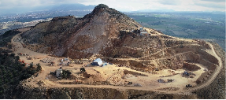
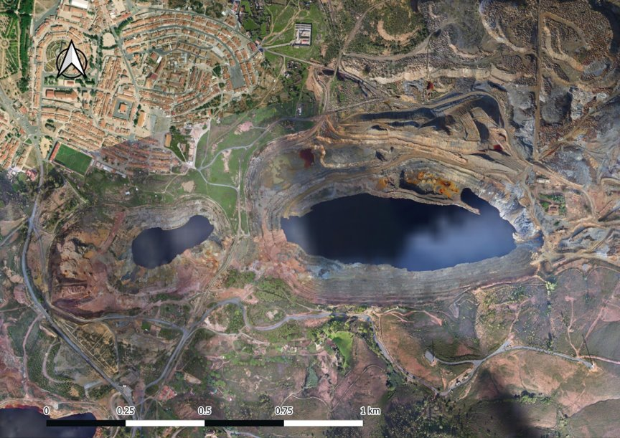
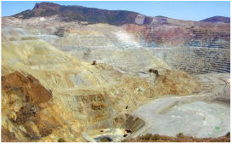
Raw Materials
Raw Materials covered:
Magnesite (Magnesium, Manganese)
Cobalt (CRM)
Copper (SRM)
Strontium
Zinc
Nickel (SRM),
Lead
Fluorite (SRM)
Silver

Slide 8
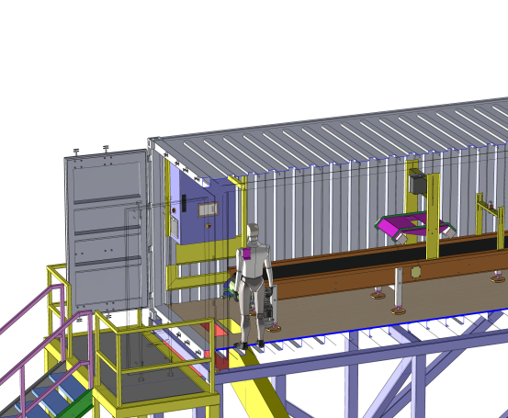
Mineral Sorting
CRM optimal recovery

Slide 9
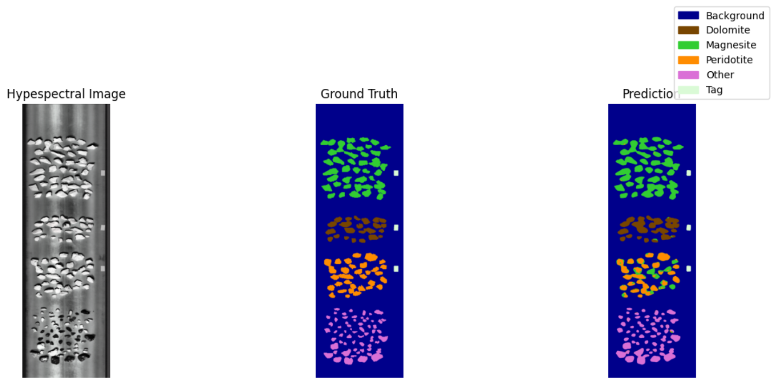
CRM recovery using Sorting Systems

Slide 10
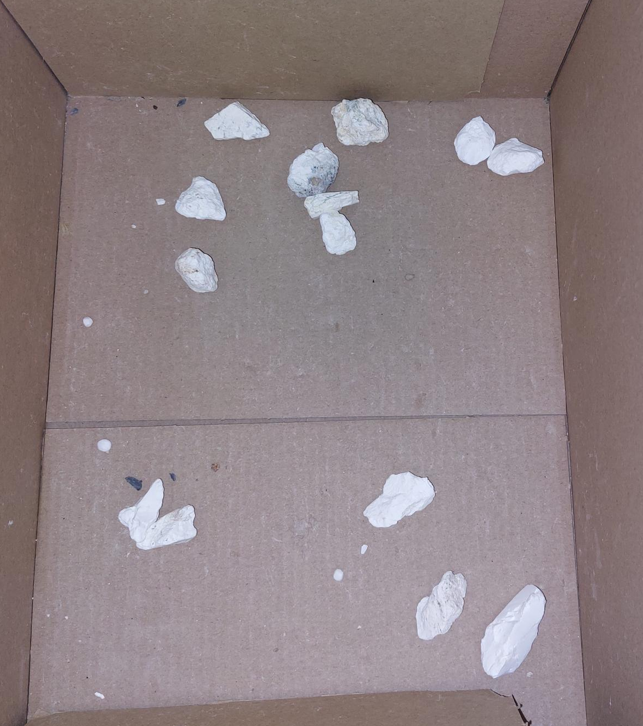
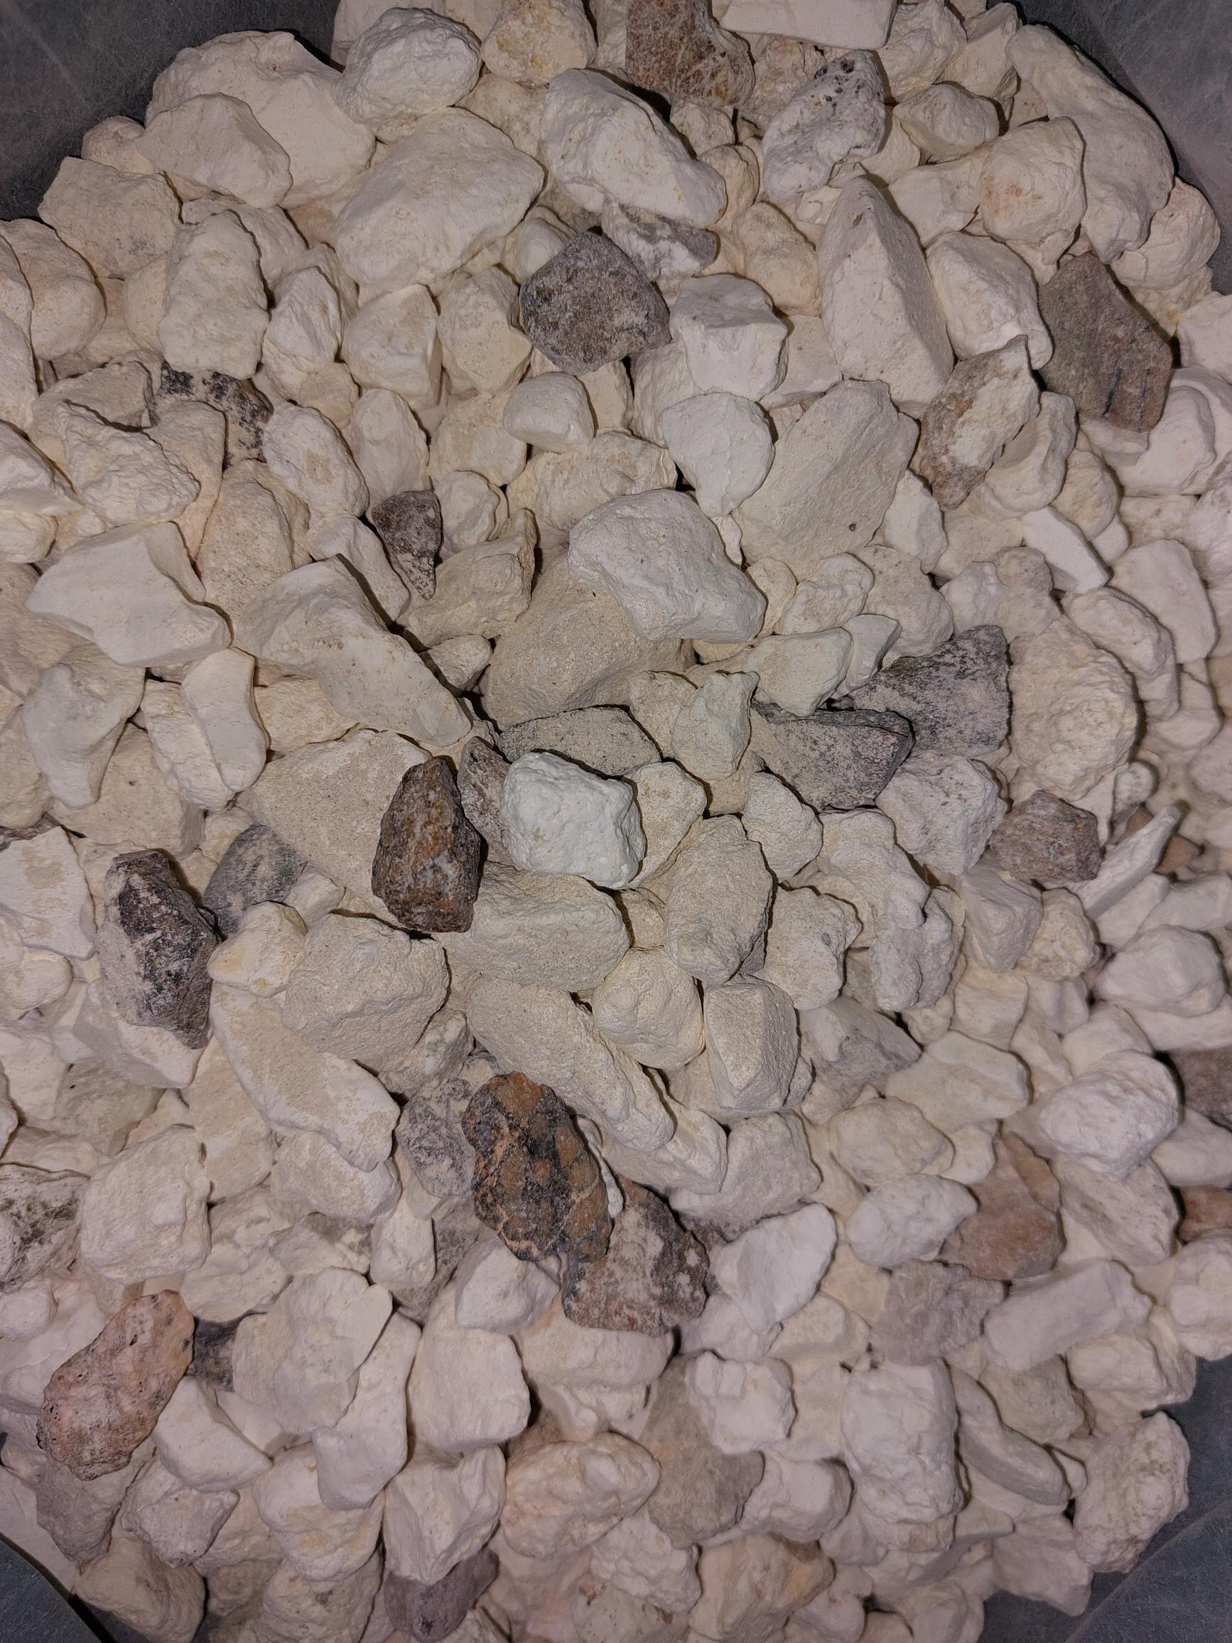
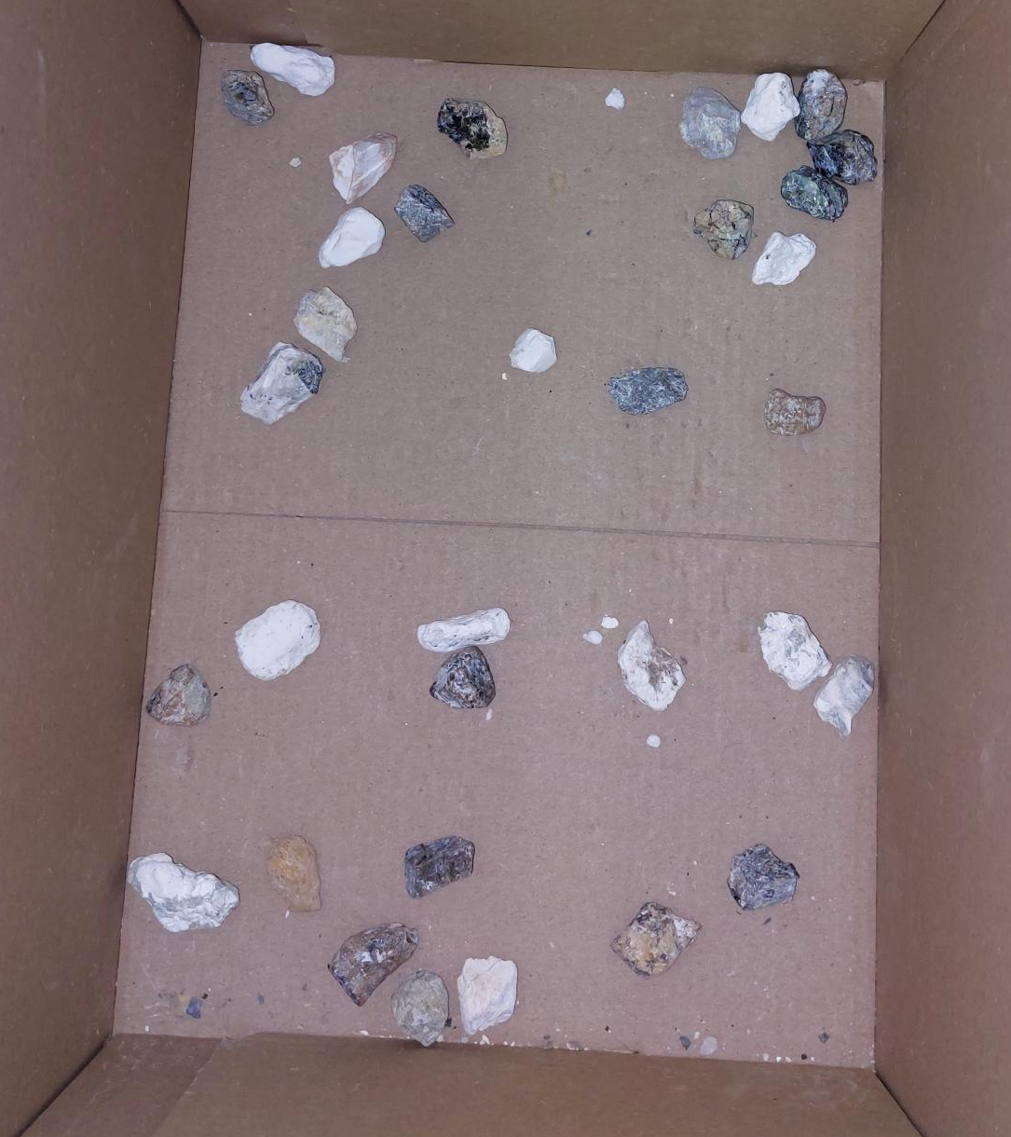
CRM recovery using Sorting Systems
Output
Size: 10 – 20 mm
Example of magnesite separation
Categories of the extracted ore samples
Input
Magnesite
  Magnesite
  Dolomite
  Calcite
  Sepiolite
  Peridotite
  Serpentinite
Rejected

Slide 11
CRM recovery using Sorting Systems Lab Scale Testing
State-of-the-Art dedicated facilities.
Advanced Sorting (XRF & XRT)
AI-Driven Multi-Sensor Systems (RGB & Hyperspectral)
Robotic Manipulation Systems
Pneumatic Sorting Technology
Flexible & Modular Design

Slide 12

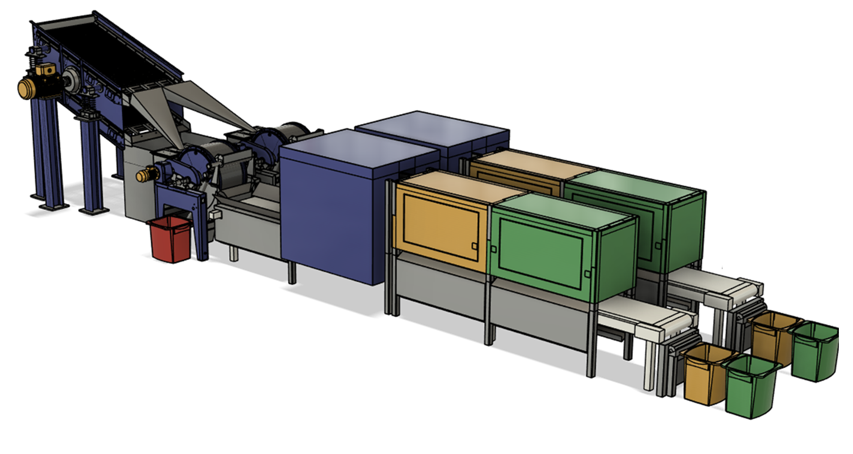
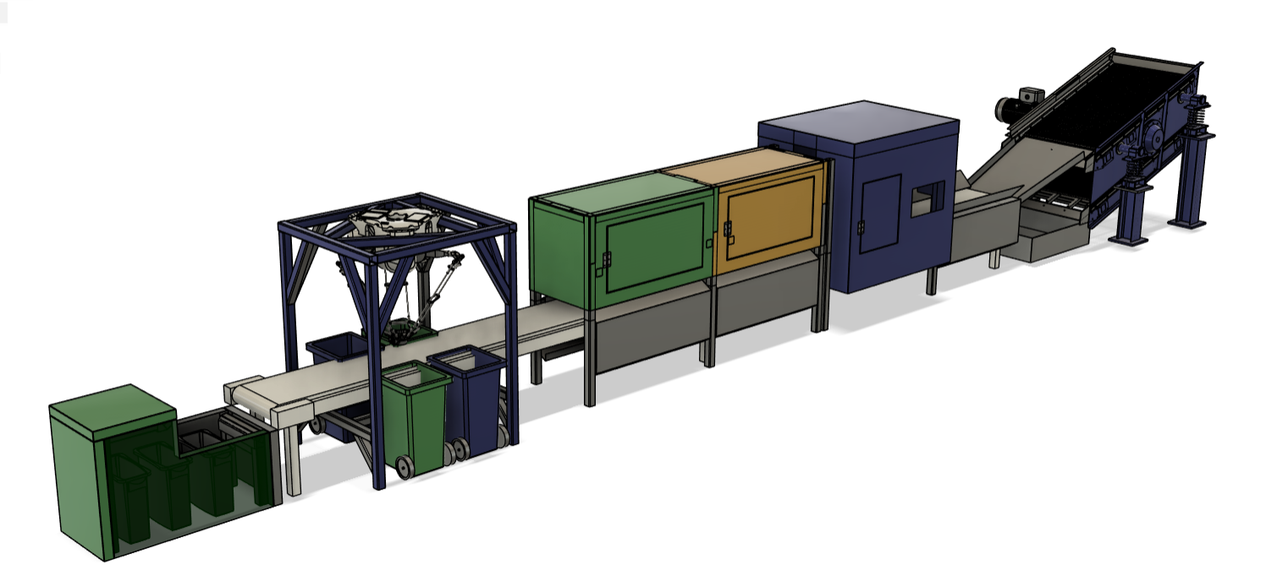

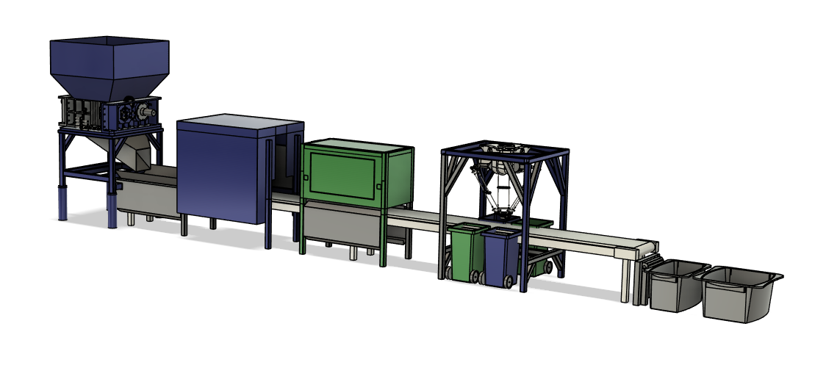
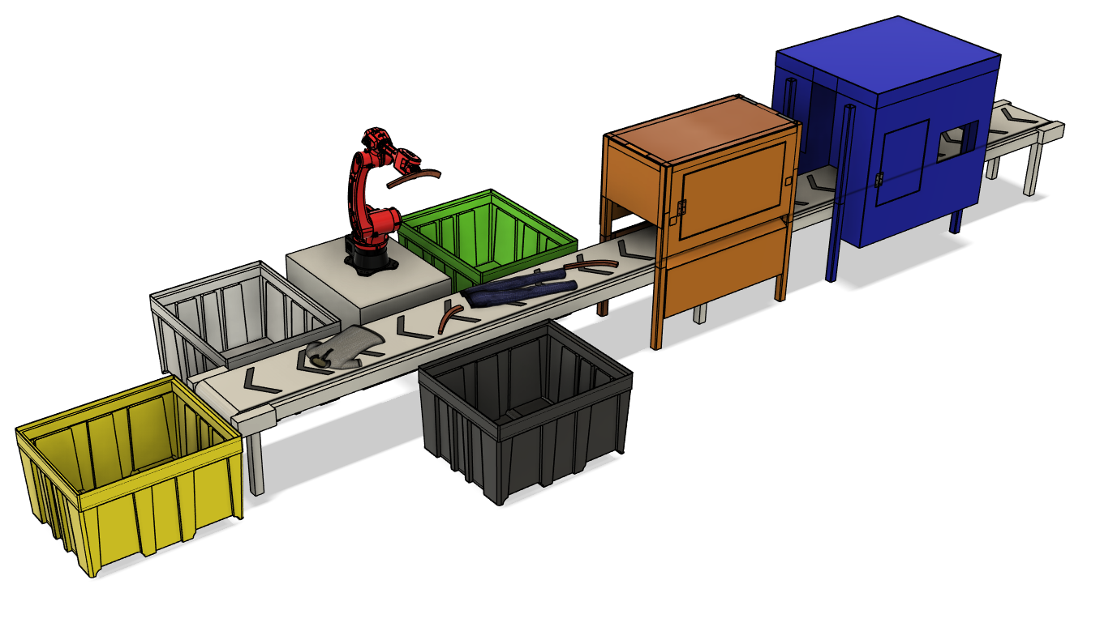


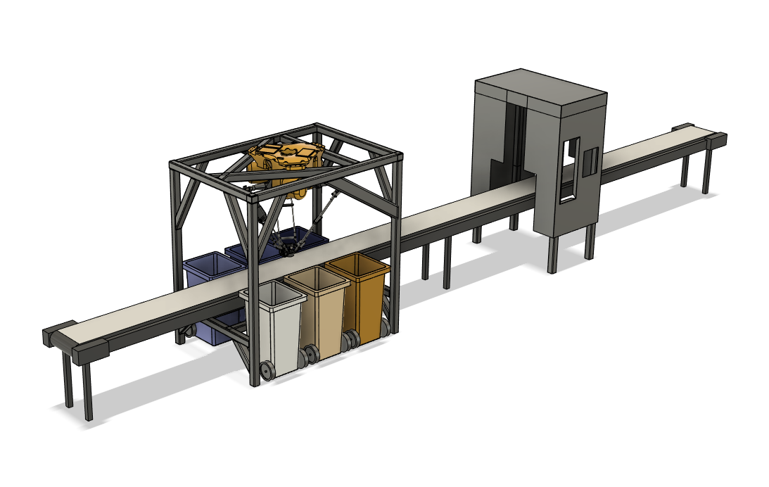
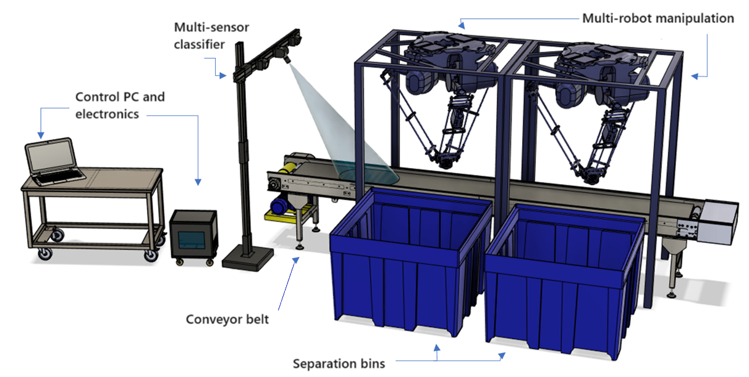
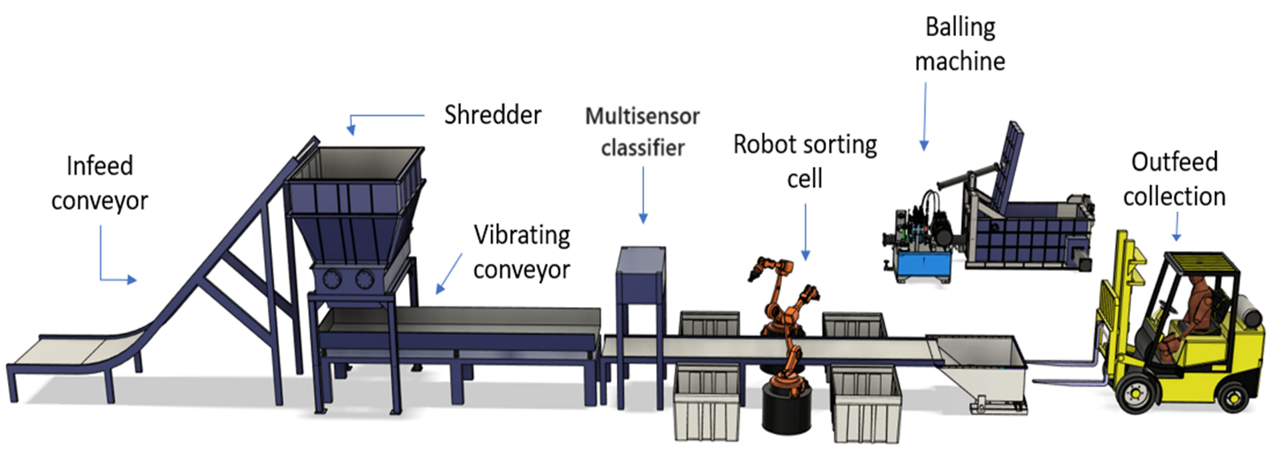



Sorting Activities across
Europe
01
The multi-spectrum sorter is used to separate plastics based on their categories from plastic waste streams. Specifically, PVC, PP, PET, HDPE, and LDPE are separated by leveraging multi-spectral data and deep learning models
02
The wood scraps sorter, utilizing optical sensors and deep learning, categorizes wood chips and wood scraps by based on moisture, shape, size, and color. The second sorter will be used to characterize and separate plastic wastes and flakes.
03
This sorter can separate different types of minerals such as dolomite, magnesite and calcite using optical, near-inferred and X-ray data.
04
This sorter can separate different classes of materials such as plastics, wood, cardboard, cement, metals from Construction & Demolition Wastes
05
This mega sorter with human-machine collaboration workstation can separate different classes of wood and glass from Construction & Demolition Wastes
06
Aims to enhance the sorting of Magnesite streams by integrating hyperspectral, optical (RGB), and X-Ray Transmission sensors to analyze spatial, spectral, and 3D molecular properties.
07
Deploying two AI-assisted sorting systems for tuneable segregation of mineral ore streams, utilizing nondestructive vision sensory devices and deep learning models.
08
Within Theseus 5 sorters will be developed in the disciplines of 1) Mixed urban wastes 2) Textile sorting based on type and quality 3) Metal wastes categorizing copper & aluminium levels 4) Glass sorting based on quality and clearness of glasses and 5) Plastics form mixed wastes

Slide 13


EXPL RE
2

Slide 14
Georgios Tsimiklis
Head of SIS Group, Isense-Group/ICCS
Managing Partner - Cognisensus

Slide 15
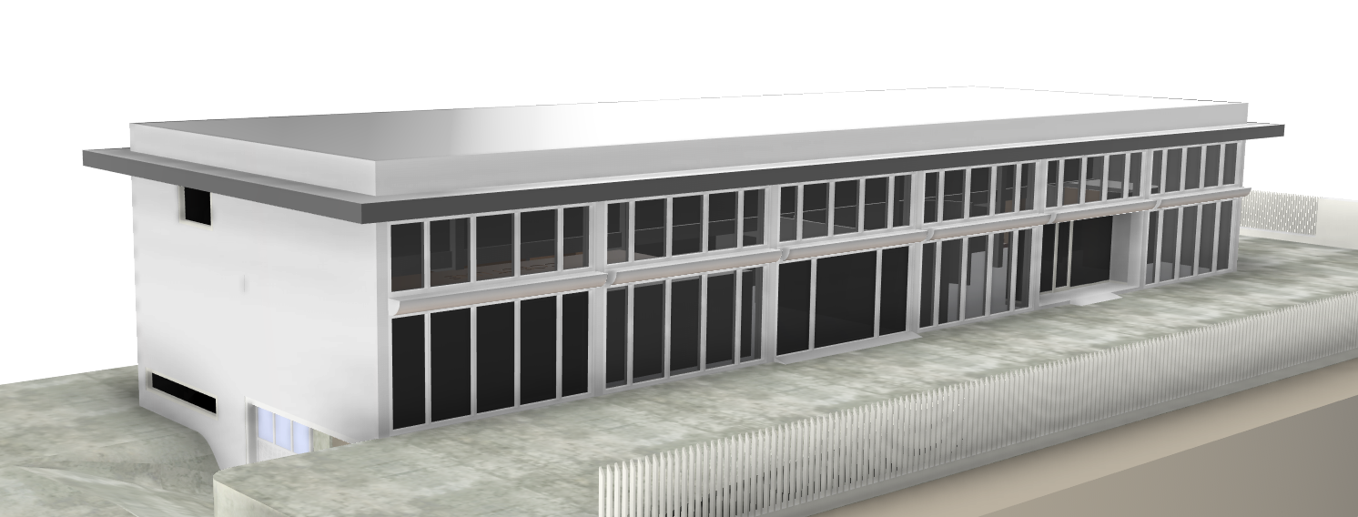
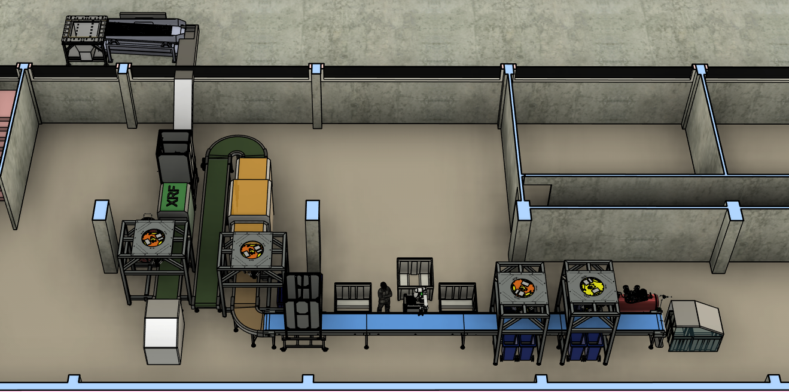
CRM recovery using Sorting Systems – Lab Scale Testing
State-of-the-Art dedicated facilities.
Advanced Sorting Lines (XRF & XRT)
AI-Driven Multi-Sensor Systems (RGB & Hyperspectral)
Robotic Manipulation Systems (Delta, Industrial Robots and Collaborative Robots)
Pneumatic Sorting Technology
Flexible & Modular Design

