Slide 1


9th Greek Raw Materials Community Dialogue
Digging into the Future: Accelerating Mining
Digital Transformation from Pit to Processing
Stefanos Kokkorikos
Founder, Managing Partner, CORE Group

Slide 2
What Do We Mean by Industry 4.0?

Slide 3
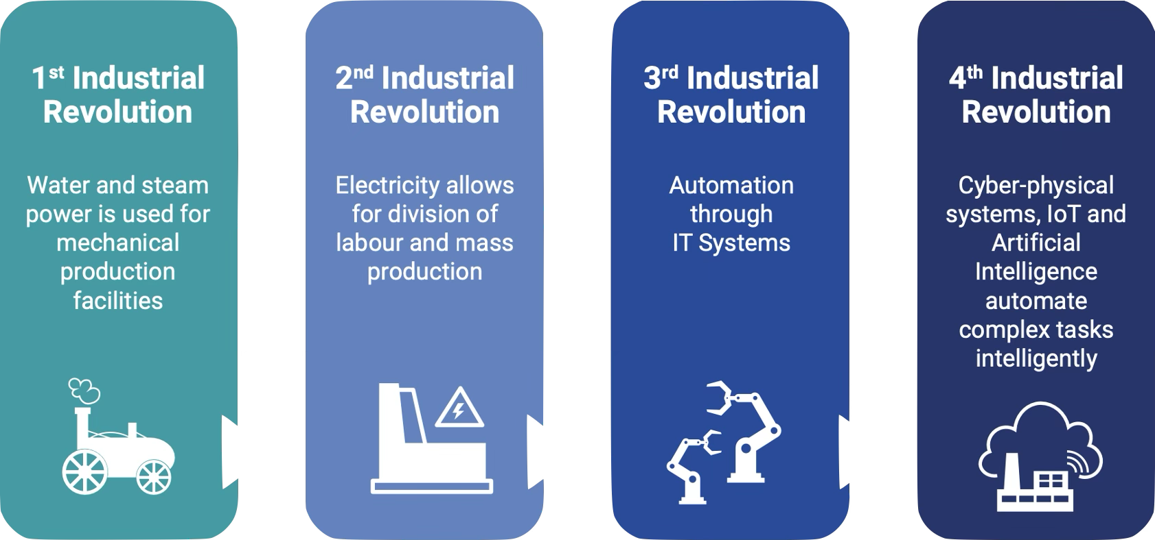

Slide 4
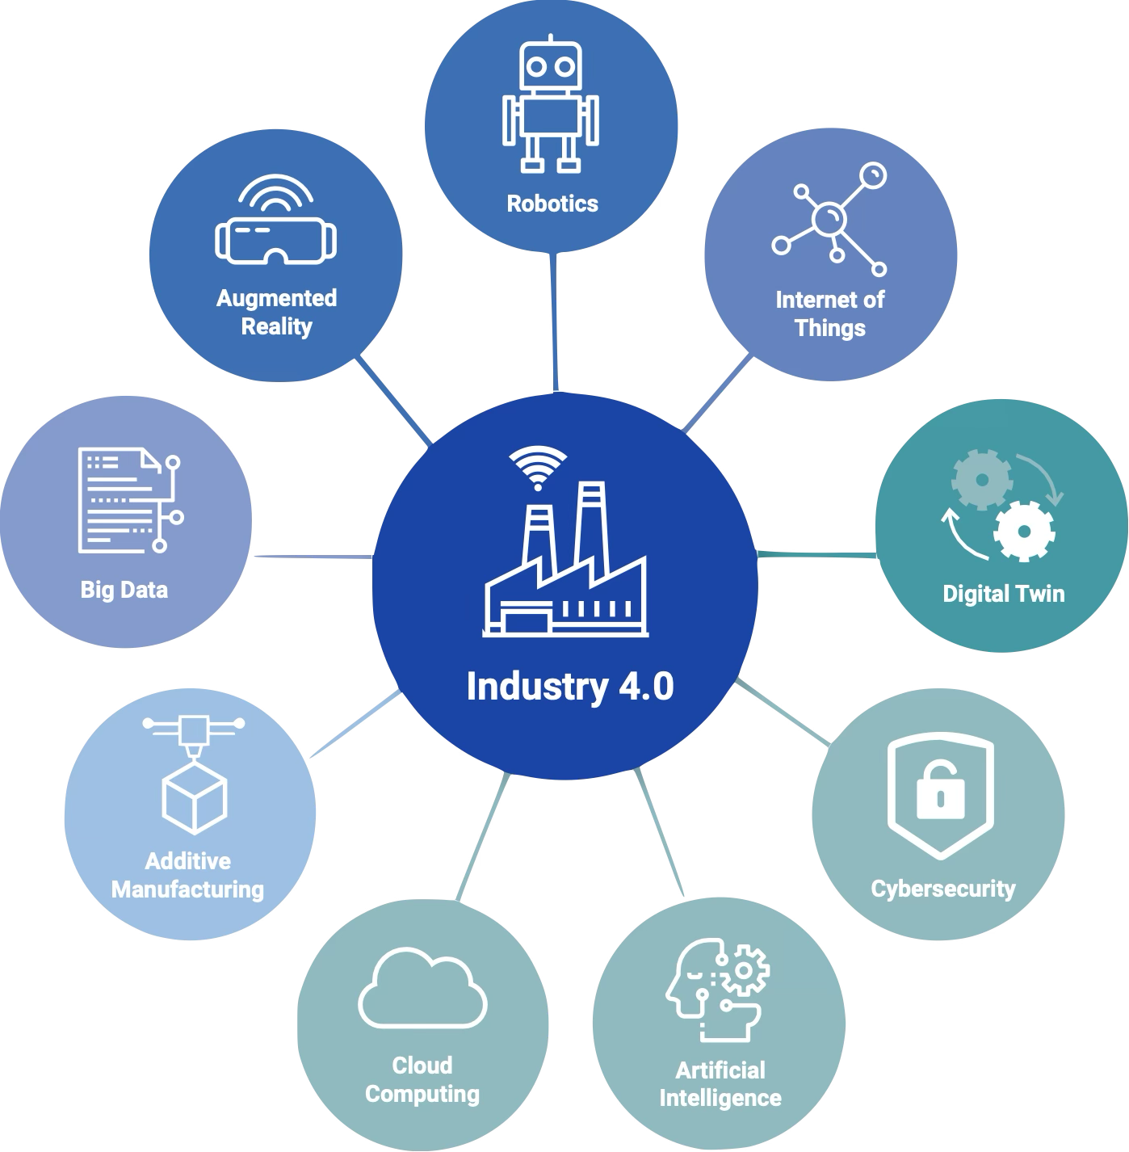
Key enabling technologies

Slide 5
How Is Industry 4.0 Applied in Mining?

Slide 6


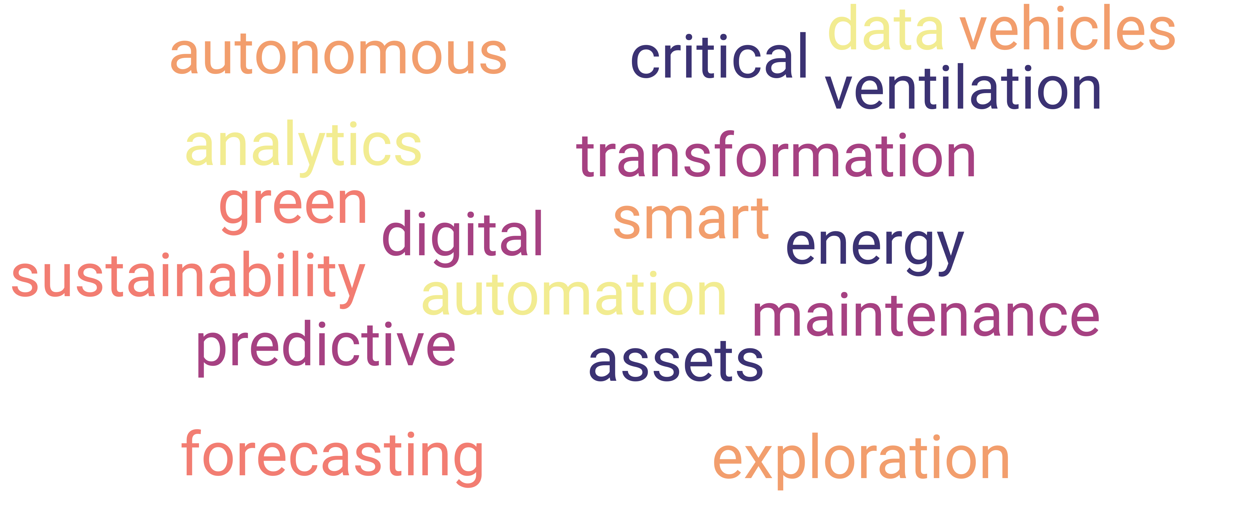
Predictive maintenance

Slide 7
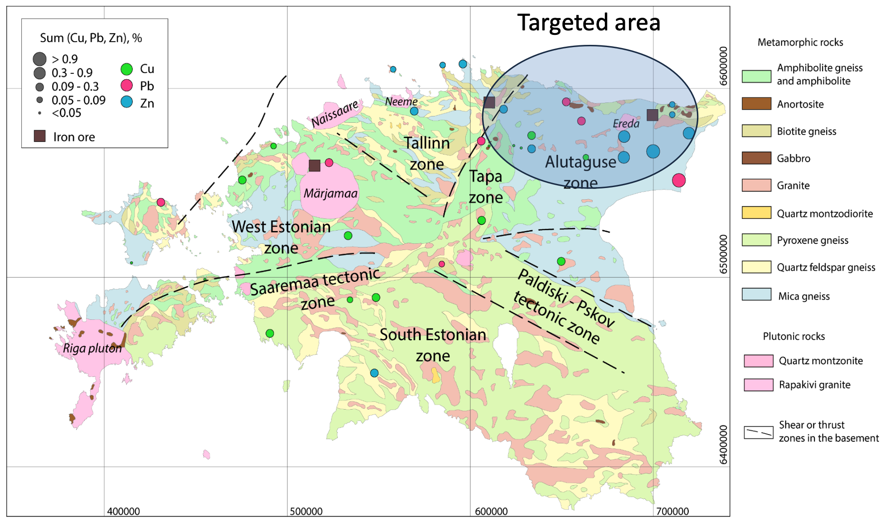
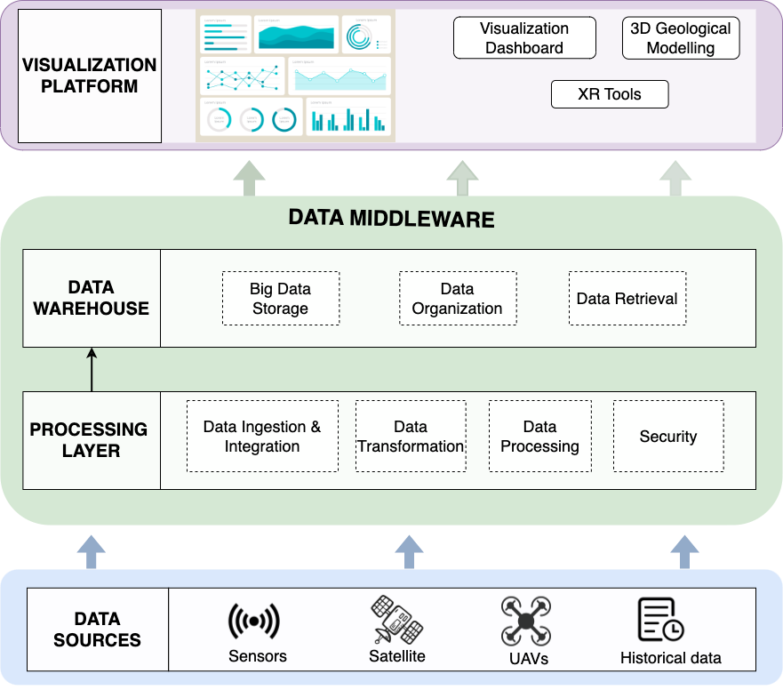
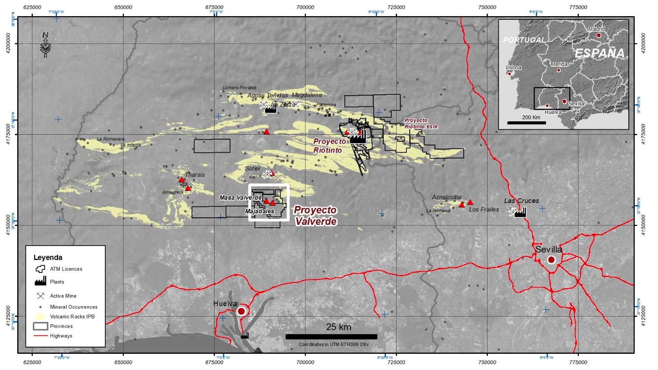

Analytics platform for smart exploration

Slide 8
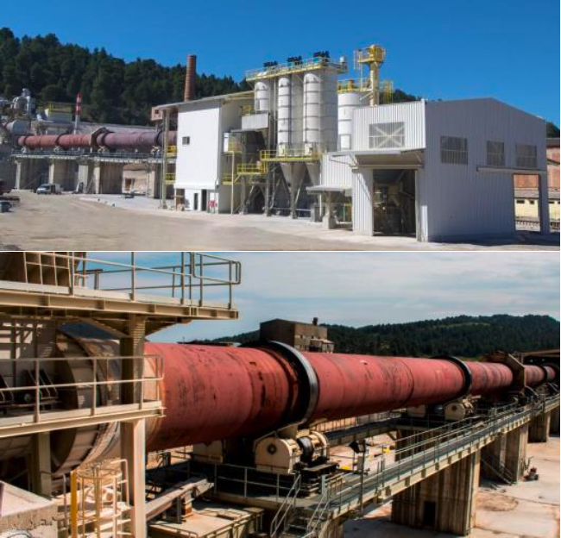
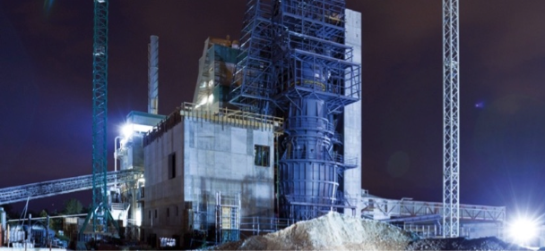
Industry 4.0 in raw materials processing

Slide 9


Virtual Miner an AI-based digital recovery assistant

Slide 10
…and many more examples

Slide 11
Where to start?

Slide 12



You cannot improve what you do not measure
Digital maturity assessment tool
Help start, scale and derive customized Industry 4.0 transformation roadmaps.

Slide 13

Smart Industry Readiness Index
Developed by industry experts and now recognised by the World Economic Forum as the global standard for Industry 4.0 Transformation,
the Smart Industry Readiness Index (SIRI) has been adopted by over 4000 organisations worldwide to start, scale and sustain their transformation.

Slide 14
Smart Industry Readiness Index
3
Building Blocks

Slide 15
Smart Industry Readiness Index
Operations
The planning and execution of
processes which lead to the
production of goods & services
Connectivity
The state of interconnectedness
between equipment, machines, &
computer-based systems to
enable communication & data
exchange across assets
Supply Chain
The planning & management of
raw materials & inventory of a
company’s goods & services,
from the point of origin to the
point of consumption
Intelligence
The processing & analysis of data collected, to diagnose problems & identify opportunities for improvement
Product Lifecycle
The sequence of stages that a
product goes through, from its
initial conceptualization to its
eventual removal from the market
Talent Readiness
The ability of the workforce to
drive and deliver Industry 4.0
initiatives
Structure & Management
Strong leadership, supported by a clear strategy and governance framework, will enable firms to be more flexible, collaborative, and empowered to design and implement Industry 4.0 strategies effectively.
Automation
The application of technology to
monitor, control, & execute the
production & delivery of products
& services

Slide 16
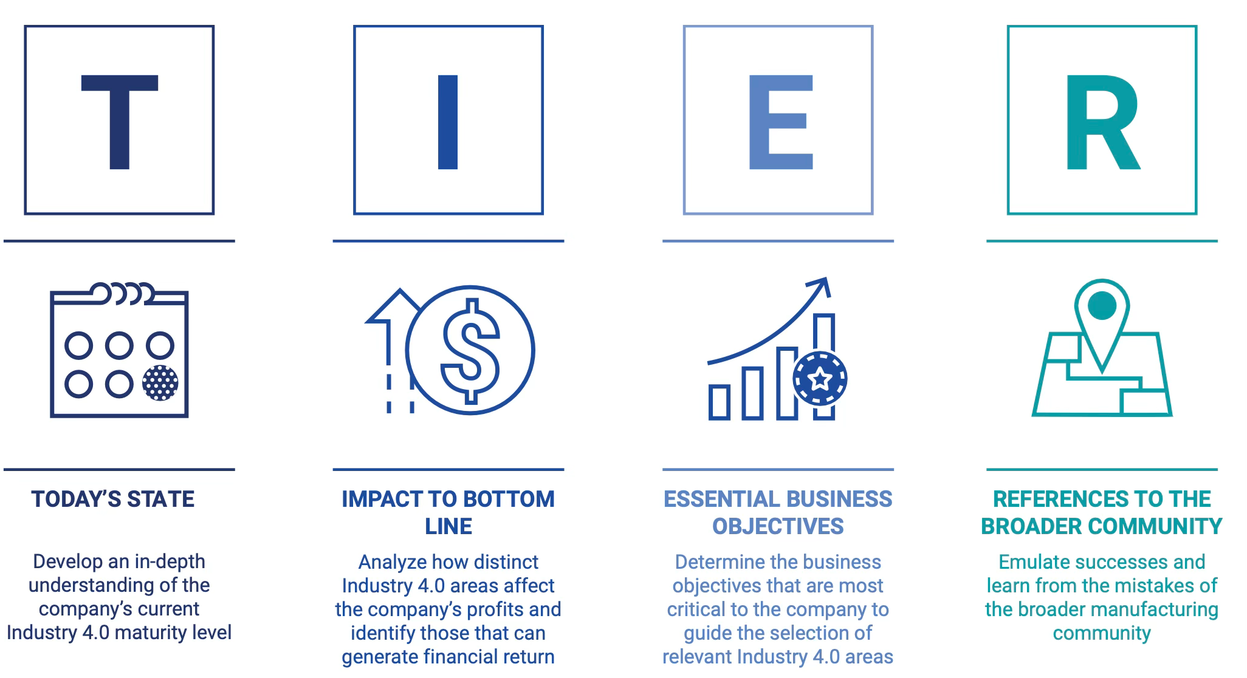
SIRI: Prioritisation Matrix

Slide 17

Weighted recommendation of key priority areas of intervention

Slide 18
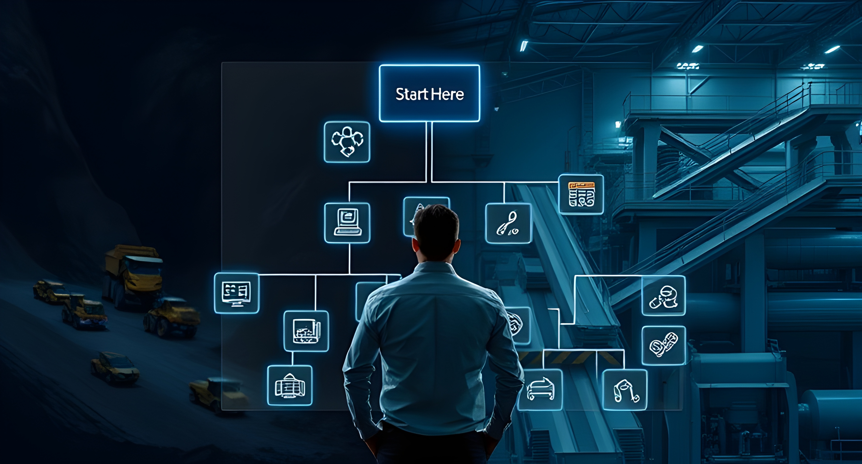

Slide 19


Slide 20


50+
EU-funded projects
24M €
EU funding
70
Team Members
300+
Partners

Slide 21




@coreinnovationtech
@coreinno2016
www.core-innovation.com
44 Solomou str 17343, Ag. Dimitrios, Athens, Greece
secretary@core-nnovation.com
+30 2109246730
@CORE INNOVATION
Stefanos Kokkorikos
SIRI Certified Assessor Co-Founder and Managing Partner skokkorikos@core-innovation.com

