Slide 1
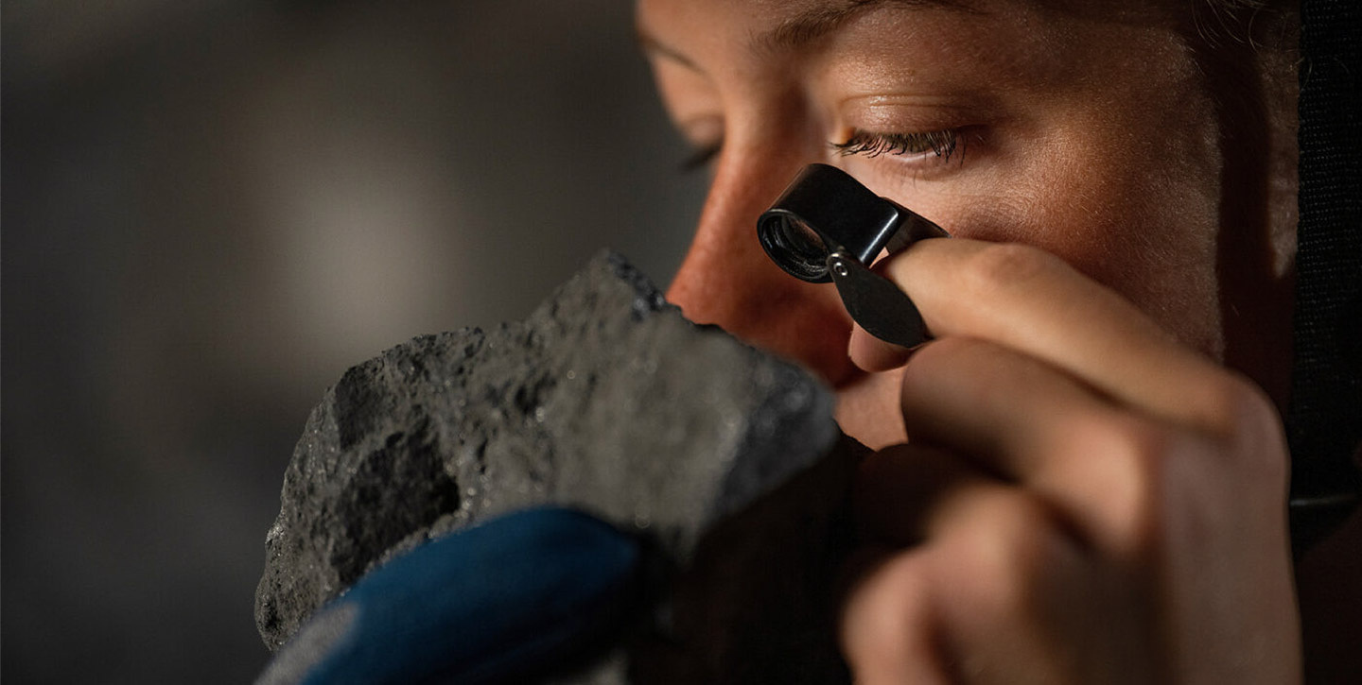
The Critical Raw Materials Act
What next?
Mark Rachovides
President Emeritus Euromines

Slide 2
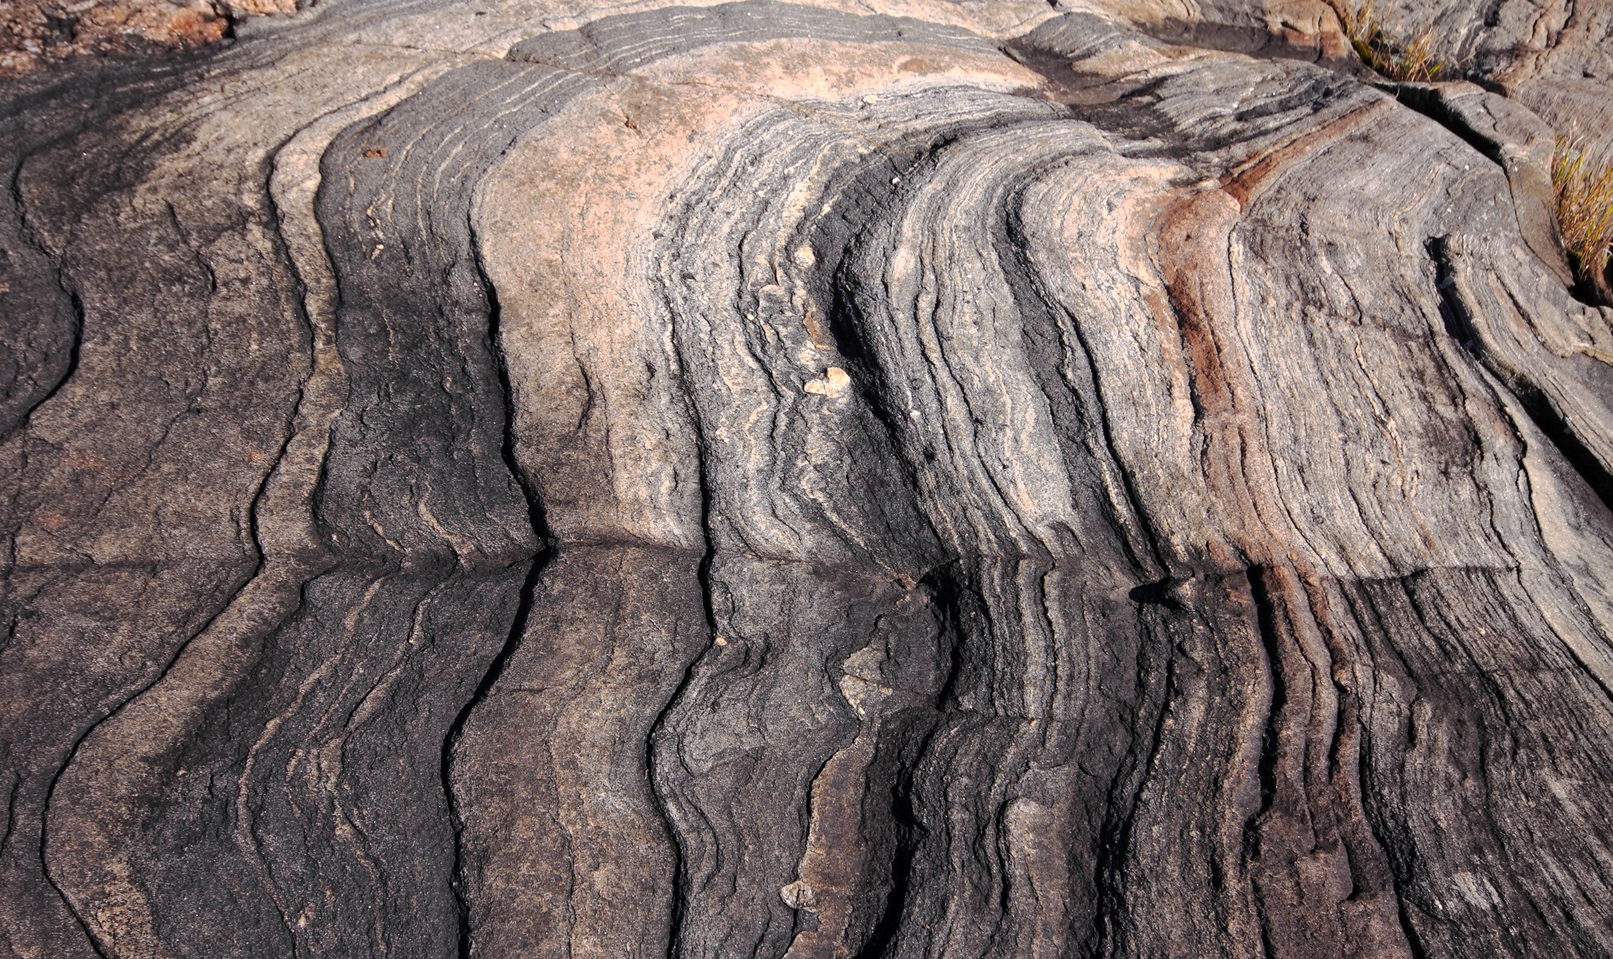










































Membership
Membership
350k Employees
54 Metals and Minerals
42 Members
17 Companies
15 Mining Federations
10 Associated members
www.euromines.org

Slide 3
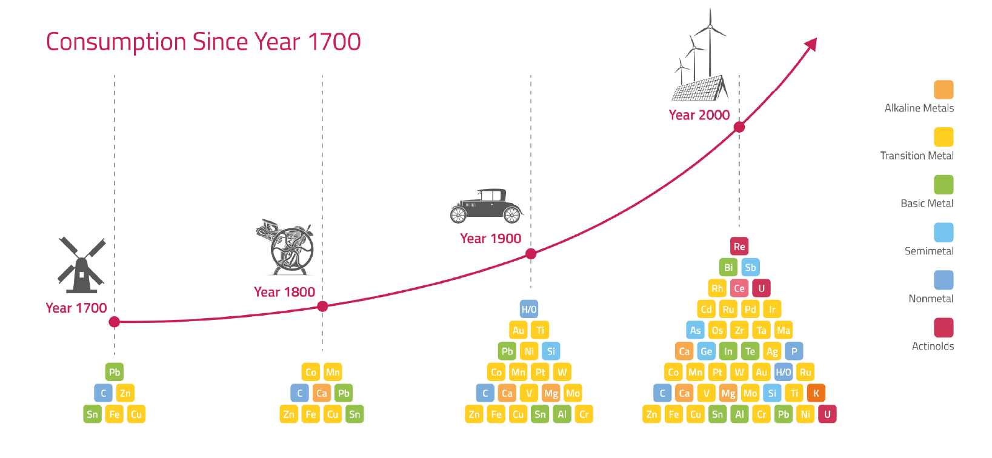
WHY?
Commodity change to modern, clean, sustainable, circular, green society

Slide 4
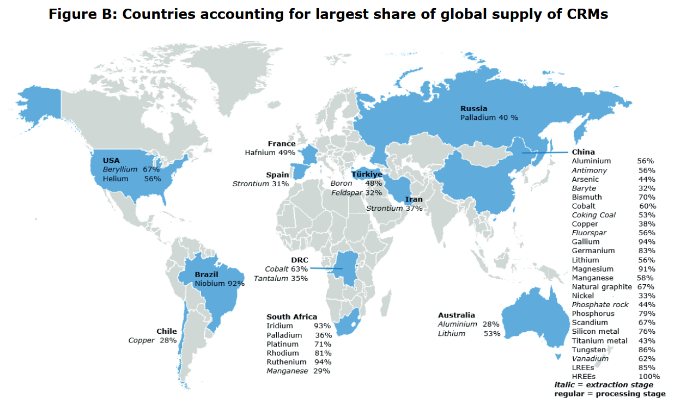
Critical raw materials (CRMs) and the EU economy

Slide 5
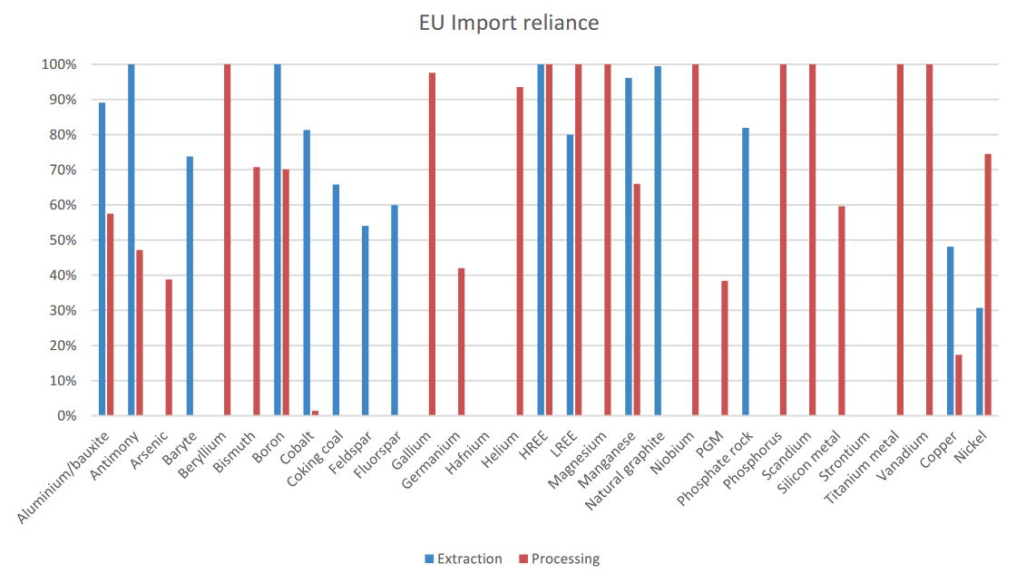
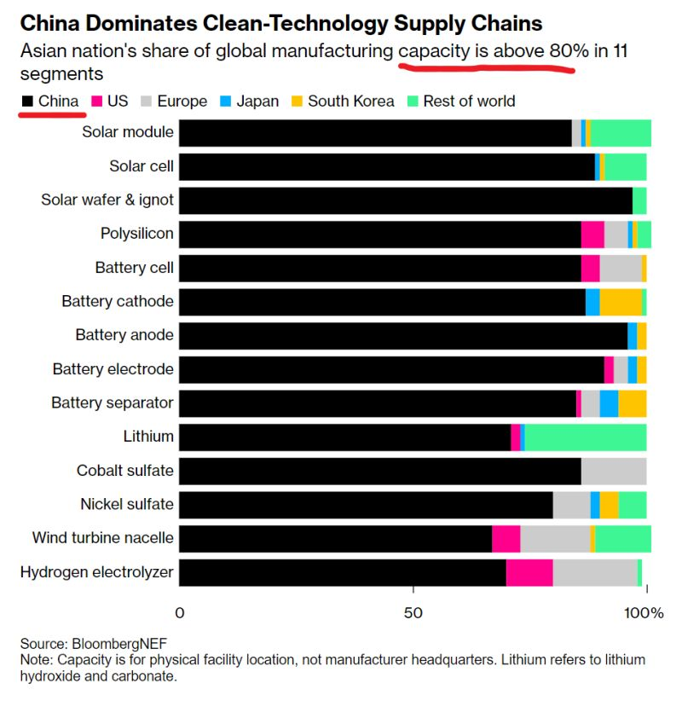
Two kinds of dependencies

Slide 6
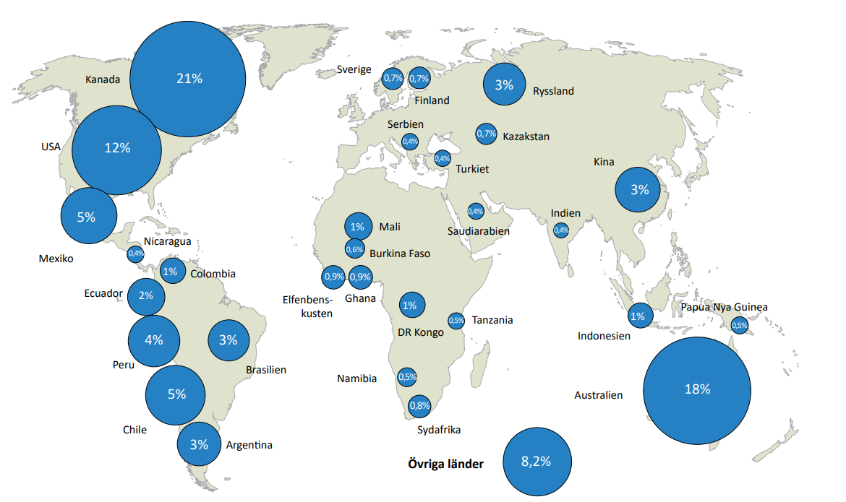
Critical raw materials (CRMs) and exploration investment

Slide 7
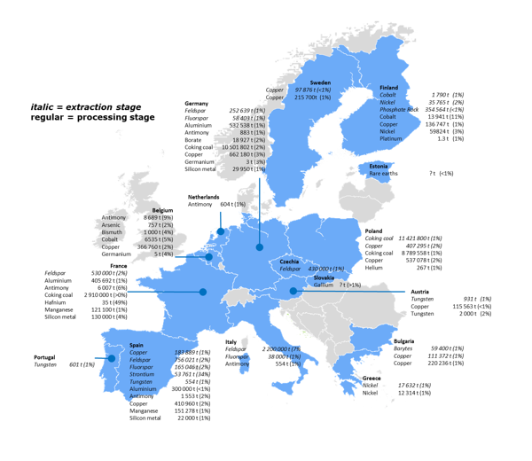
EU producers of CRMs
(shares of global supply, 2016-2020 )

Slide 8




The EU Critical Raw Materials Act “CRMA”
Ensuring a secure and sustainable supply of critical raw materials for the European Union
Strengthen all stages of the European CRM value chain and expedite permitting
Improve knowledge of EU-own resources
Stimulate skills, knowledge and innovation
Develop novel mechanisms to foster sustainable raw materials production

Slide 9
CRMA: A first step in the right direction
A new shift – driven by ambition and geopolitics
Away from outsourcing pollution and importing raw materials
EU more than a market – it becomes a productive region – again
To spur investment into raw materials
It sets 2030 benchmarks to increase domestic production, processing and recycling.
EU capacities along the strategic raw materials supply chain must satisfy at least:
10% of the EU’s annual consumption of mined materials,
40% of its consumption of processed products and
25% of its consumption of recycled material.
No more than 65% of the EU’s annual consumption of each strategic raw material at any relevant stage of processing should come from a single third country.
Identifying Strategic Projects that would benefit from faster permitting procedures and EU-facilitated financing.
Time limits on permitting for strategic projects for the green and digital transitions.
27 months for extraction projects and new mines,
15 months for refining and recycling facilities

Slide 10
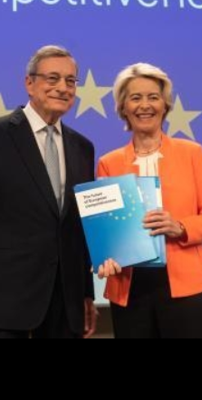

Draghi Report - Guide to boosting Europe’s Industry competitiveness
EU needs massive investments: common debt, the way forward. But from where?
Europe has a 'China problem’ – in certain fields, our competitive advantage is gone
Keeping Europe's companies in Europe by boosting innovation
A focus on industry and framework conditions
www.euromines.org

Slide 11
DRAGHI - BEYOND CRMA:
Headline proposals
A comprehensive EU strategy building on the CRMA from mining to recycling.
Establish a dedicated EU Critical Raw Material Platform (a European JOGMEC..)
Develop financial solutions supporting the critical raw materials value chain.
Develop further resource diplomacy for securing supply and diversification and joint strategies with other global buyers in the G7/OECD
Promote the untapped potential of EU resources linked to better standards and integration with industry at different levels of the value chain.
Boost European excellence in research and innovation in alternative materials for processes to substitute critical raw materials in various applications.

Slide 12

The CRMA needs to enable
1st call for Strategic Projects: swift and thorough evaluation and implementation
Revive exploration: out of 1000 exploration projects only 1 mine
Reduce costs – work on high OPEX and unpredictable permitting
Demonstrate what we are best at! Lead markets for sustainably mined materials

Slide 13
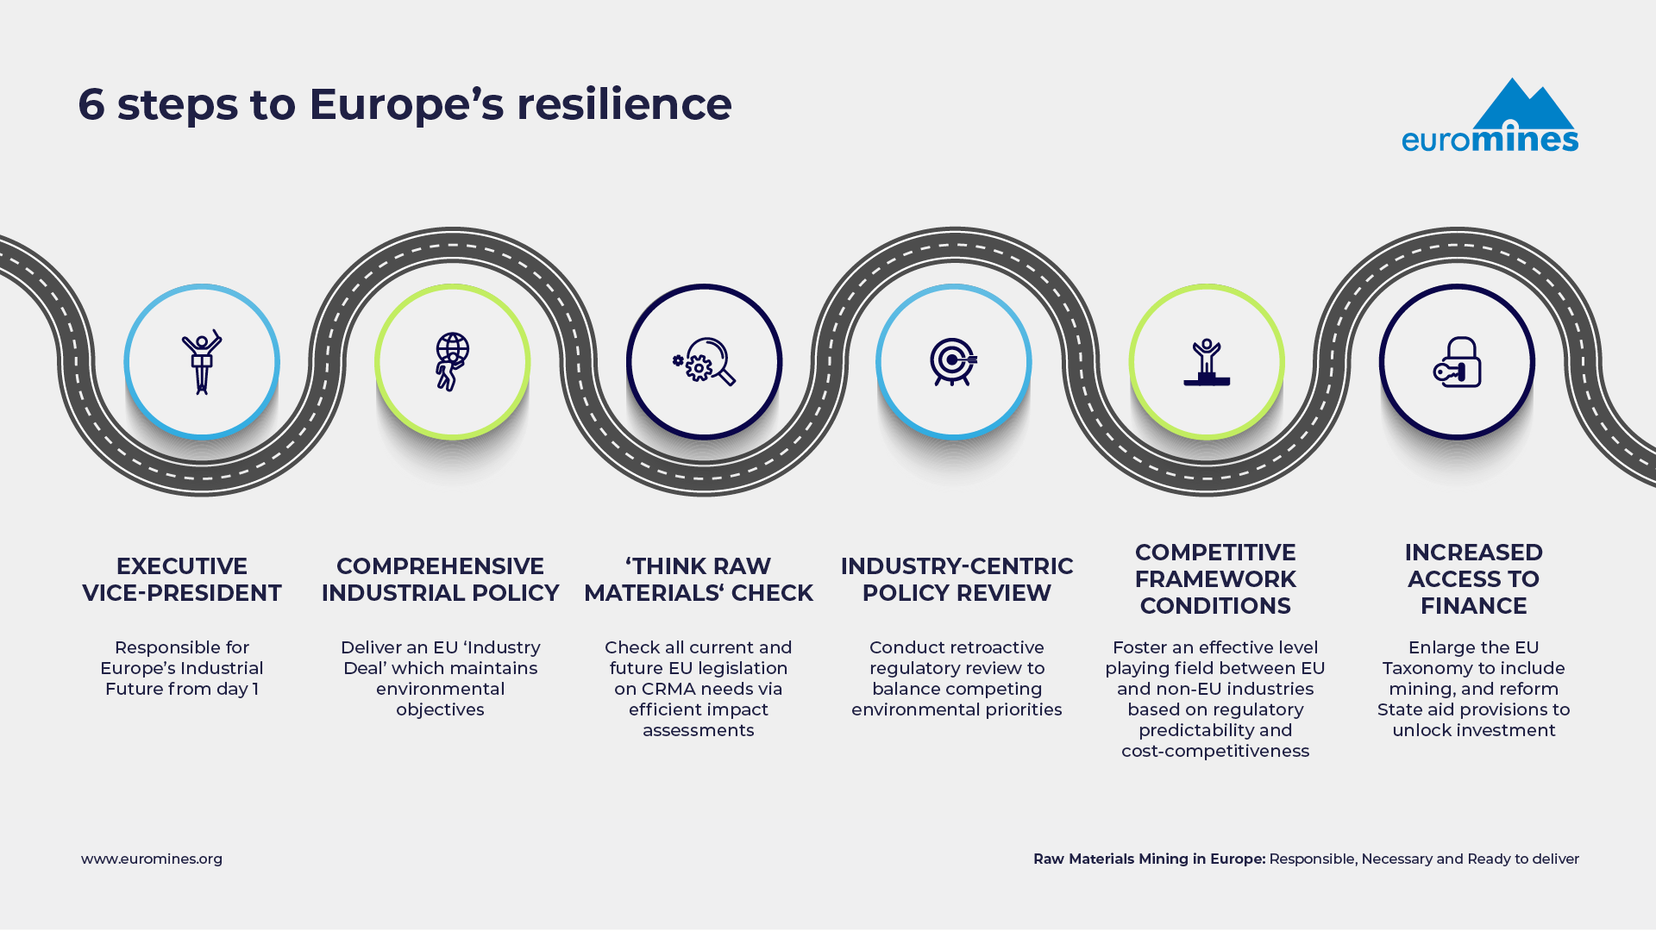
EUROMINES MANIFESTO 6 steps to Europe’s resilience
www.euromines.org

Slide 14
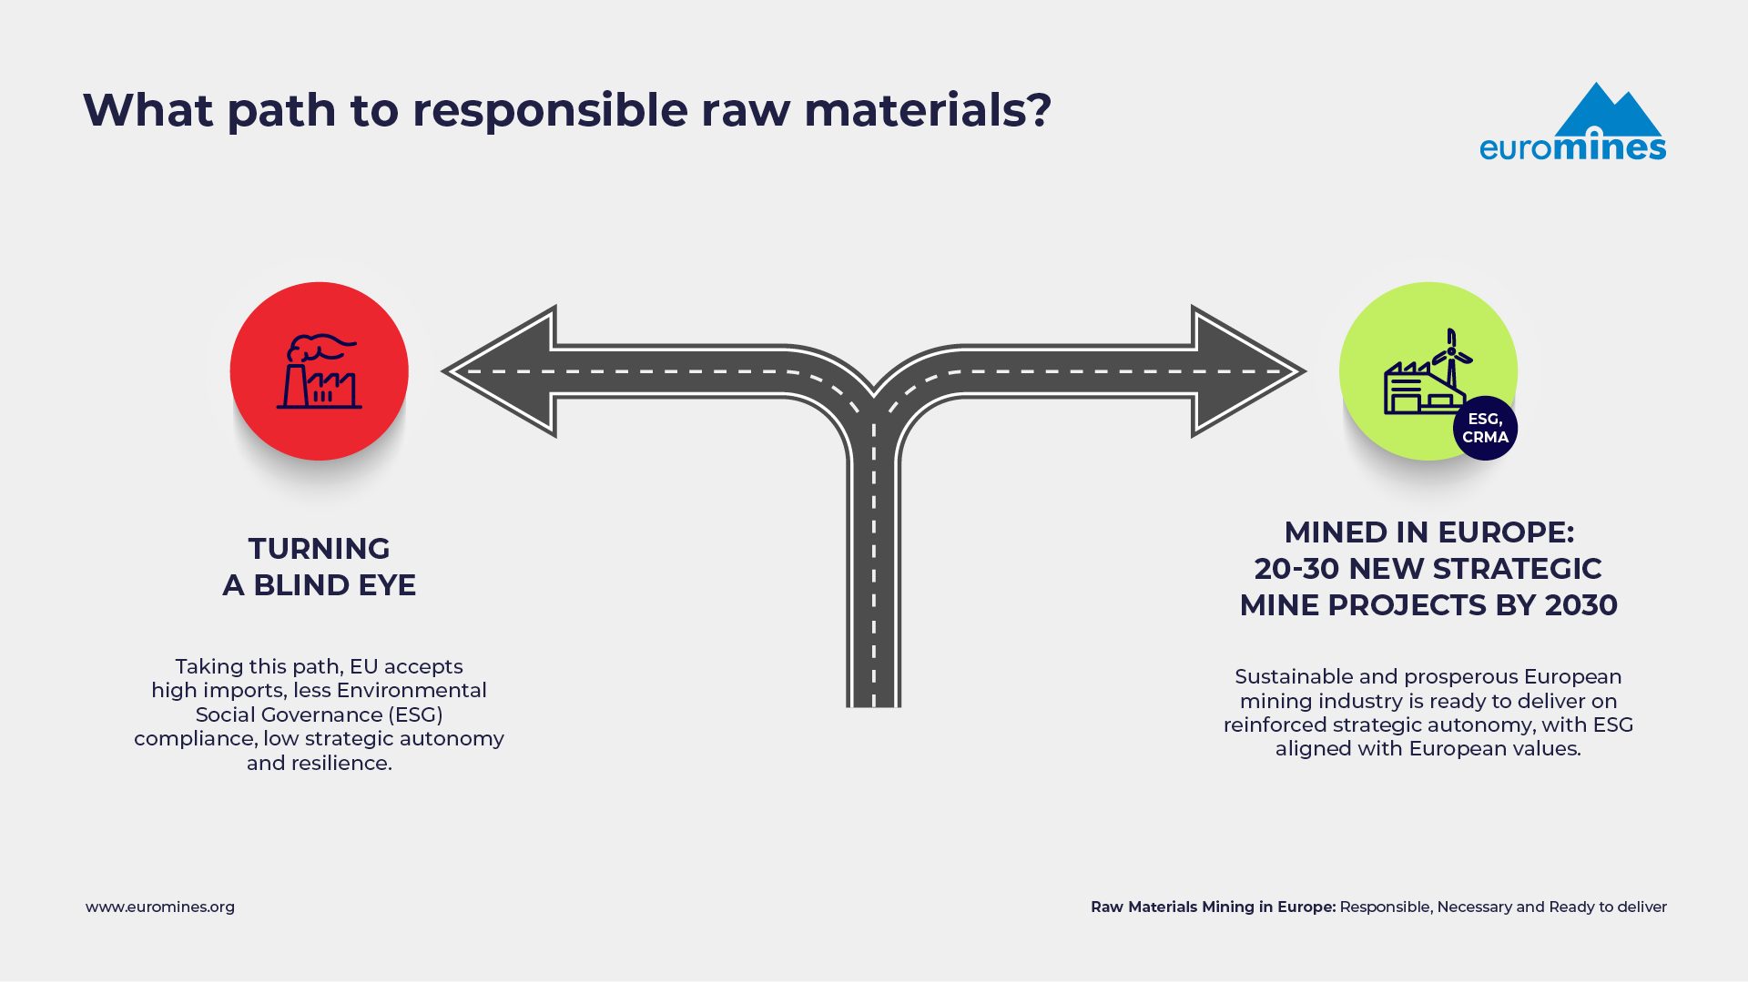
Euromines’ take on a resilient industry

Slide 15
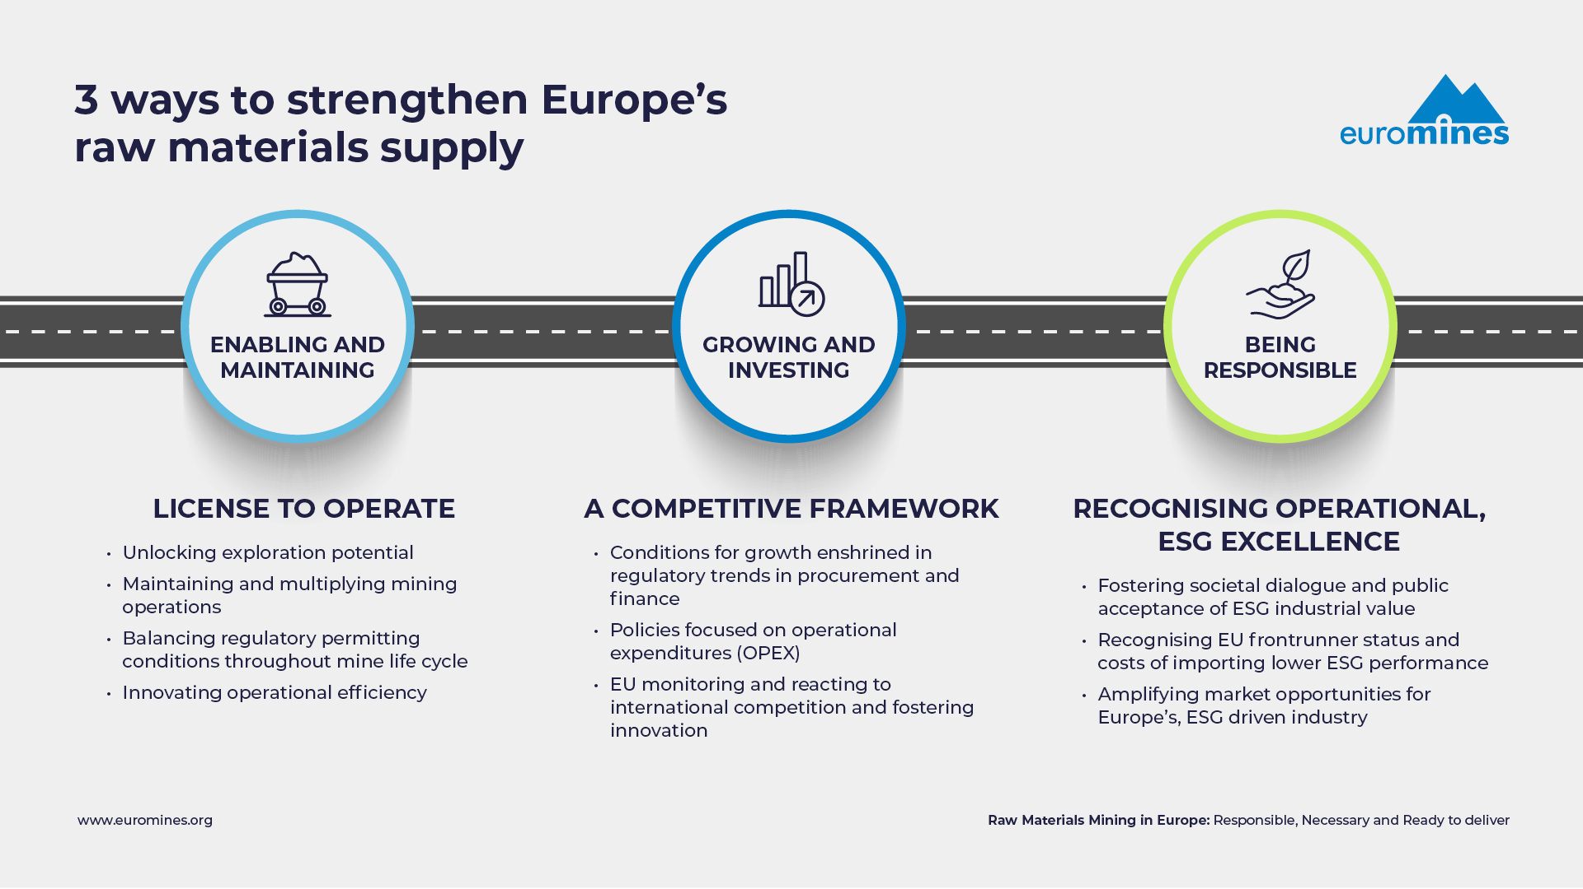
Euromines’ take on a resilient industry

Slide 16

Thank you
Euromines
European Association of Mining Industries, Metal Ores & Industrial Minerals
Avenue de Tervueren, 168, box 15
1150 Brussels-Belgium
www.euromines.org
secretariat@euromines.be

