Slide 1

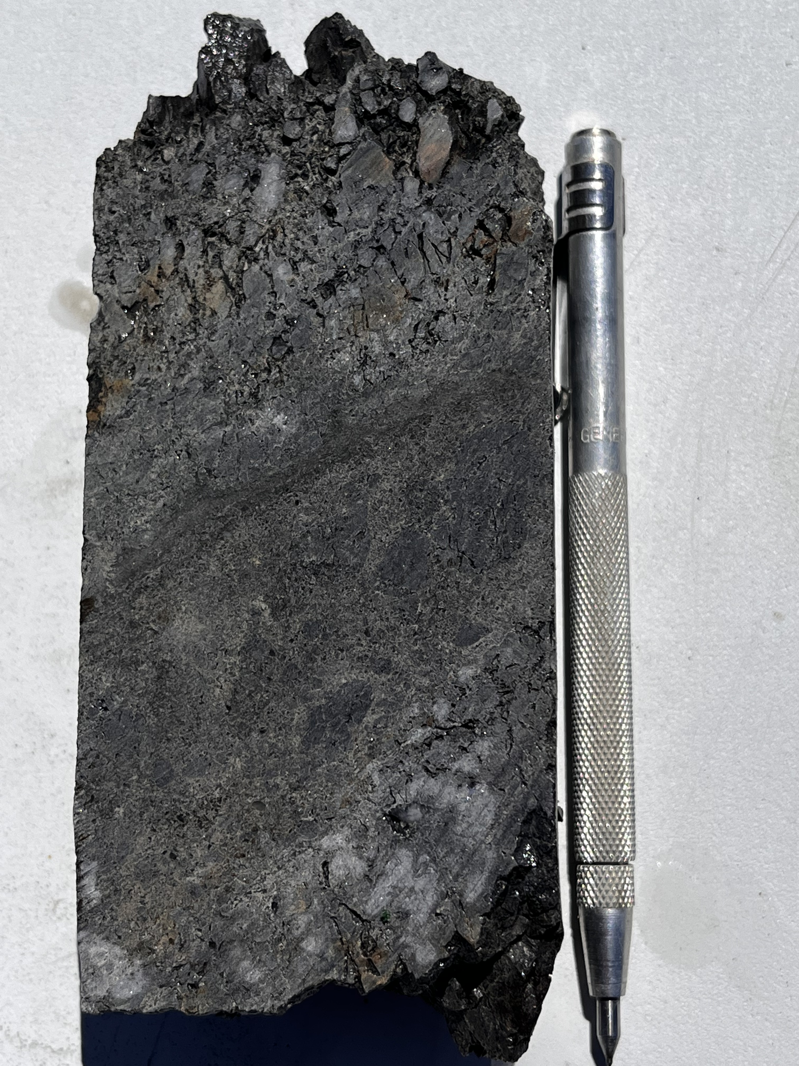
Securing a European critical raw material supply for generations to come
The Molaoi Project, Greece
(zinc/silver/lead/germanium)
9th Greek Raw Materials Community Dialogue
Athens November 20, 2024

Slide 2
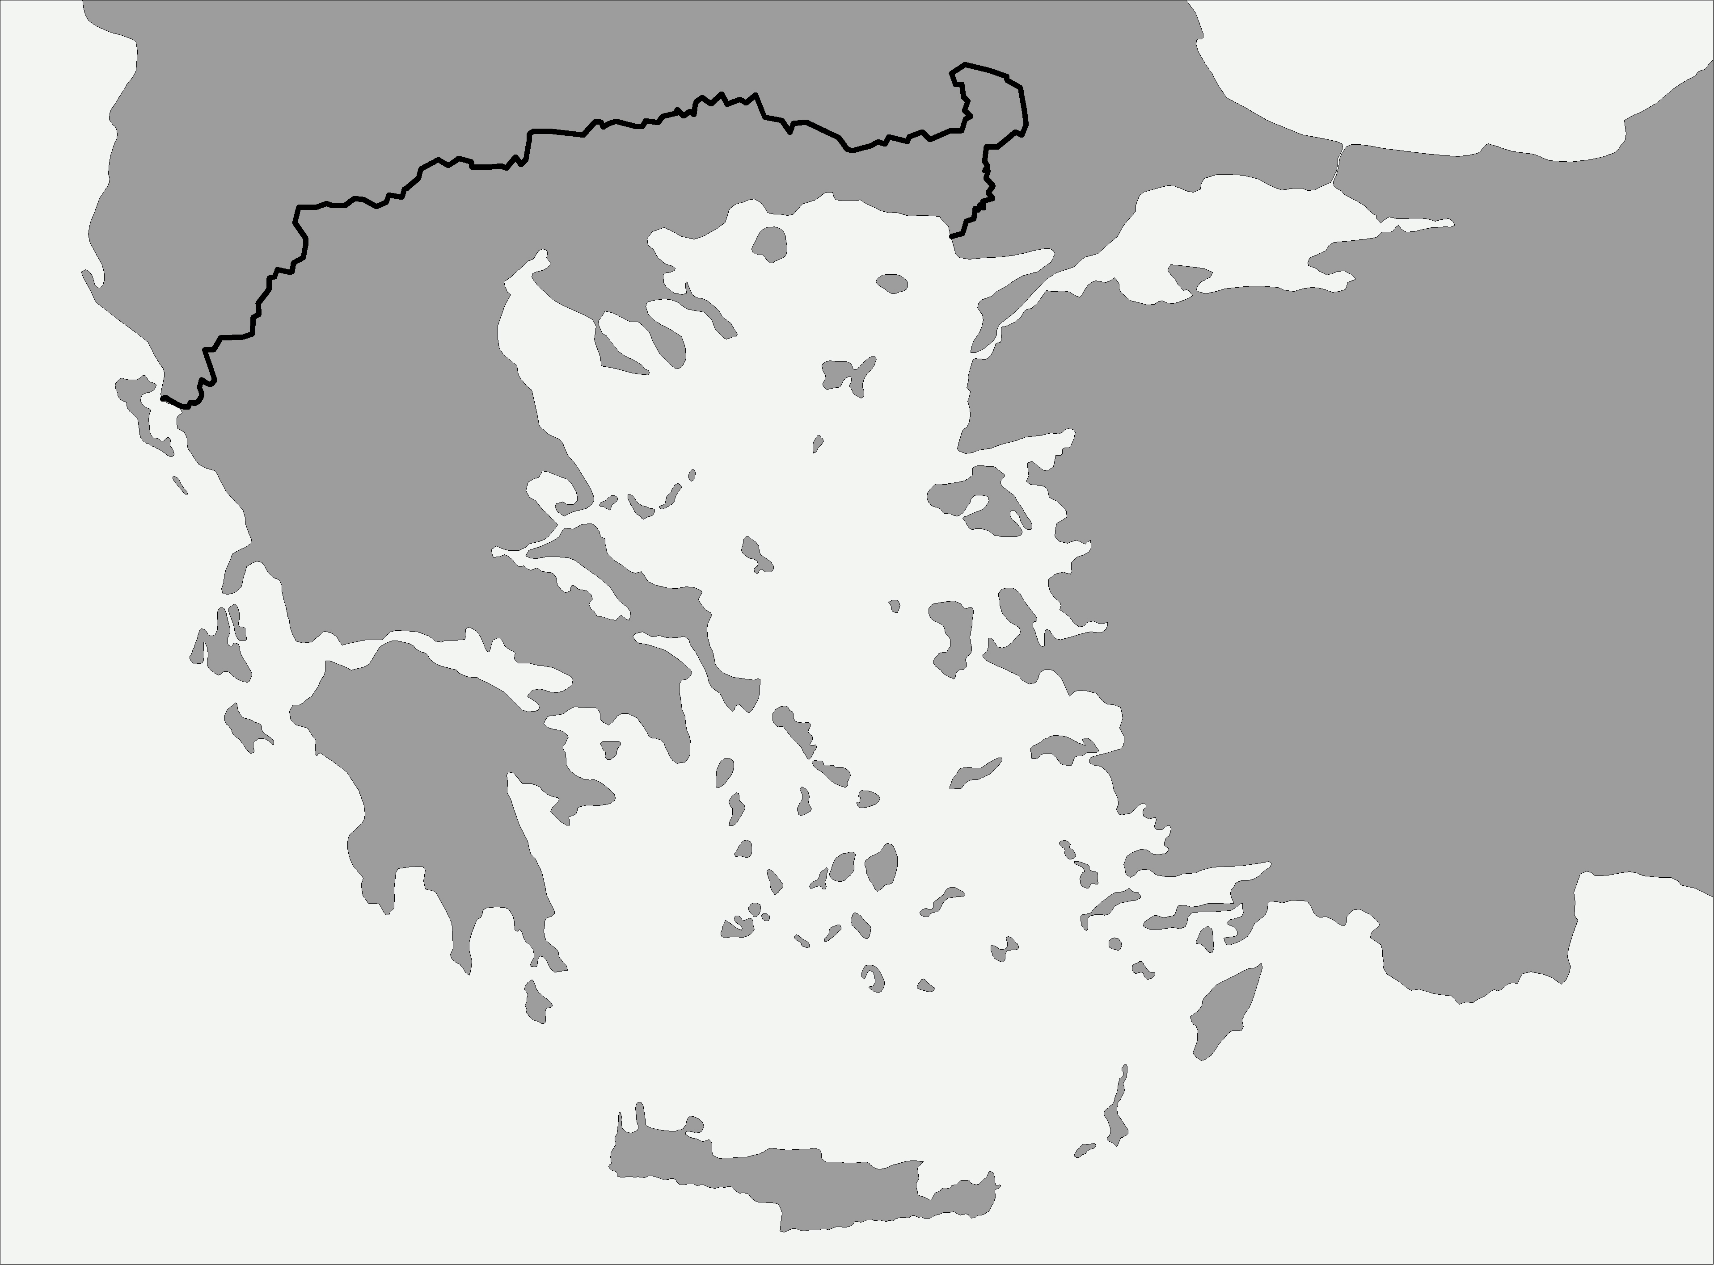
Athens
MOLAOI

Slide 3

Greece – Critical Raw Materials in Europe
Hellenic is a proud custodian of one of the largest critical raw material deposits in Europe
Hellenic is positioned at the centre of the Continent’s critical raw material supply chain
A resolute commitment to responsible exploration, development and mining
Striving to be leaders in the exploration and development of critical raw material projects in Europe
Building a domestic supply to power Europe for generations to come

Slide 4
Molaoi JORC Resource - 4 September 2024
Inferred JORC (2012)
15.0 million tonnes @ 7.26 % Zn, 1.75 % Pb, 39.5 g/t Ag
(9.96 % zinc equivalent)
1.09mt of zinc, 260,000t of lead 19.1moz of silver
Molaoi is in the top 20 undeveloped zinc deposits globally
18 sub-parallel zinc lodes modelled, with 23 lodes identified
Upside potential is to increase the current resource by at least 4x.
Next target upgrade is 40mt – 50mt @ 8.0% ZnEq. – 9.0% ZnEq.

Slide 5
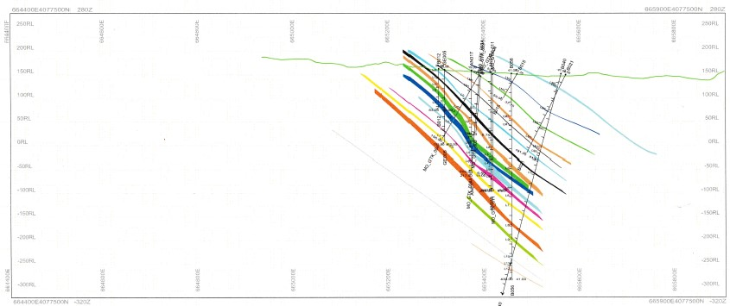
Mineralisation from surface and open at depth
600m
300m
Each colour is an individual zinc lode
Cross section 4077500 looking north

Slide 6
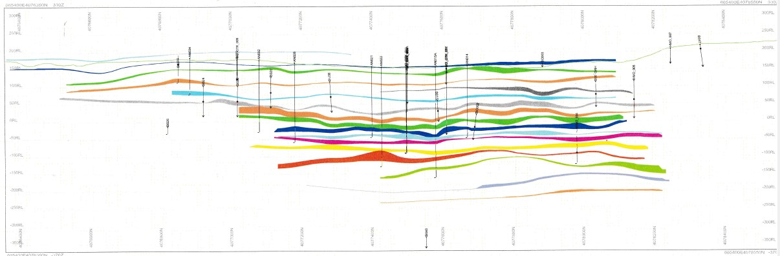
Amenable widths for underground mining
Lode thickness varies from 0.1m – 23m (average 4.1m)
A minimum width of 2.0m is required for mechanised underground mining
2,000m
400m
Each colour is an individual zinc lode
Long section 665400E looking west

Slide 7
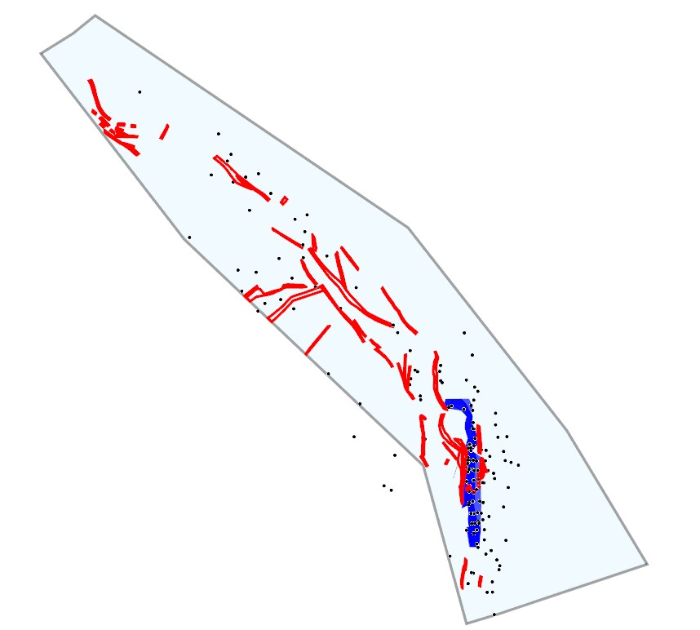
Apideas undrilled
Kofini undrilled
Derveni
undrilled
Fournos
3m @ 8.4% Zn
2km
Mesovouni
0.3m @ 3.2% Zn
Gkagkania 3m @ 6.7% Zn
Stavros
7m @ 10.2% Zn
Vigla 3m @ 12.9% Zn
Zinc prospect
1.09mt Zn
260,000t Pb
19.1moz Ag
Upgrade target is
40mt – 50mt
8.0% – 9.0% ZnEq.
Kalamaki
zinc resource
Agio
Eustratios
0.5m @ 27.3% Zn
Potamia
undrilled
PLAN VIEW

Slide 8
Future Mining and Processing considerations
Historical studies assist feasibility studies
Hydrology, metallurgy, geotechnical, fauna, flora and earthquake studies have been completed by the Greek State previously and may feed into future studies
Mining
Underground – to minimize the surface footprint
Widths allow for use of mechanized equipment – low mining costs
Ground conditions are known to be poor
Processing
On-site – crush grind flotation
Proven treatment flowsheet (2x concentrates: Zn/Ge and Pb/Ag/Cu/Au)
Transport concentrates to European smelters
Concentrate grades are 57% Zn; 856g/t Ag; 63.6% Pb; 117g/t Ge
2.62% Cu, 0.52 g/t Au
Germanium separation

Slide 9
Separation of germanium from zinc concentrates
Migration behavior of germanium and its related elements in zinc hydrometallurgy process - ScienceDirect
A combined process of fire-hydrometallurgy (roasting) to enrich germanium twice, and then recovery through a two-stage acid leaching process. Most of the germanium cannot be leached.
Germanium is captured by the isomer (zinc ferrite, ZnFe2O4) formed by zinc and iron in the roasting process. Zinc is not easily leached at this point.
The leaching residue (enriched in zinc), contains a large amount of iron, silicon, calcium and other metals.
A rotary kiln reduction volatilization method can be used to treat zinc leaching residue, so that most of the iron, silicon and calcium are left in the slag phase, while zinc, germanium, lead and other substances are secondarily enriched in the zinc oxide fume obtained by volatilization.
Finally, the germanium in zinc oxide dust is dissolved in sulfuric acid solution under a high temperature and low acid and a high temperature and high acid leaching process.

Slide 10
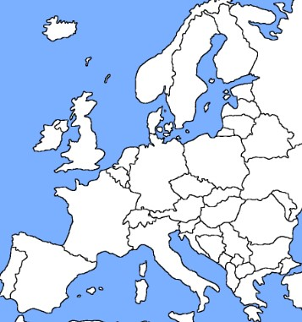
A choice of zinc smelters throughout Europe
Zinc smelter
Asturiana de Zinc
Auby
Balen/Pelt
Nordenham
Odda **
Kokkola
Zakłady Górniczo-Hutnicze
Portovesme **
KCM
Kardjali **
6
5
4
3
7
2
1
Germanium refinement
plant (Umicore)
9
10
** Please note that some smelters are currently on Care & Maintenance.
8
MOLAOI

Slide 11
Uses of zinc (US Critical Mineral List)
• Galvanising other metals to prevent rusting (automotive, aviation, marine industries). Corrosion costs the US around US$ 276 billion (3.2% of GDP) annually **.
• Alloys (brass, bronze, aluminium solder).
• Paint, toothpaste, insect repellant, plastics, sunscreen, soap, shampoo.
• Biological labelling, drug delivery, gene delivery, and nanomedicine.
• Cosmetics. Zinc is a strong anti-inflammatory and is commonly used for skincare, as well as accelerating wound healing.
• Electrical equipment including circuit boards for computers and phones.
• Energy storage systems and batteries - low cost, safe, and long-duration.
• Coatings for solar panels and wind turbines to prevent rust.
** Case Study: How Corrosion’s Economic Impact Across Multiple Industries – Cor Pro (cor-pro.com)

Slide 12


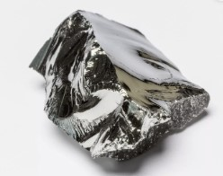
Uses of Germanium
Rockfire
GERMANIUM
Element 32
A critical mineral for a technological future.

Slide 13
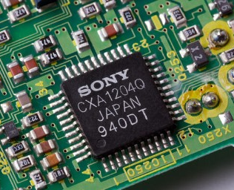
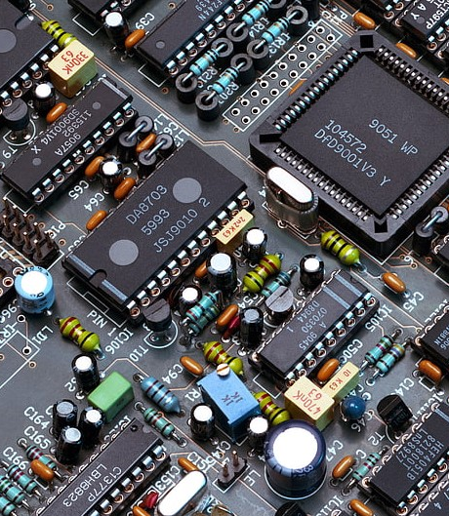
Electronics
Rockfire
The standard microchip uses silicon as its base material. Silicon-germanium enables manufacturers to produce smaller electronic chips, with less electronic noise interference from the chip itself.
Germanium-based chips are more energy efficient than traditional silicon-based chips and, therefore, extend the life of battery-operated electronics.
Other benefits include being more stable over a wider range of temperatures and operation at ultrahigh frequencies.

Slide 14


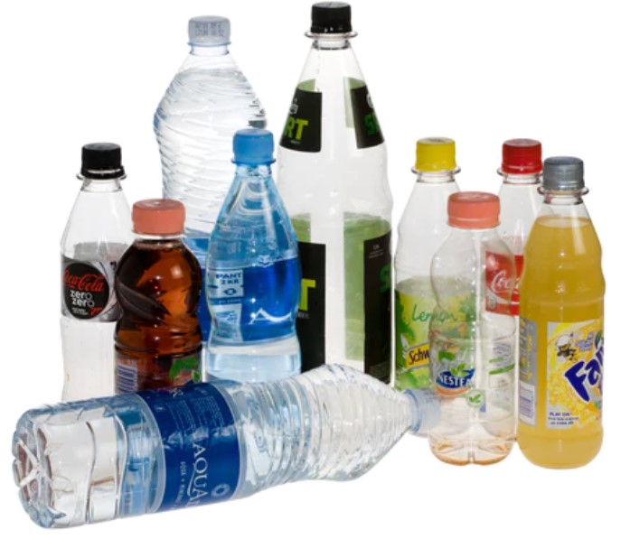
Recycled Plastics
Rockfire
Germanium is a catalyst in the production of polyethylene terephthalate (PET) plastic.
Used in bottles, food packaging, bakery products, water and soda bottles, peanut butter and condiment jars, frozen food packaging, cosmetics, as well as plastics for the storage of chemicals and household cleaners.
Rockfire

Slide 15

Advanced Driver Assistance Systems (ADAS)
Rockfire
Forward-looking infrared (FLIR) devices form images by sensing the thermal contrast between objects and background.
Integrated into all modern vehicles for essential safety features, including:
parking assistance
blind spot detection (BSD)
lane change assist (LCA)
reverse parking sensors
“Nightdriver”, night-vision system manufactured by Raytheon allows drivers to see up to 5 times farther.

Slide 16
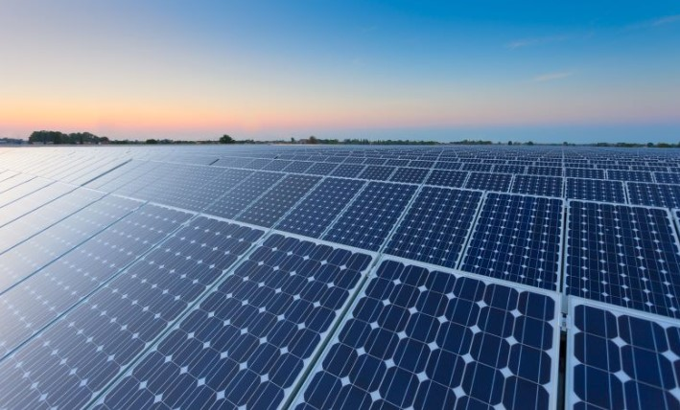
Solar panels
Rockfire
The materials adopted in the production of solar cells are tellurium, germanium and indium and are deemed to have the most critical demand-to-supply ratio.
Germanium-based solar cells convert up to twice as much light into electricity as silicon cells.
Germanium is more resistant to cosmic radiation damage, resulting in an extended life for a solar cell by up to 20 years.

Slide 17

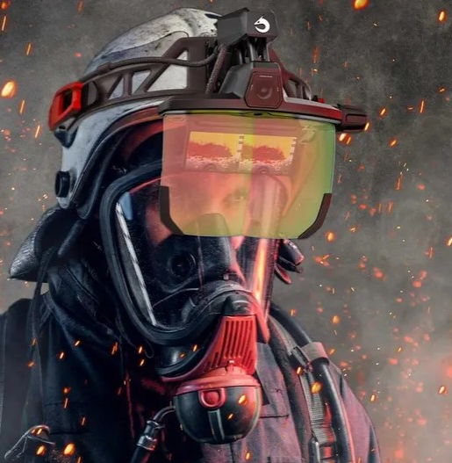
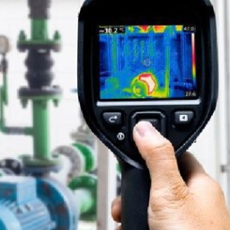

Safety and security
Rockfire
infrared night-vision and surveillance
detecting overheating bearings in machinery
locating lost hikers in wilderness areas
monitoring rock surface temperatures in mines
satellite mapping
detecting faults in structural materials
personnel detection equipment in poor visibility environments
used by fire departments to improve thermal-imaging systems to detect endangered individuals, hot spots, and team members in smoky environments.

Slide 18
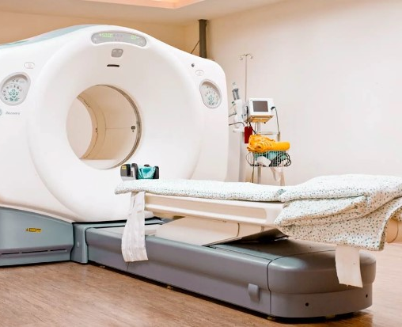
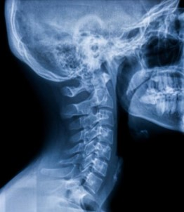
Medical
Rockfire
used in medical diagnostics
detectors for gamma and x radiation
some organometallic compounds of germanium are of interest in medical treatment for the prevention of cancer and high blood pressure.
crystals of bismuth-germanium oxide are used in positron emission tomography (PET) scanners.
chemotherapy (toxic effects against certain microorganisms).
Rockfire

Slide 19




Military & warfare
Rockfire
weapon-sighting applications
infrared heat-seeking missile guidance
Infrared night vision goggles and binoculars
surveillance cameras
global positioning systems (GPS).
Rockfire

Slide 20
Securing a European critical raw material supply for generations to come
Hellenic Minerals S.A.
Rockfire Resources plc
www.rockfireresources.com
info@rockfire.co.uk
9th Greek Raw Materials Community Dialogue
Athens November 20, 2024

