Slide 1

The Growing Need for Innovative Educational Programmes in the Raw Materials Sector
Katerina Adam, Professor Emeritus, NTUA & Educational Advisor, EIT RawMaterials RIS Hub Greece

Slide 2

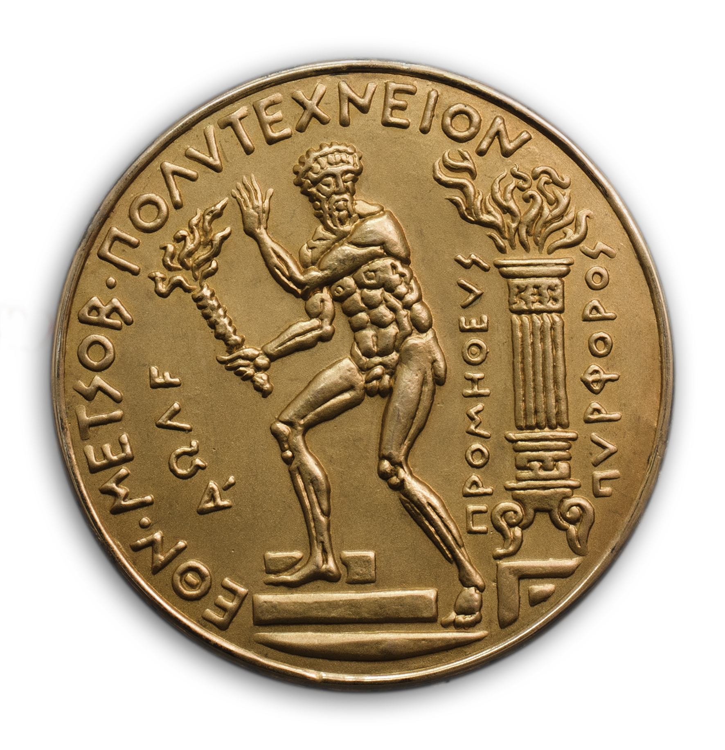
Contents
RM Skills shortages– Educational needs
EIT RM & NTUA Education Programs
European Universities Alliances, EULiST
EIT RM calls for HEIs
Conclusions

Slide 3
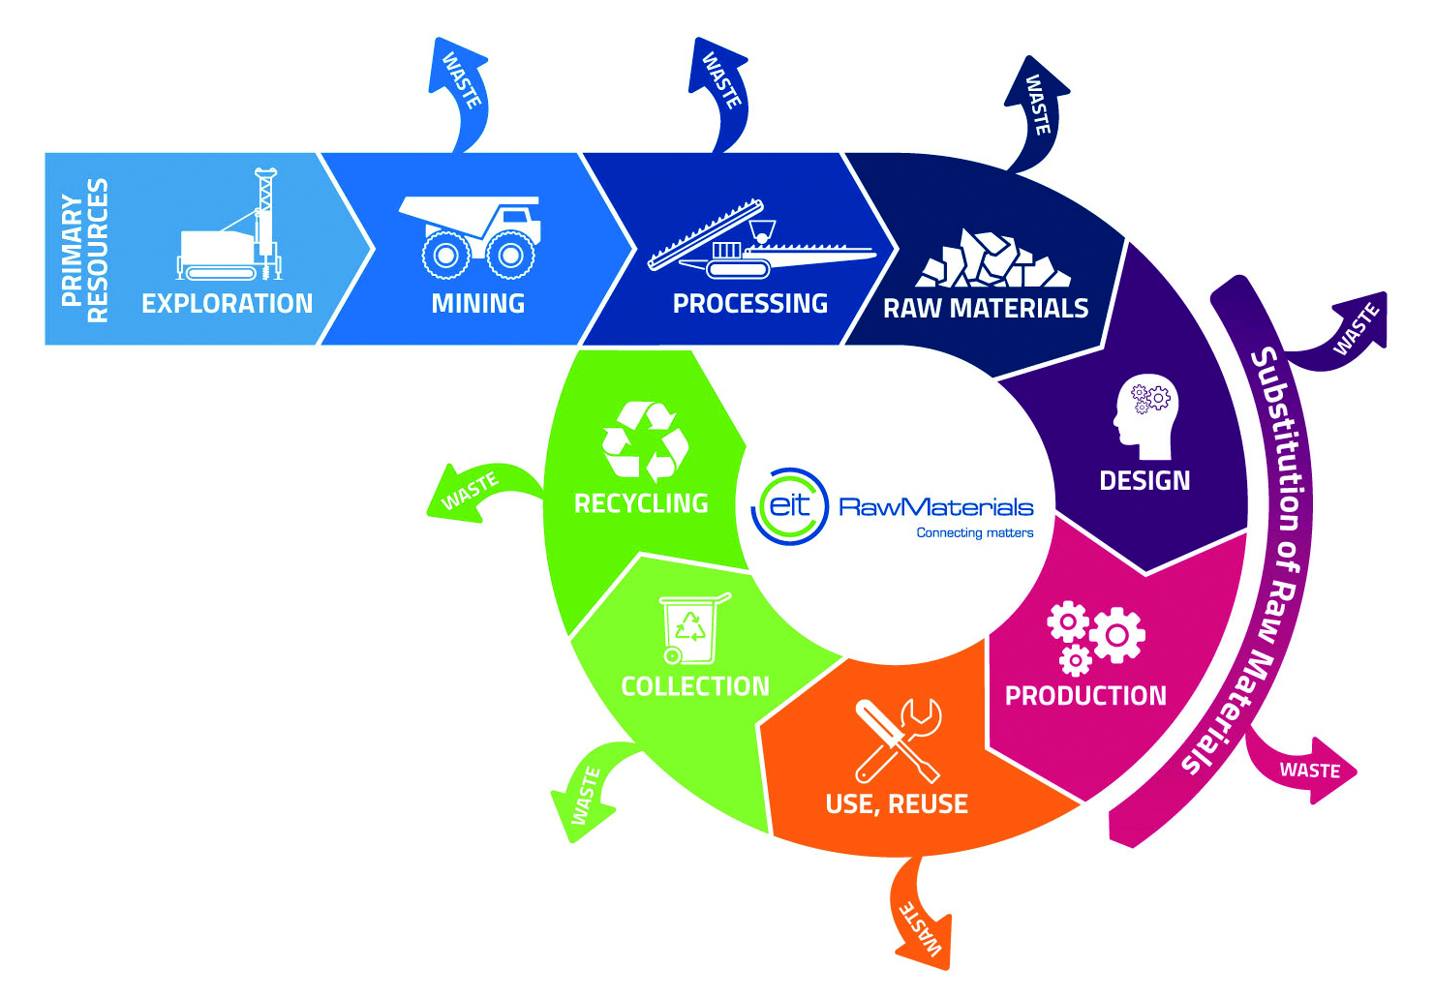
RM Skills Shortage /Educational Needs
Skills fit for the twin transition
Raw Materials, RM, play a pivotal role towards the Transition of Europe into a Sustainable economy.
To secure the supply of critical and other strategic raw materials for Green and Digital transition, major emphasis in the development of innovative solutions along the whole value chain, with the cooperation of HEIs, Industry and RTOs.

Slide 4

RM Skills Shortage/ Educational Needs
Despite its Strengths and Opportunities, Threats that often prevent the sustainable development of the EU RM sector include,
the lack of acceptance from the public
the shortage of skilled graduates and engineering professionals necessary to implement Digital Transformation and Industry 4.0.
Systematic efforts during the last decade to update the education of the Raw Materials students and professionals in Europe.

Slide 5
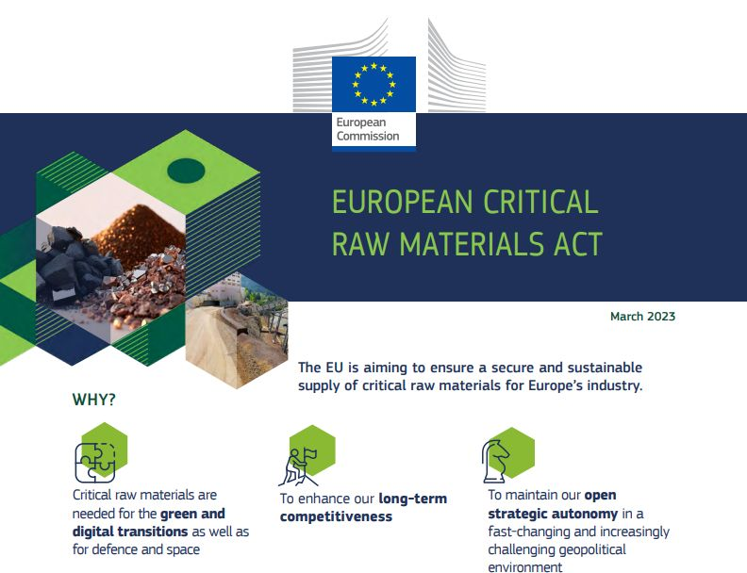
RM Skills Shortage/ Educational Needs
CRMA: Need to invest in research, innovation and skills
Establishment of a large-scale skills partnership on Critical Raw Materials and of a RM Academy will promote skills relevant to the workforce in critical raw materials supply chains

Slide 6
EIT RM & NTUA* Education Projects
In Numbers
2017 - today:
Participation in 18 Projects: 13 completed & 6 ongoing
Cooperation with more than 80 Partners from 30 EU & non-EU countries
464 students, young professionals, and researchers participated in these projects
179 trainees (39%) from NTUA
80 trainers – 9 (11%) from NTUA
85 trainers (RIS-Internship) – 13 (15%) from Greece
* Core Partner of EIT RM
Project type |  | Project Name
RM Academy | Lifelong Learning | HydroMetEC, SkiComCu, EE4M
 | Wider Society Learning | CEMOOC, VIRTUAL MINE, RM@Schools-ESEE, SISTEM
 | Master’s | SETI, VR Lab, EIT RM Master School (RMUD)
 | PhD | TOPSTARS, PRO-SLO
 | Regional Innovation Scheme (RIS) | TrainESEE v2, EnAct-SDGs, RIS Education & Entrepreneurship, RMs Manager, RIS-BRIEFCASE RIS-Internship, DIM-ESEE-2

Slide 7

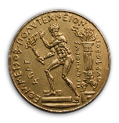
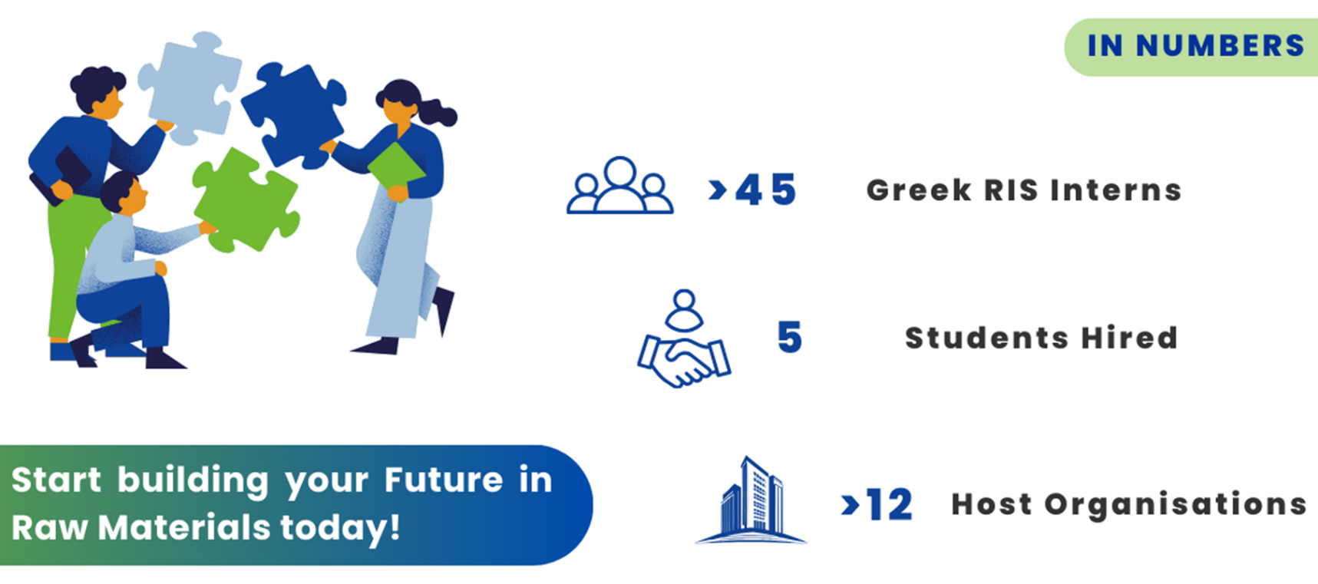

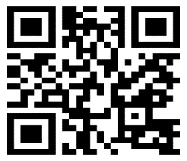

EIT RM & NTUA Education Projects
RIS INTERNSHIP
RIS- Internship
Apply here!

Slide 8

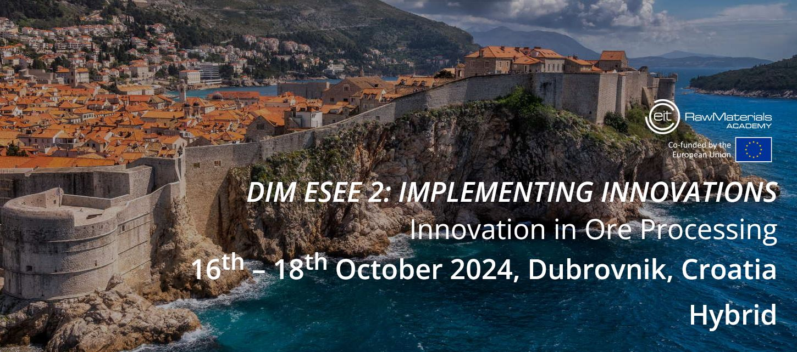
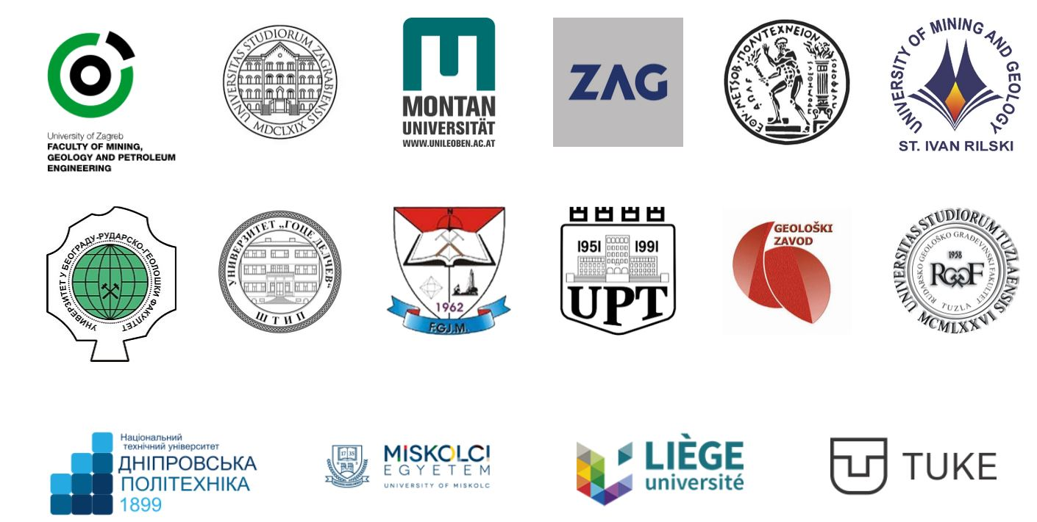
EIT RM & NTUA Education Projects
DIM-ESEE2: Implementing Innovations
Duration: 2021-2024
A total of 160+ professionals were trained

Slide 9

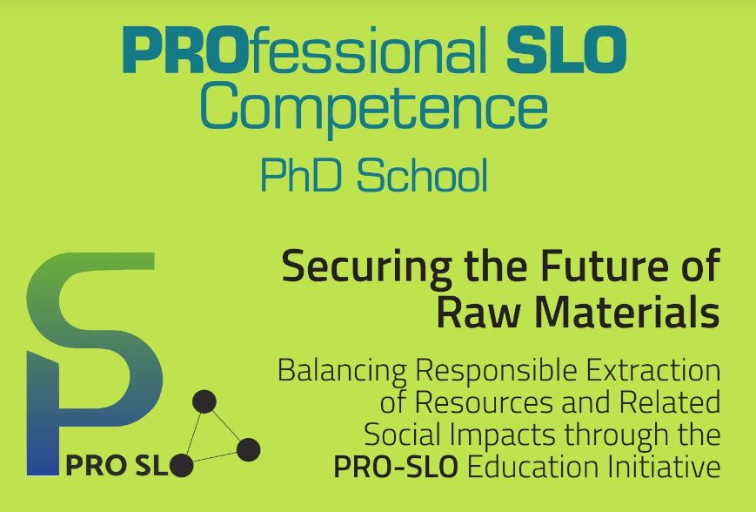

EIT RM & NTUA Education Projects
PRO-SLO PhD School
An alliance of SLO experts from research, universities and industry will design and deliver a tailored PhD school
The School will be based around challenges provided by the industry, facilitated by innovative teaching/learning methods
Duration: 2023-2026
A total of 50+ PhD level students will be trained

Slide 10

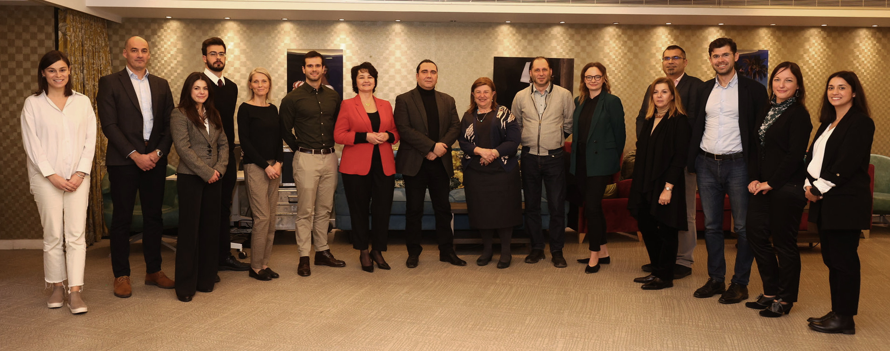



EIT RM & NTUA Education Projects
SkiComCu, 2023-2026, funded by EIT RawMaterials
A Life-Long-Learning Project aiming to provide current & future professionals in the Copper Industry with skills for:
Sustainable practices
Communication & problem solving
New technologies
NTUA leads the Design and Development of Educational & Training Curriculum and Tools
Universities
NTUA (GR), UPM (ES), FCT NOVA (PT)
Research Organizations
KGHM-CUPRUM (PL), La Palma (ES), Łukasiewicz (PL)
Industrial Partners
ElvalHalcor (GR), Aurubis (BU), KGHM (PL)

Slide 11



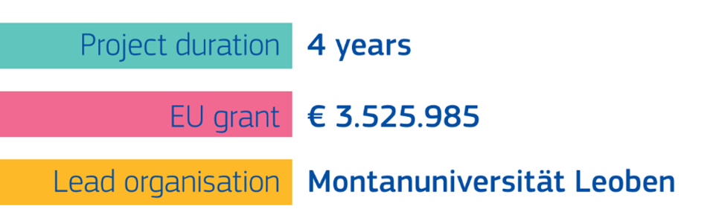















NTUA Education Projects,
EE4M - Engineering Excellence in the Mobility Value Chain
Pupils
Students
Engineers
Investigation of required
competences of future engineers
Development of
compentence profiles
Logistics and
Supply Management
Product Development and
Manufacturing
Entrepreneurship and Industrial Marketing Management
Notes:
Starting point of EE4M for the realignment of the engineering education to foster engineering excellence in the mobility value chain.
We want to achieve educational permeability (EQF 4-8) .
Include a international consortum. 15 full partners. 30 associated partner. 50+ supporting partners.

Slide 12

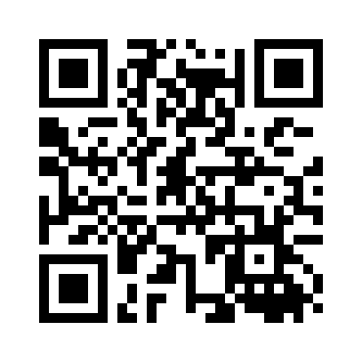


NTUA Education Projects
ΕΕ4Μ WP3 Recommendations & next steps
Curriculum Reform and Educational Innovation
Training and Upskilling for Professionals
to ensure they meet the needs of both digital and sustainable transformation. Universities should work closely with industries to co-create educational content.
to ensure the integration of digitalization and sustainability within curricula as interconnected disciplines. Adopt project-based learning models, encouraging students to engage with real-world challenges that combine digital innovation and sustainable practices
programs for both new graduates and existing professionals in the workforce such as VET Adaptation to the evolving needs of industries, focusing on both digital and sustainability skills.
Stronger Industry-Academia Collaboration
Further insights are now collected via survey on “Specific Competency-based requirements for SSOM”. Please use the QR code above to participate.

Slide 13
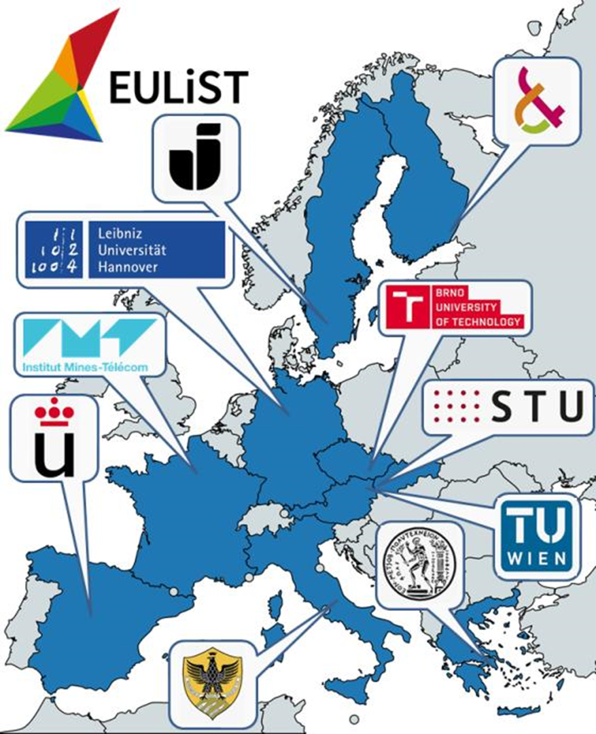
NTUA in the European University Alliance EULiST
European Universities Linking Society and Technology
Funding Period 2023-2027
Demand for highly skilled people for deep technological and structural changes.
European Universities Initiative aims at accelerating the transformation of HEIs into the universities of the future with structural, systemic and sustainable impact, so young people are prepared for the jobs of tomorrow in a fast-changing society, and future generations are empowered to find solutions to big societal challenges that Europe and the world are facing.

Slide 14
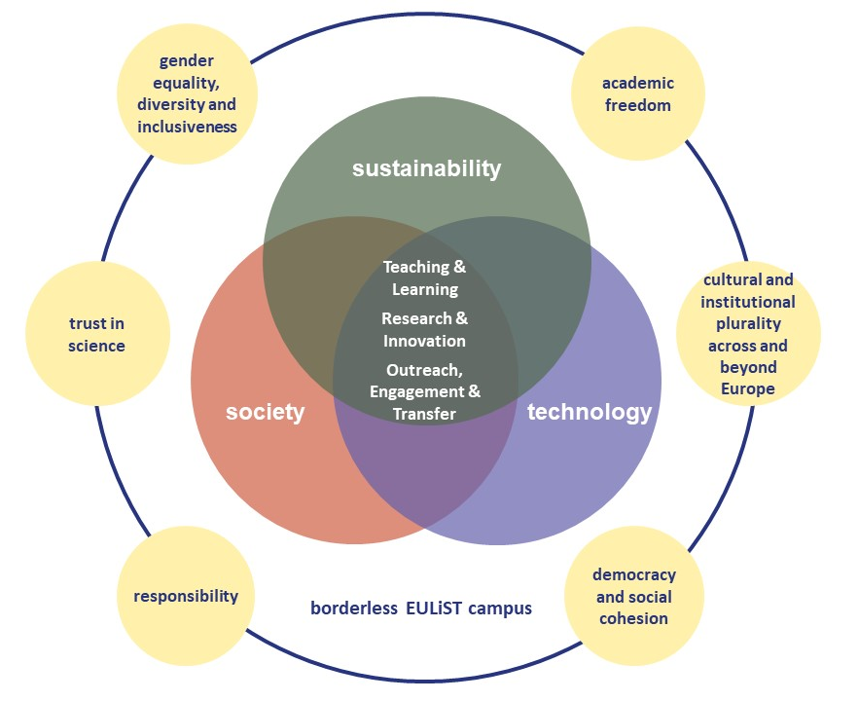
NTUA in European University Alliance
EULiST Vision and Mission
EULiST has a clear focus based on sustainability, interlinking knowledge in STEM together with Social Sciences and Humanities to develop solutions to the major societal challenges of today and tomorrow – climate change, digital transition and social cohesion.
EULIST will generate a unique and creative academic ecosystem of sustainable development, exhibiting innovative techniques and providing access to hands-on experience.

Slide 15

EIT RawMaterials Calls for HEIs
1. EIT HEI Initiative
2. Social License to Operate Hub
Submission deadline: December 12
Objectives:
Innovations to Market
European Higher Education Competitiveness
Employability through skills and competencies development
Dynamic and inclusive innovation community
Transforming HEIs into Hubs of Innovation and Entrepreneurship
Submission deadline: December 9
Objectives:
Comprehensive Τraining programs and consultation services on best practices for fostering community relations and ensuring sustainable operations
Equip professionals with tools to address environmental, social, political, legal, and business challenges related to SLO in the RM sector
The Hub will be instrumental in supporting the EU goals outlined in the CRMA

Slide 16

Conclusions
Results of the EIT RM and other EU funded Education projects are used to upgrade the RM schools curricula and develop LLL programs with the aim to address the present and future needs of the RM sector using innovative education tools, emphasis in challenge based education.
Education Programs and Training schemes, for students and professionals in the RM Industry, developed taking into account best practices from innovation providers and the views of the stake holders, consist an important tool providing the sector the skills, and competencies to successfully mitigate the current major challenges, including the achievement of SLO

Slide 17
Katerina Adam
Professor Emeritus, NTUA
katadam@metal.ntua.gr

