Slide 1

Driving Growth: Greece's Strategic Role in the EU and Sustainable Raw Materials Supply Chains
Christos Balaskas | President, Hellas Gold
Notes:
Welcome to our presentation on Greece’s strategic role within the EU concerning sustainable raw materials supply chains.
We will explore how Greece can drive growth through its unique geographical position, rich mineral resources, and commitment to sustainable practices. Let’s dive into the key aspects that highlight Greece's importance in this context.

Slide 2
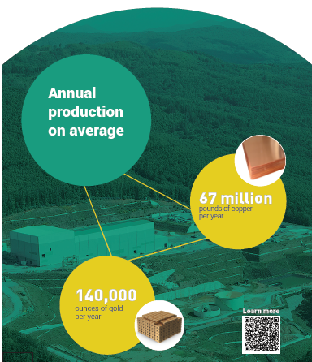
Greece’s mining sector at a glance
Mineral Wealth
Greece possesses significant resources essential for green technologies, including bauxite, copper, gold and other minerals.
Economic Growth
Sector contributes significantly to Greece’s GDP.
Provides direct employment for thousands and supports ancillary industries (transportation, manufacturing).
EU Resilience
Greece can help ensure a steady flow of essential materials to European markets, thereby supporting economic stability and growth.
Potential for exploration and extraction of additional critical raw materials.
SKOURIES PROJECT
AT A GLANCE
2
Notes:
The Greek mining sector is not only rich in resources but also plays a crucial role in the national economy. With significant deposits of bauxite, copper, and gold, Greece is well-positioned to meet both domestic and European demand for these critical materials. The sector contributes around 3% to the GDP and provides thousands of jobs, highlighting its importance as an economic driver. Additionally, it supports various related industries, creating a multiplier effect on economic growth.
Also, due to its geographical advantage, in times of global disruptions—such as geopolitical tensions or pandemics—Greece can help ensure a steady flow of essential materials to European markets, thereby supporting economic stability and growth.

Slide 3
CRMA’s Impact On The Greek Mining Sector
Streamlined Licensing and Growth:
Boosts Greek sector for projects to proceed faster encouraging investment.
Increased Financial Support for Innovation:
More accessible Financing for sustainable projects in mining.
Incentives for Advancing Technology:
Promotes investment in technology that reduces environmental impact.
Establishment of a large-scale skills partnership:
Fosters skills development and creates employment opportunities
Notes:
The Critical Raw Materials Act has significant implications for the Greek mining sector.
First, the CRMA creates new investment opportunities setting ambitious targets for boosting domestic production. By streamlining permitting processes and providing financial support for strategic projects, Greece can attract both domestic and international investments.
It enhances the regulatory framework by providing clear guidelines that promote sustainable mining practices. This is crucial for ensuring that Greece can meet its environmental commitments while still capitalizing on its rich mineral resources.
This collaboration between public and private sectors will be essential for fostering innovation in sustainable mining technologies, ensuring that Greece remains competitive in the evolving global market for critical raw materials. Moreover, this initiative is expected to create significant employment opportunities, particularly for youth and underrepresented groups in the labor market. By ensuring that the workforce is skilled in innovative and sustainable mining practices, Greece can enhance its role in the EU's critical raw materials supply chain while contributing to economic growth and environmental stewardship. Moreover, collaborations with educational institutions will be crucial in developing tailored programs that align with industry needs, ensuring that graduates possess the relevant skills sought by employers.

Slide 4
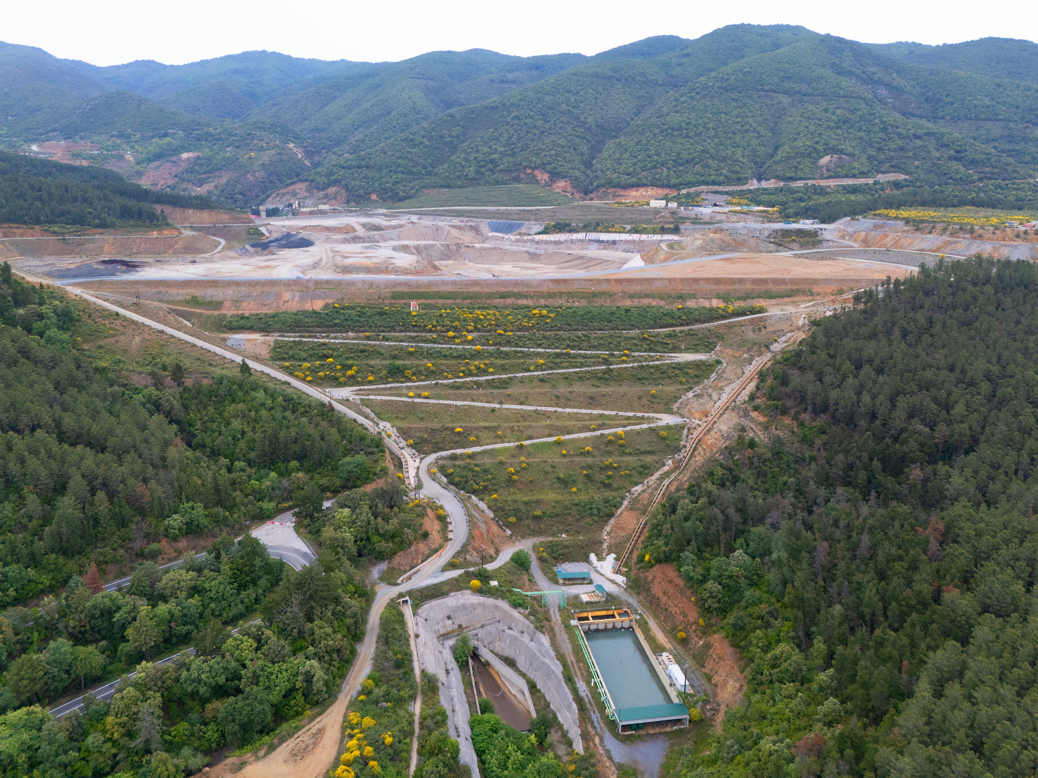
Building a Sustainable Future for Mining
Responsible Mining: Greek mining companies prioritise high environmental, social, and governance standards. Focus on responsible waste & water management, land rehabilitation, and biodiversity protection to ensure the sustainability of resources for future generations.
Enhancing Community Engagement: Building strong relationships with local communities and stakeholders is essential for ensuring that mining activities contribute positively to social and economic development while addressing concerns related to environmental and social impacts.
Investing in Technology and Innovation: Embracing advanced technologies and innovative methods can enhance efficiency and reduce the environmental impact of mining operations, facilitating a transition towards a more sustainable industry.
Notes:
Sustainability is becoming increasingly important in the mining sector. Greek companies are adopting eco-friendly methods that not only comply with stringent EU regulations but also promote environmental stewardship. For instance, Hellas Gold operations are implementing water recycling systems, tailings dry-stacking & reusing in the mine and exploring the use of renewable energy sources to reduce their carbon footprint. Furthermore, initiatives focused on land rehabilitation after mining activities are crucial for preserving biodiversity and ensuring that local ecosystems thrive post-extraction. We have cleaned up Olympias from 4 mil. tonnes of tailings from past uses.

Slide 5
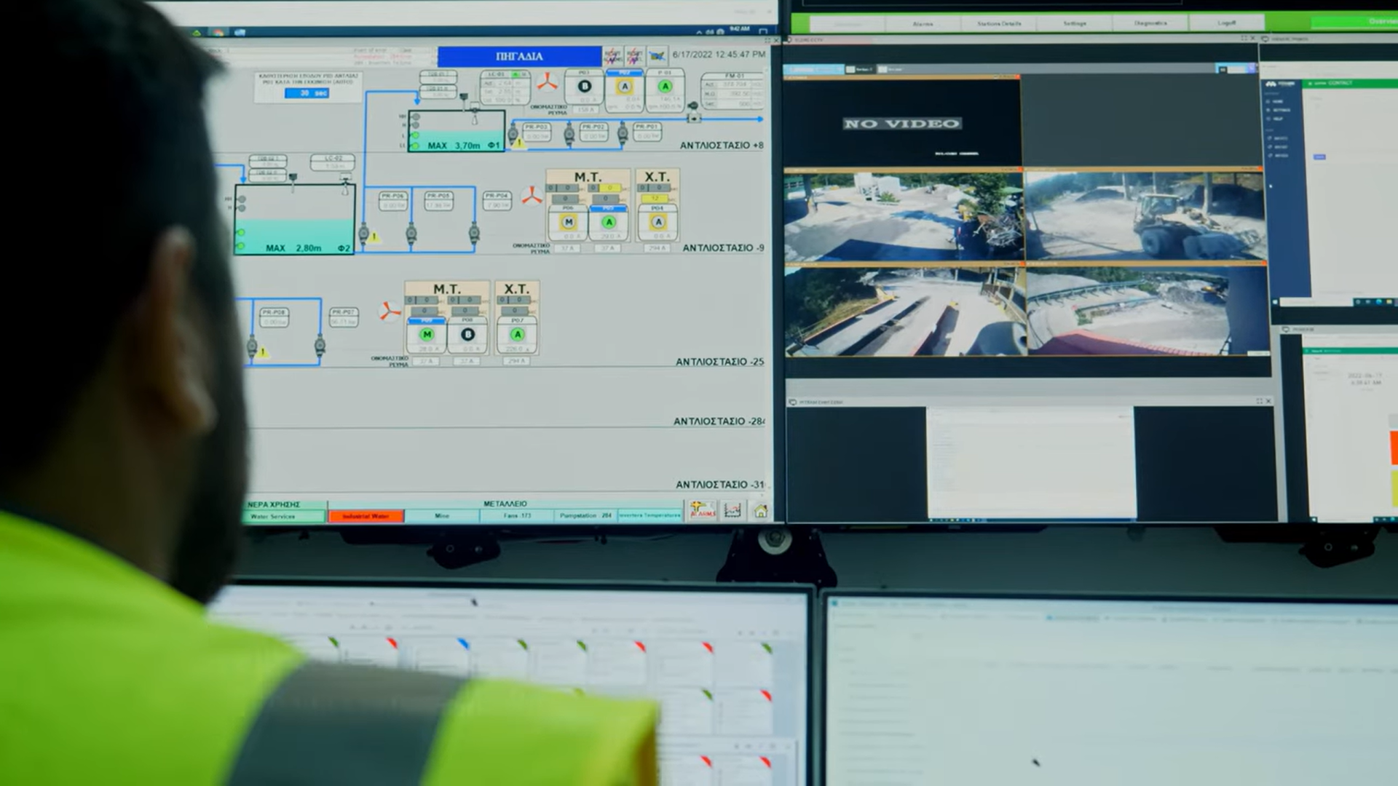
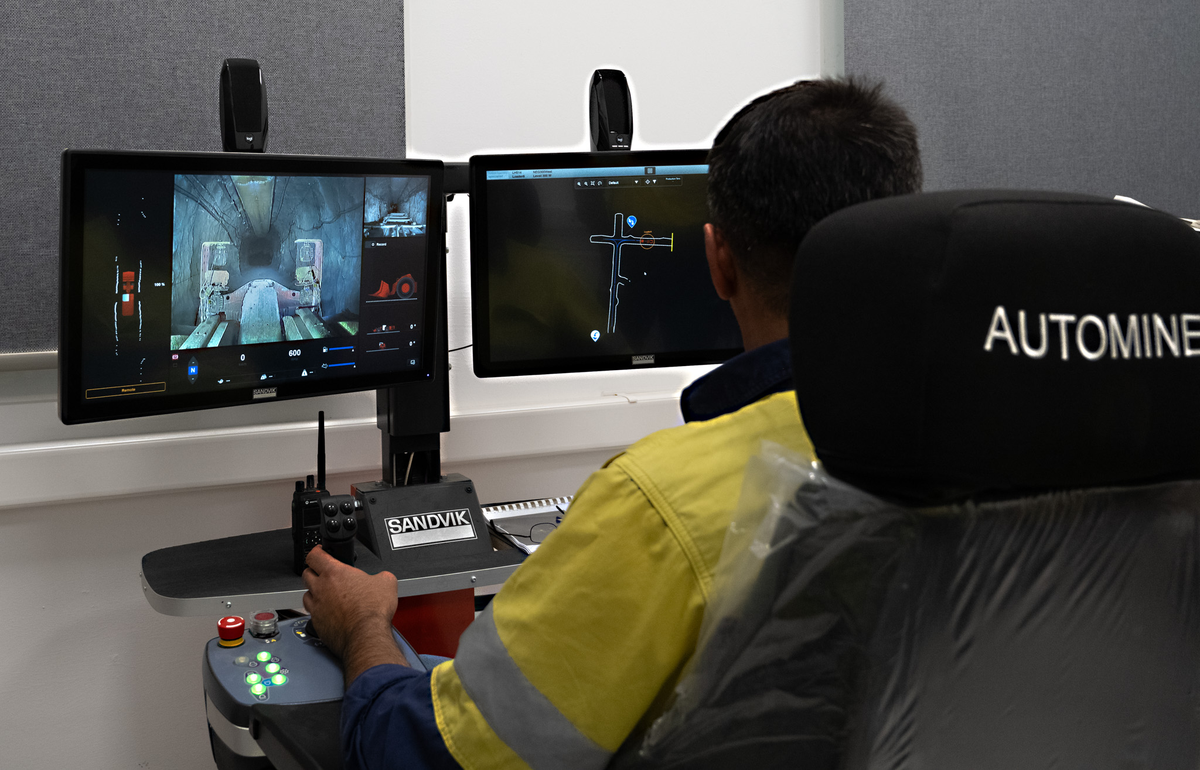
Digital Transformation
Campus Network: Leading-edge / Innovative 4G/LTE network (by Cosmote)
Remote Blasting
Remote mucking (in collaboration with Sandvik for loaders)
Vehicle Telematics
Ventilation on Demand → Phase I: Remote monitoring and management of fans in progress → Required amount of clean air only to active work fronts.
Control room at the surface: non-stop control of the network and its cycle in real time, ensuring safety and productivity for operations on the site.
Other Innovative Technologies
Underground Safety Monitoring system: personal protective equipment of the personnel for precise and real-time location of the underground mining workers.
Experiential Learning Programs / Training & Educational Center in Mavres Petres (Specialised area with 2 simulators on interactive features) → for continuous training of HG personnel in virtual reality conditions.
FLAIM Trainer System: uses virtual reality technology that allows firefighting
Implementation of Industry 4.0 technologies for efficiency and safety
Adoption of remote operations and automation
Digital solutions for supply chain transparency
Investment in training programs using virtual and augmented reality
Notes:
Investment in technology is transforming the landscape of the Greek mining sector. By adopting advanced automation technologies—such as remote mining methods, advanced safety systems —companies can enhance operational efficiency and reduce costs. Additionally, data analytics is being utilized to optimize resource extraction processes, leading to reduced waste and increased sustainability.
Additionally, investing in workforce training programs is essential to equip workers with the necessary digital skills. Collaborations with educational institutions will help develop curricula that align with industry needs, ensuring a skilled workforce ready for future challenges.

Slide 6
The Road Ahead
Greece’s Strategic Role in Europe’s Future
The CRMA as a catalyst for change
Building partnerships towards a greener future
Leveraging Technological Advancements for Sustainable Mining Practices
Greece poised to play a pivotal role in shaping Europe’s mining future
CRMA harmonises regulations across EU countries to facilitated smoother processes and attract sustainable investments
EU countries can work together closely to align on best practices, share technologies and foster a unified approach to sustainable mining
Advanced technologies can optimise mining processes, reduce waste and ramp up safety – Greece can lead in developing circular economy models, such as in the flagship Skouries project.
Notes:
As we look to the future, Greece is poised to play a pivotal role in shaping Europe’s mining landscape. The implementation of the Critical Raw Materials Act (CRMA) will harmonize regulations across EU countries, making it easier for companies to navigate the legal landscape while attracting sustainable investments.
Moreover, collaboration among EU member states will be essential. By aligning on best practices and sharing technological advancements, countries can foster a unified approach to sustainable mining that benefits all. Technological innovations are set to revolutionize the mining sector. Advanced technologies will not only optimize processes but also significantly reduce waste and enhance safety.
Greece has the potential to lead in developing circular economy models, as seen in flagship projects like Skouries, which aim to minimize environmental impact while maximizing resource efficiency.
In conclusion, by embracing these opportunities and challenges, Greece can solidify its position as a leader in sustainable mining within Europe.

Slide 7
C. Balaskas
President, Hellas Gold

