Slide 1

Empowering Sustainable Mining: Building Public Trust Through Transparent Practices and Community Engagement
Mathieu Vallart | Sustainability Director, Hellas Gold

Slide 2
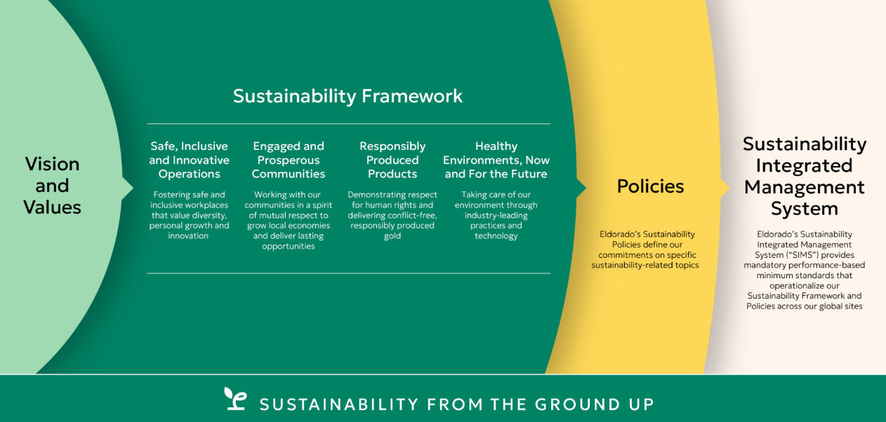
Our Approach to Sustainability
Notes:
Welcome to our presentation on empowering sustainable mining. We begin with our sustainability philosophy, which emphasizes our commitment to responsible resource management. This philosophy guides our operations, ensuring we balance economic growth with environmental stewardship and social equity. Our Integrated Management System is designed to align our sustainability goals with our daily operations. It allows us to continuously improve by monitoring our performance, evaluating outcomes, and incorporating stakeholder feedback into our processes.

Slide 3
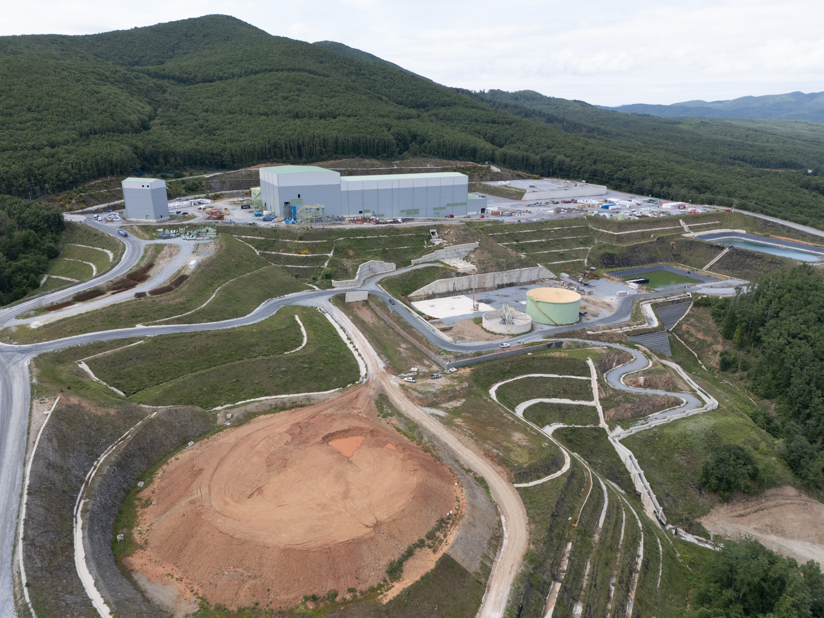
Building Public Trust Through Transparency
Exploration
Development
Construction
Operation
Closure and Post-Closure
Mining lifecycle stages
Transparency Maintain open communication & engagement at each stage
Responsibility Solid sustainability performance
Notes:
Engaging communities from the very beginning -during exploration- helps build trust and ensures that local knowledge is integrated into our operational plans. Ongoing dialogue is crucial; it allows us to address community concerns proactively, fostering a collaborative environment that benefits both the mining operation and the local population. At the same time, we are responsible for developing the necessary standards which define our way of working and ensure a solid sustainability performance. By adopting voluntary standards like those from the International Council on Mining and Metals and other associations, we can further enhance our commitment to responsible practices. Ultimately, these transparency efforts lead to greater accountability and trust from the communities we serve.

Slide 4
Stakeholder Engagement Strategies
Stakeholder Engagement
Identifying and analyzing all our stakeholders helps us evaluate their needs, interests, and concerns.
Grievance Mechanism Framework
A mechanism through which our stakeholders can confidentially submit any concerns they may have regarding our activity (channels: interactive online form, by email/post, dedicated telephone line, complaint boxes at our facilities).
Community of Interest Committee (CiC)
A group of key stakeholders that our Hellas Gold representatives (CLOs) meets regularly to inform about the progress and development of our operations as well as our social performance.
Community Office
A direct point of contact between the company and local communities. Our stakeholders can meet with our CLOs on a regular basis by visiting our established community office in Palaiochori to report their concerns/ requests in person.
Stakeholder Engagement
Grievance Mechanism Framework
1
4
2
3
Community Office
Community of Interest Committee (CiC)
Notes:
Community engagement is vital for ensuring that mining projects are accepted and supported by local populations.
Our Stakeholder Engagement Plan is designed to identify community needs and expectations effectively. One effective approach is participatory decision-making, where we actively involve community members in discussions, on an always-on approach.
These engagements can take various forms, such as public fora, participatory workshops, grievance mechanisms and other channels through which their voices are heard. When communities feel involved and valued, it strengthens our relationship with them and enhances our social license to operate.

Slide 5
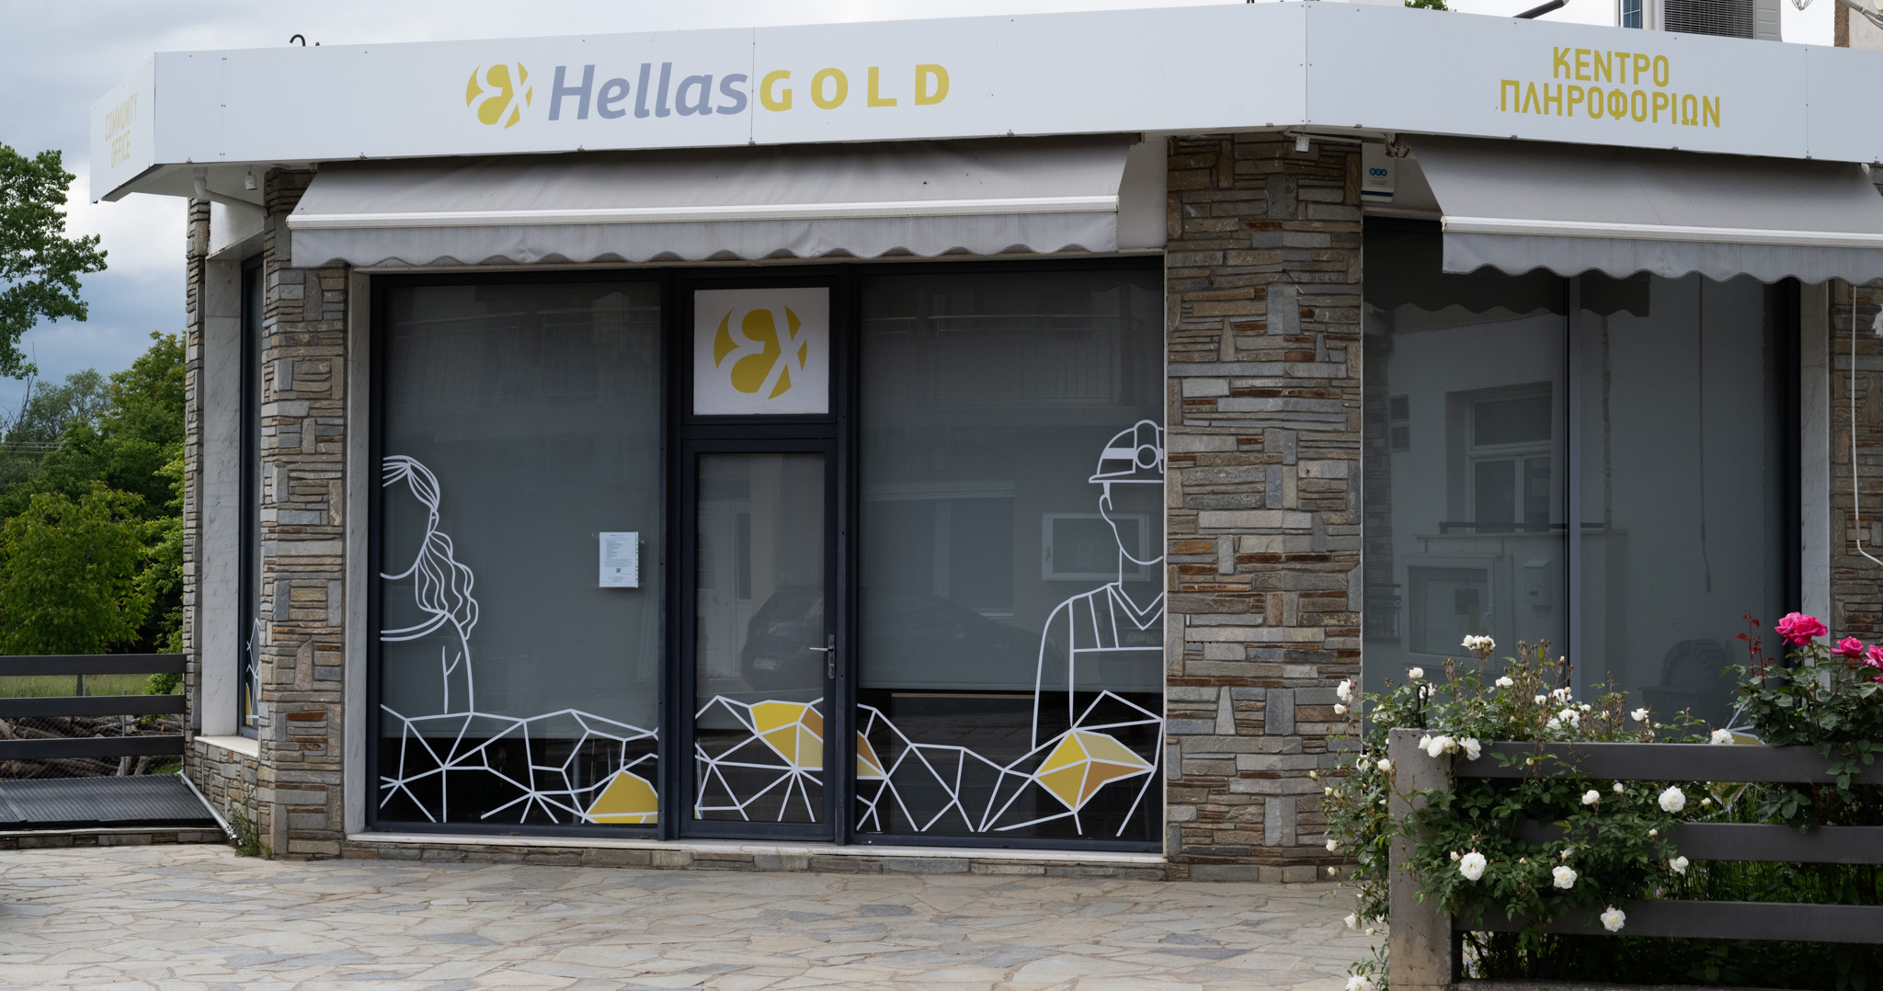
Public Consultation of Environmental & Social Impact Assessment
Comprehensive Environmental & Social Impacts Assessment
12 open events in the community
Presentation of the Environmental and Social Impact Assessment Study
Received and addressed questions & concerns of the local community
Notes:
Transparency is a cornerstone of building public trust in the mining sector. One of the key practices is conducting Environmental & Social Impact Assessments, which allow us to evaluate potential effects on the environment and local communities before projects begin. Sharing our plans & mitigations with the public is essential for fostering informed discussions. The extensive ESIA consultation that took place a couple of years ago is a strong example of such kind of engagements.
Additionally, developing Management Plans help outline how we will mitigate any potential impacts identified during assessments.

Slide 6





Creating lasting positive impacts for the communities
Community investments Strategic Pillars
1
2
3
Support the development of the local economy
Contribute to capacity building on gender equality & inclusion in the local communities
Support community environmental resilience (focus on climate change adaptation)
4
5
Support educational opportunities for youth in the local communities
Support sustainable primary healthcare network and social support for vulnerable groups
Front-loaded USD 80 million Community Investment Programme
4
Notes:
We prioritize projects and initiatives that bring long-term positive impacts, emphasizing our area of influence and aligned with our values and strategic pillars.

Slide 7
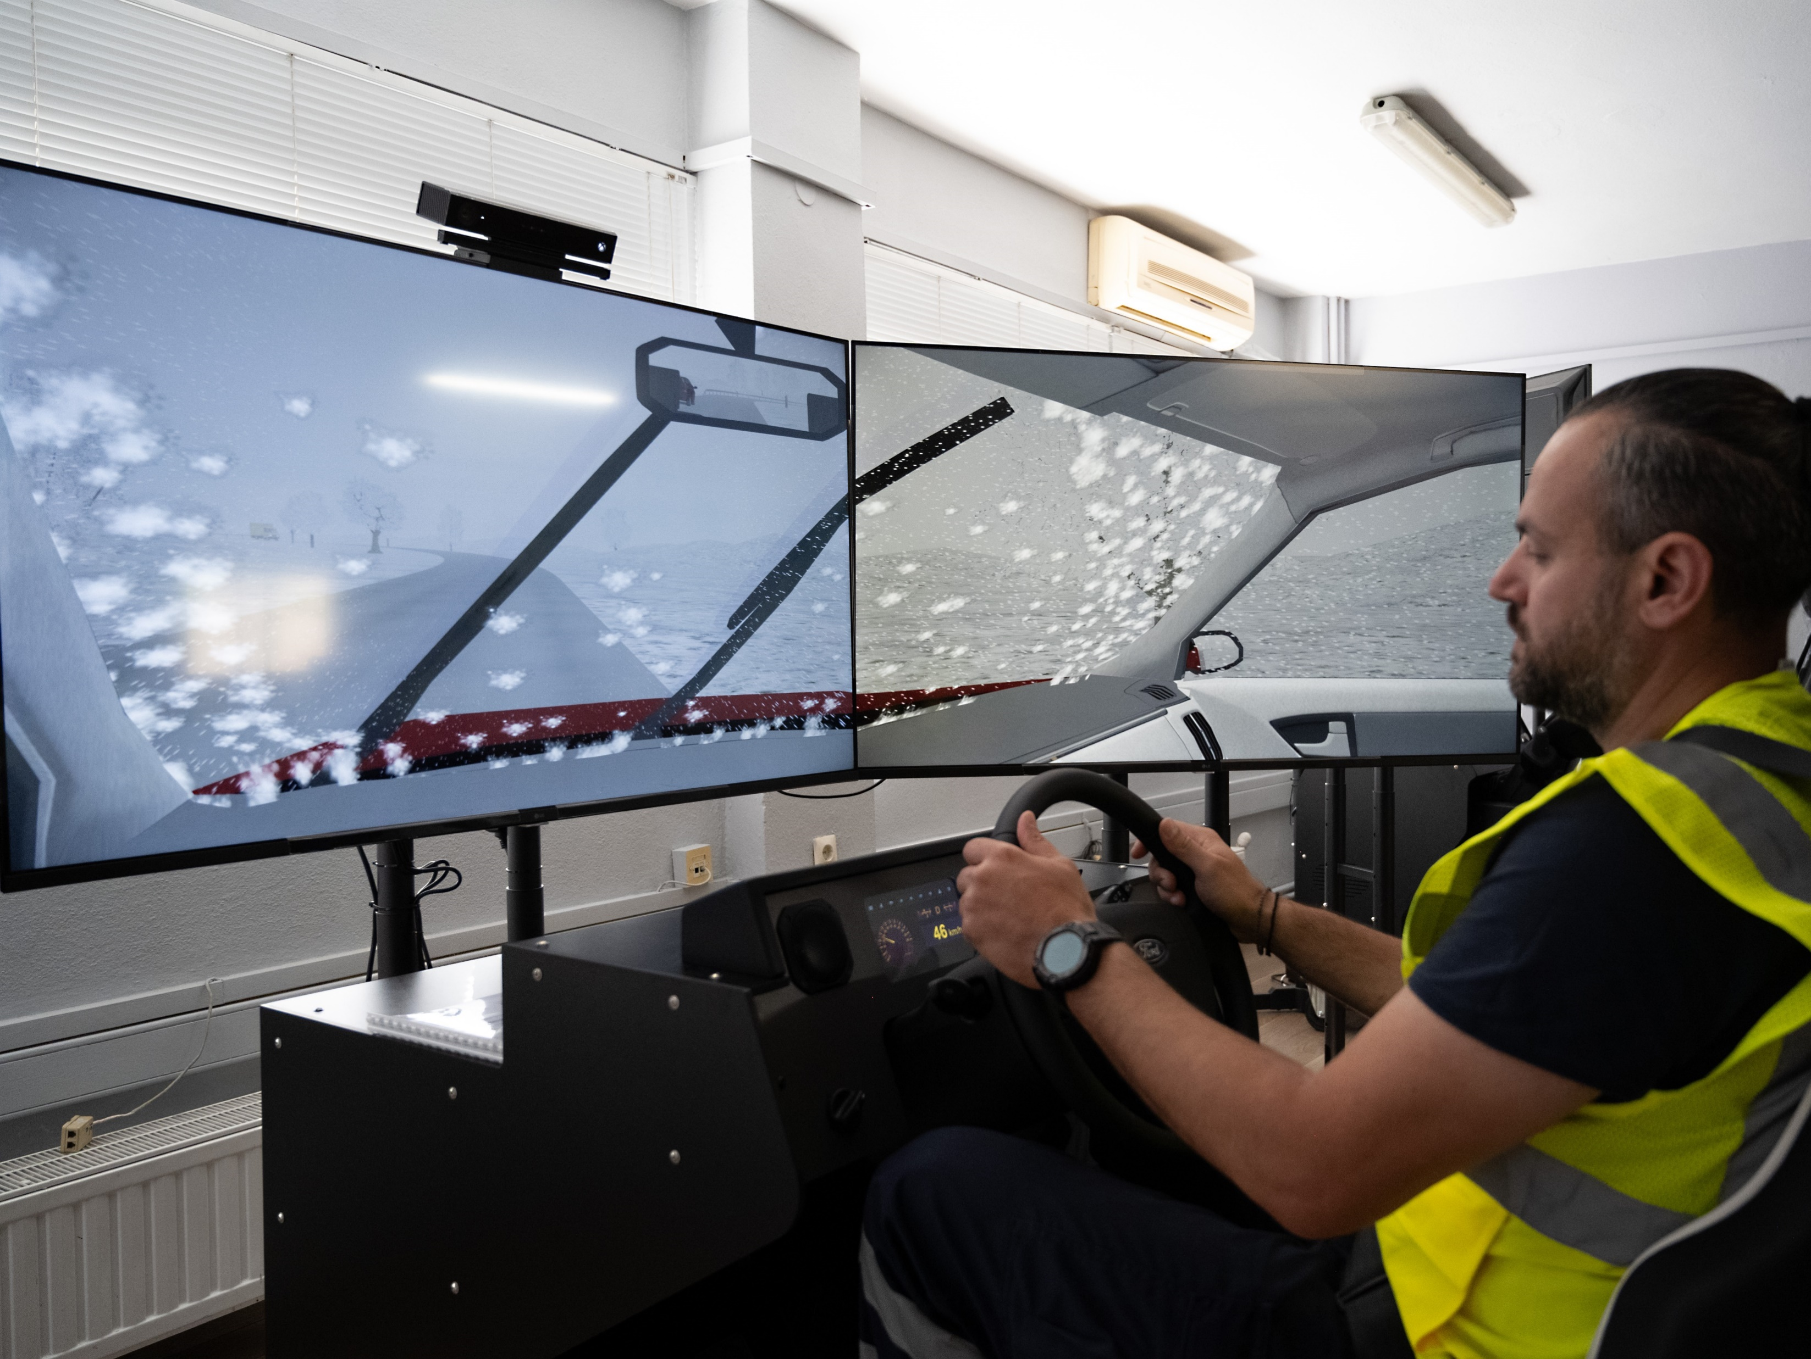
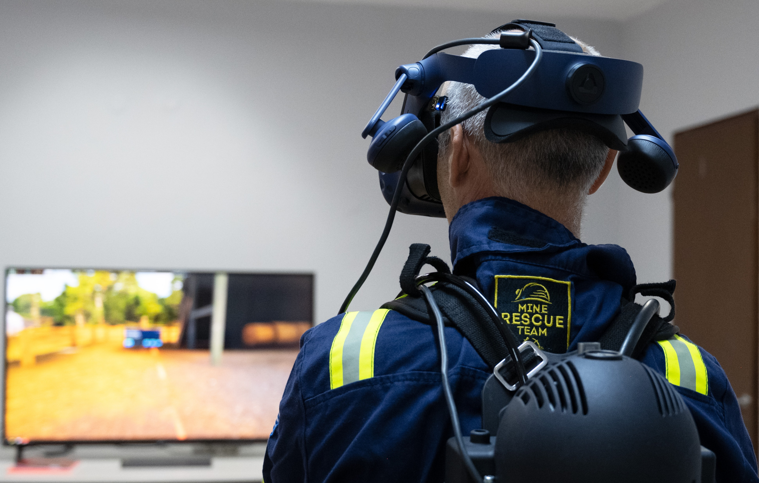
Skills & Community Capacity Development
Training Programs and Skill Building
Long-term Economic Benefits
Community Training Centre
Adapting to evolving needs
Notes:
Finally, education and skill development are critical components of our commitment to sustainable mining. We offer training programs aimed at equipping the local workforce with skills relevant to the mining industry, thereby enhancing employment opportunities within the community. We have established a modern Technical Training Center purposed to upskill and reskill our workforce and community members so that they will be qualified to work for our projects now and in the future.

Slide 8
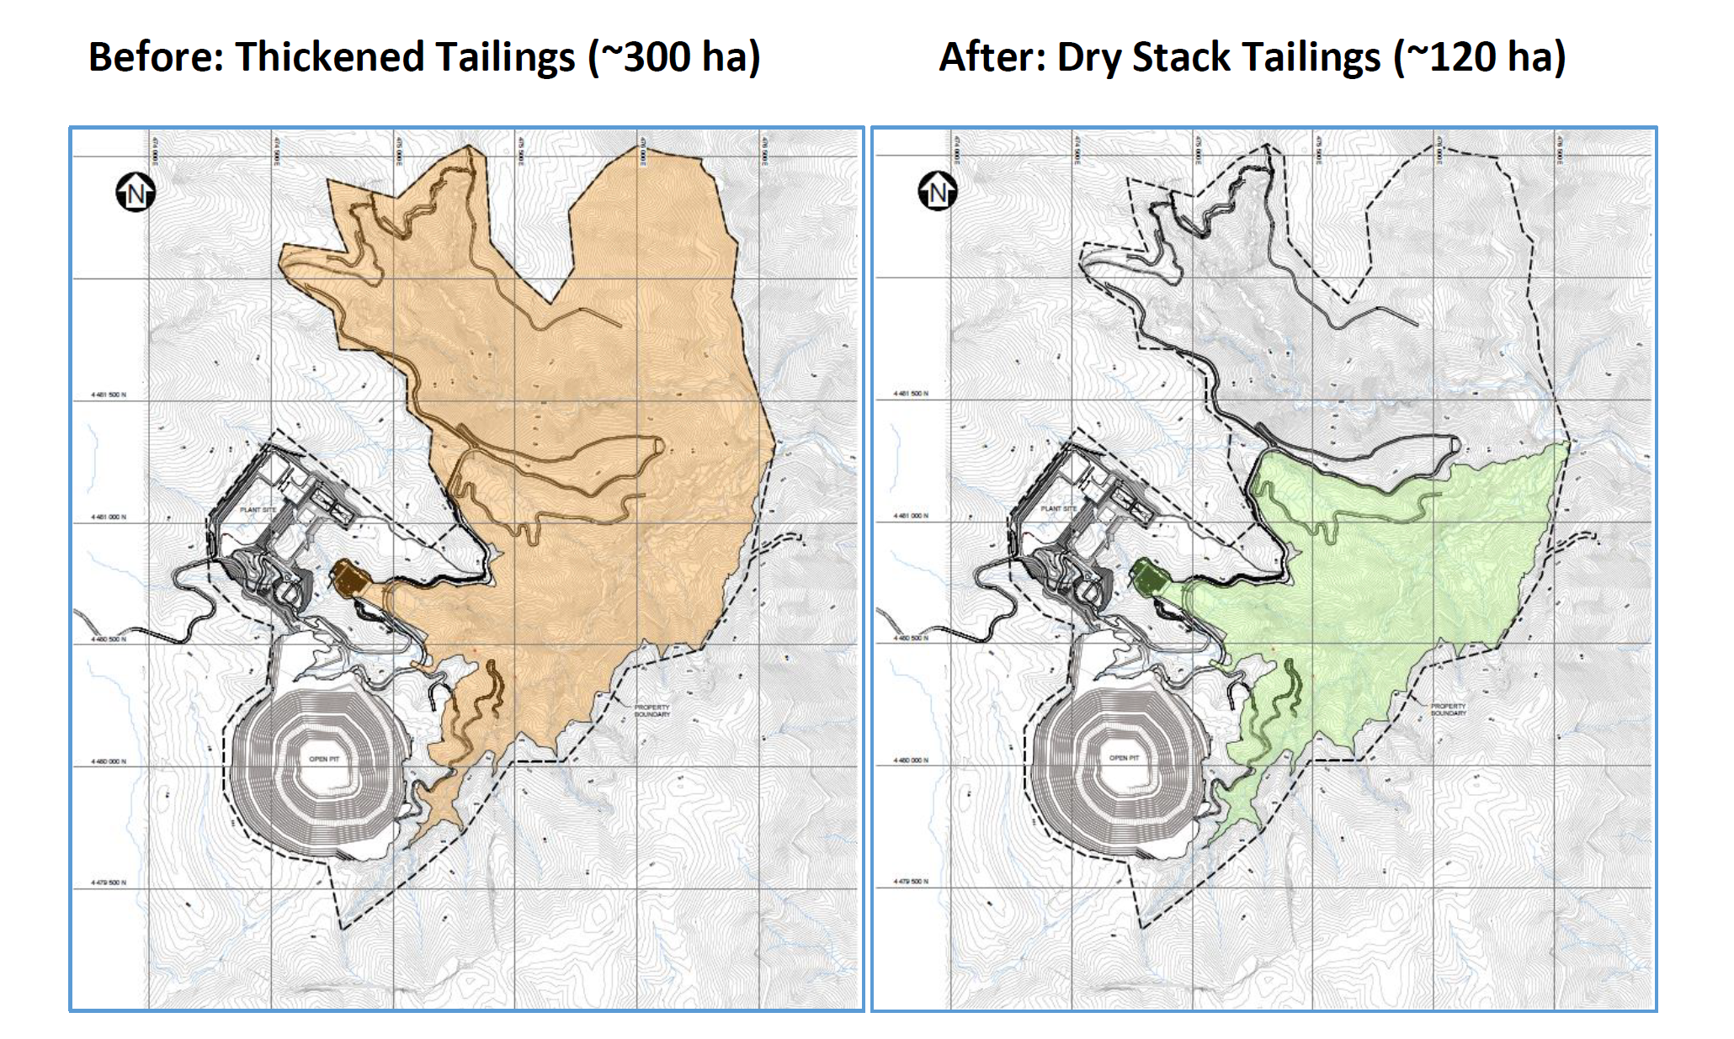
Innovative Environmental Practices & Biodiversity Protection
Dry-stack tailings management
Notes:
Innovative environmental practices are essential for minimizing our environmental footprint. This includes leveraging technology to manage waste and enhance resource efficiency throughout our operations. Additionally, we prioritize the rehabilitation of mined land (Olympias clean-up of 4mil. tonnes from past tailings) using native species to restore ecosystems effectively (example of our nursery with 1 mil. local plants).
At the same time we are operating one of the most extensive environmental monitoring programs in the country, with 500 stations inside and around our facilities to measure the status of the environment in 13 different parameters, ie. Water, dust, noise, vibration, biodiversity, etc.

Slide 9
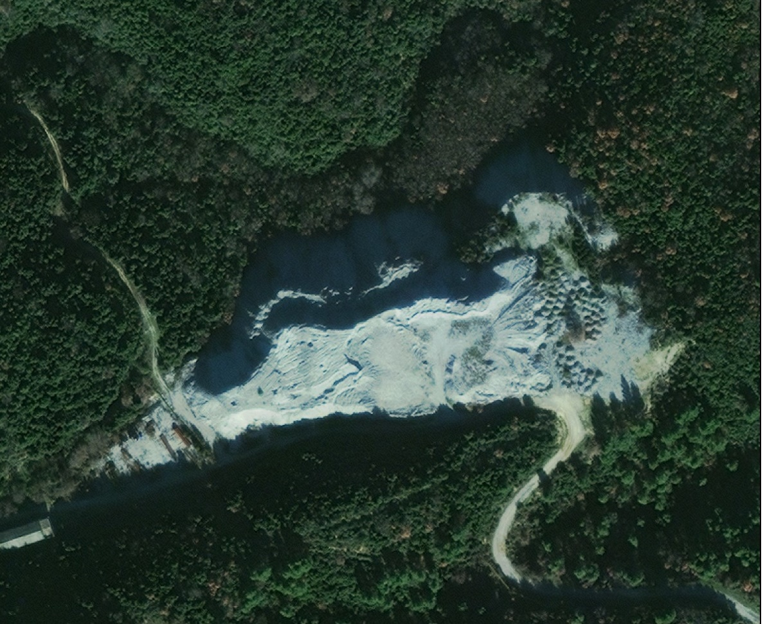
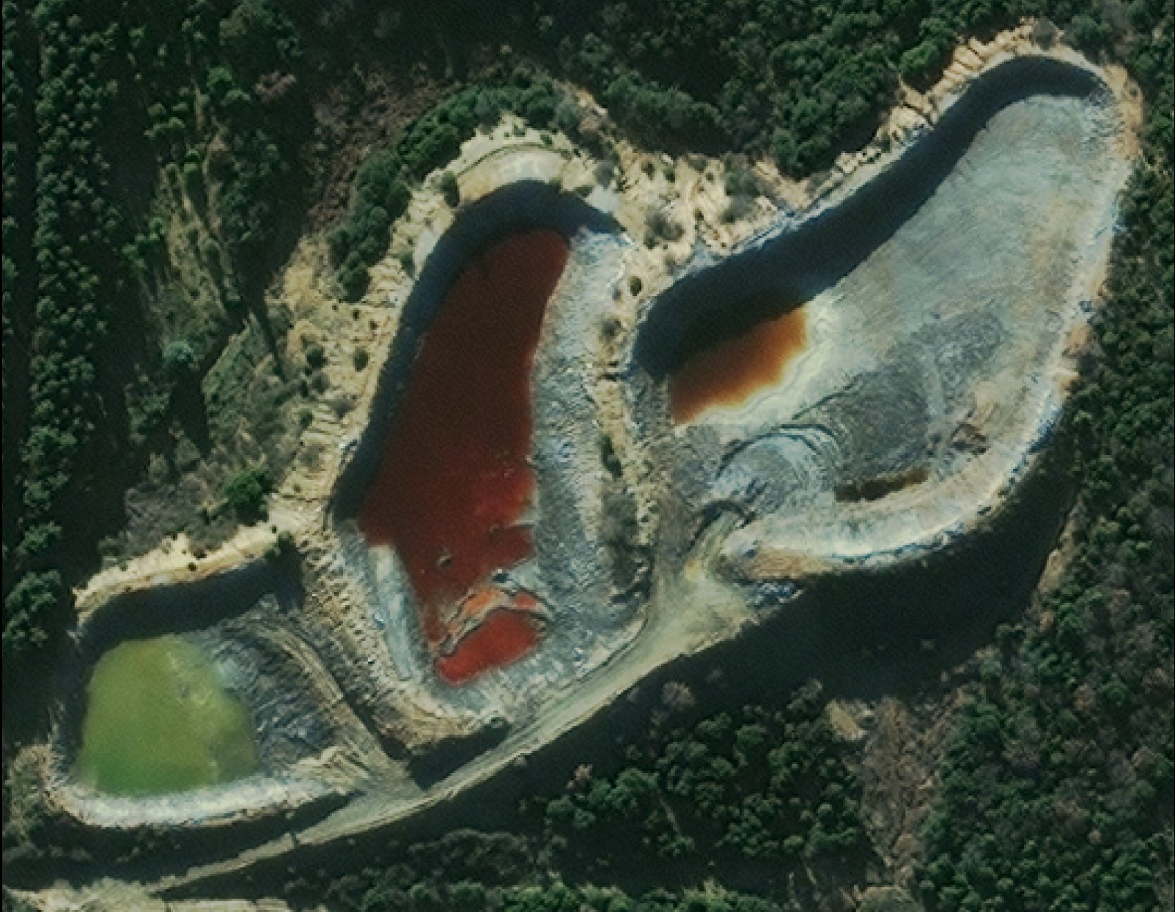
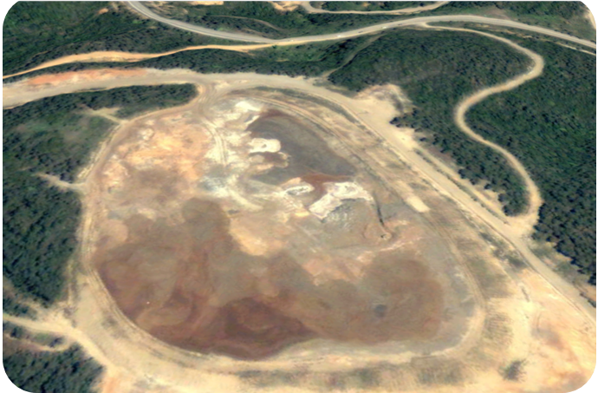
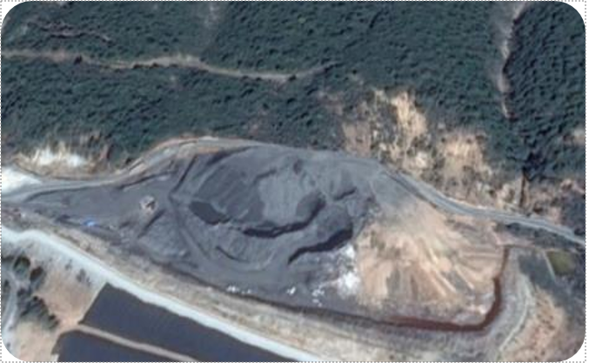
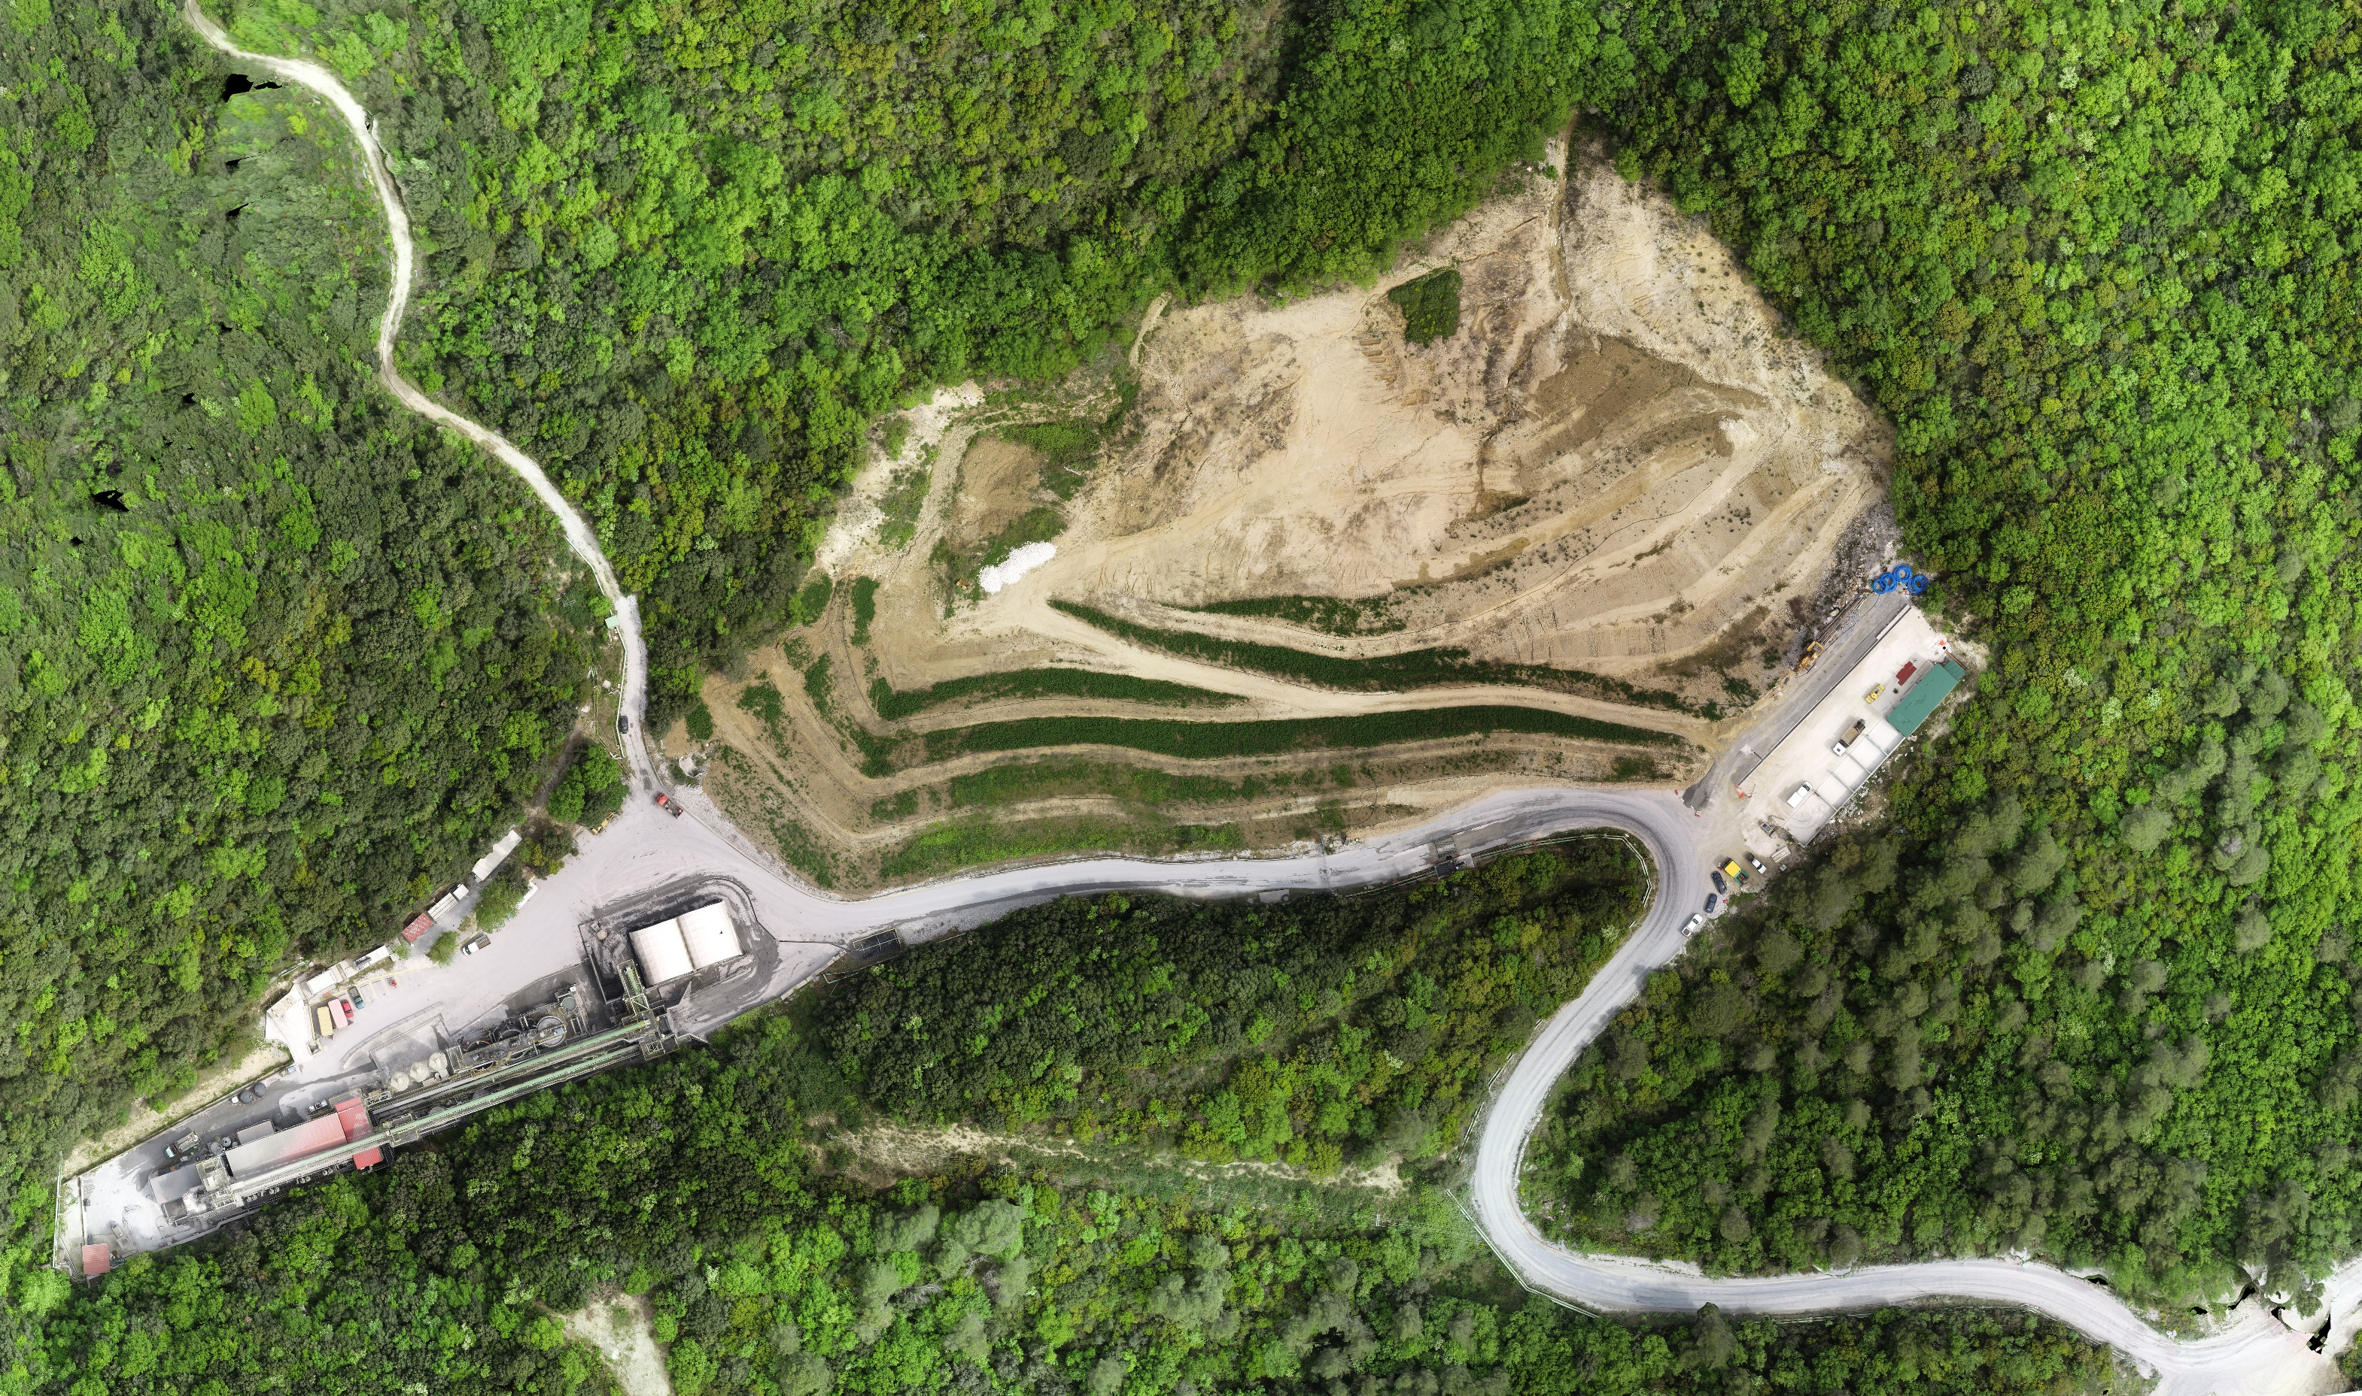
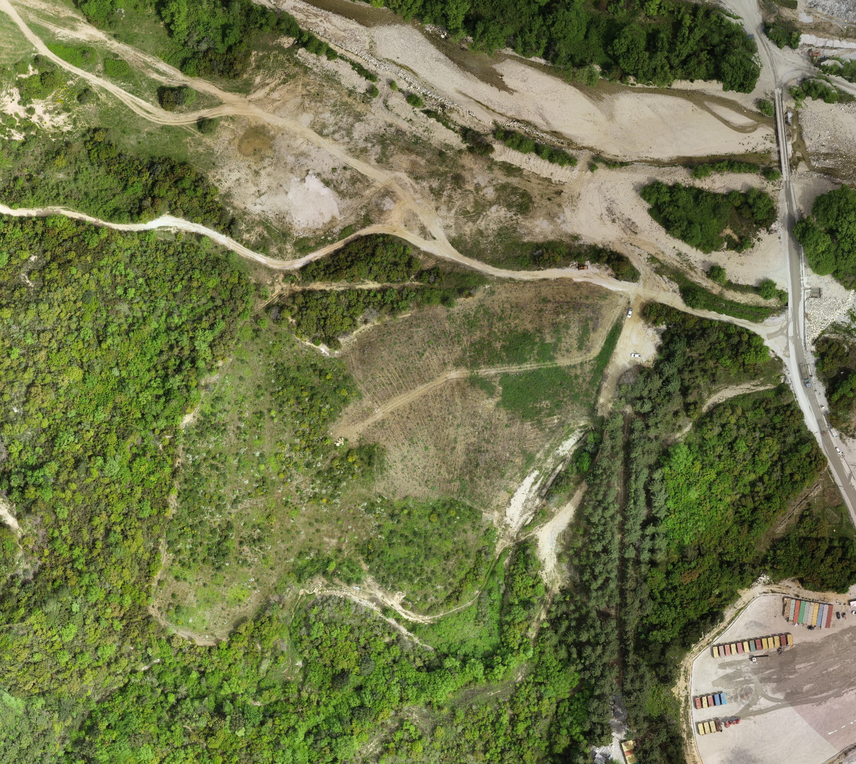
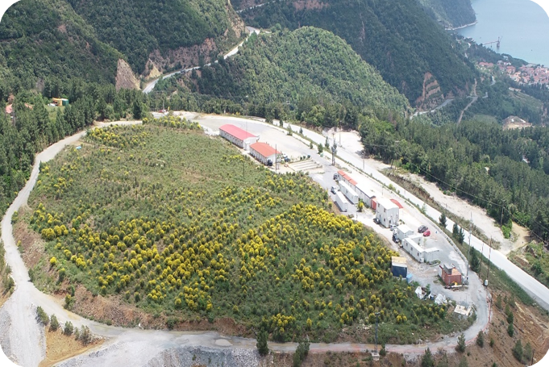
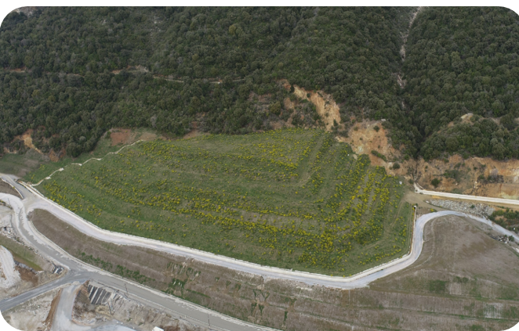
Innovative Environmental Practices & Biodiversity Protection
Dry-stack tailings management
Reclamation of legacy mine sites
Αποκατάσταση παλαιού χώρου απόθεσης στείρων μεταλλείου Πλατείας Φιρέ (28 στρ.)
Αποκατάσταση παλαιών σωρών αρσενοπυρίτη Ολυμπιάδας (32 στρ.)
Παλαιός χώρος απόθεσης στείρων – Πριν (2005)
Παλαιοί σωροί αρσενοπυριτών – Πριν (2005)
Εργασίες αποκατάστασης σε εξέλιξη (Απρίλιος 2023)
Μετά την ολοκλήρωση της αποκατάστασης (Απρίλιος 2023)
Παλαιός χώρος απόθεσης αποβλήτων Καρακόλι (Στρατώνι) - Πριν (2014)
Ανάχωμα Σεβαλιέ Μαντέμ Λάκκος (Στρατώνι) – Πριν (2014)
Απομάκρυνση 500.000 τόνων αρσενοπυρίτη & επιβαρυμένων εδαφών και αποκατάσταση του αρχικού αναγλύφου με εδαφοκάλυψη και εγκατάσταση της βλάστησης
Απομάκρυνση και επαναχρησιμοποίηση 500.000 τόνων παλαιών στείρων μεταλλείου ως υλικό κατασκευής του χώρου απόθεσης Κοκκινόλακκα
Μετά την ολοκλήρωση της αποκατάστασης (2022)
Μετά την ολοκλήρωση της αποκατάστασης (2023)
Notes:
Innovative environmental practices are essential for minimizing our environmental footprint. This includes leveraging technology to manage waste and enhance resource efficiency throughout our operations. Additionally, we prioritize the rehabilitation of mined land (Olympias clean-up of 4mil. tonnes from past tailings) using native species to restore ecosystems effectively (example of our nursery with 1 mil. local plants).
At the same time we are operating one of the most extensive environmental monitoring programs in the country, with 500 stations inside and around our facilities to measure the status of the environment in 13 different parameters, ie. Water, dust, noise, vibration, biodiversity, etc.

Slide 10
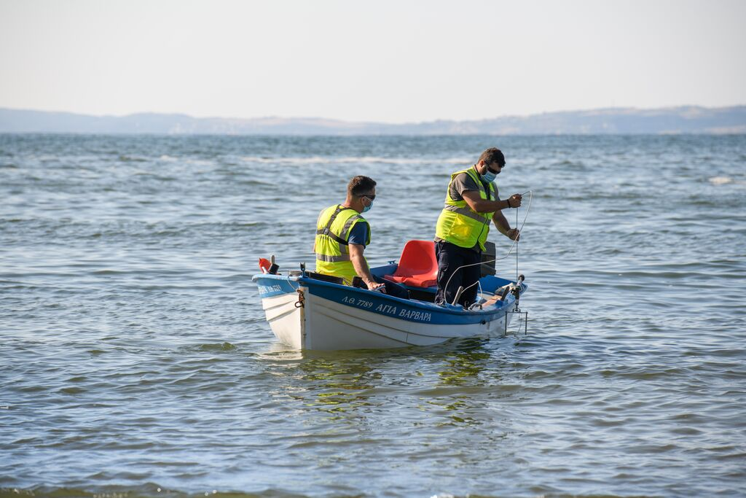
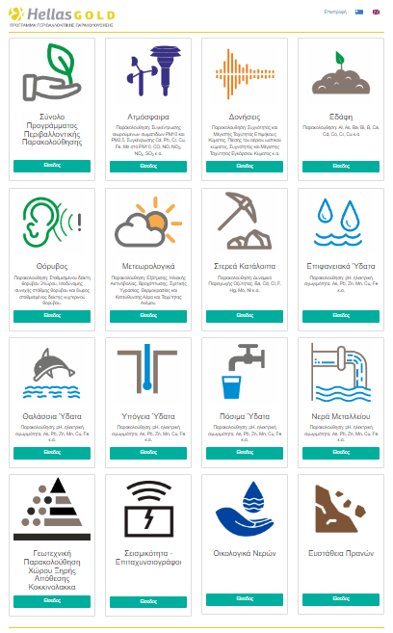
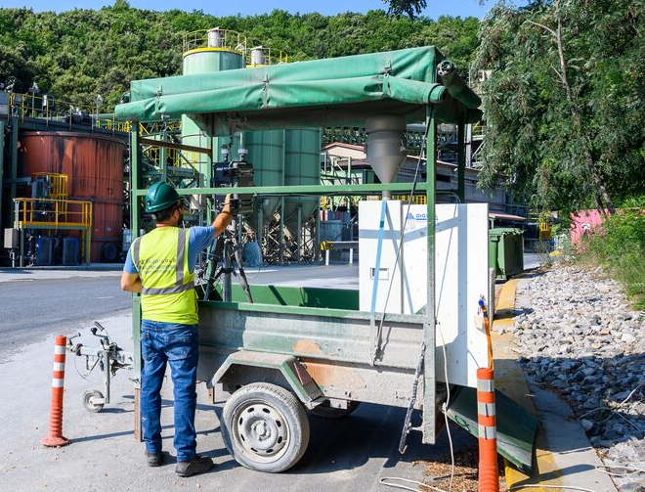
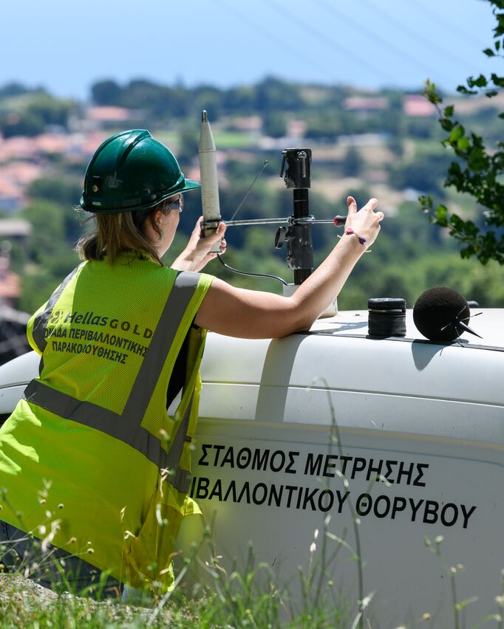
Innovative Environmental Practices & Biodiversity Protection
Dry-stack tailings management
Reclamation of legacy mine sites
Advanced Environmental monitoring systems
Notes:
Innovative environmental practices are essential for minimizing our environmental footprint. This includes leveraging technology to manage waste and enhance resource efficiency throughout our operations. Additionally, we prioritize the rehabilitation of mined land (Olympias clean-up of 4mil. tonnes from past tailings) using native species to restore ecosystems effectively (example of our nursery with 1 mil. local plants).
At the same time we are operating one of the most extensive environmental monitoring programs in the country, with 500 stations inside and around our facilities to measure the status of the environment in 13 different parameters, ie. Water, dust, noise, vibration, biodiversity, etc.

Slide 11
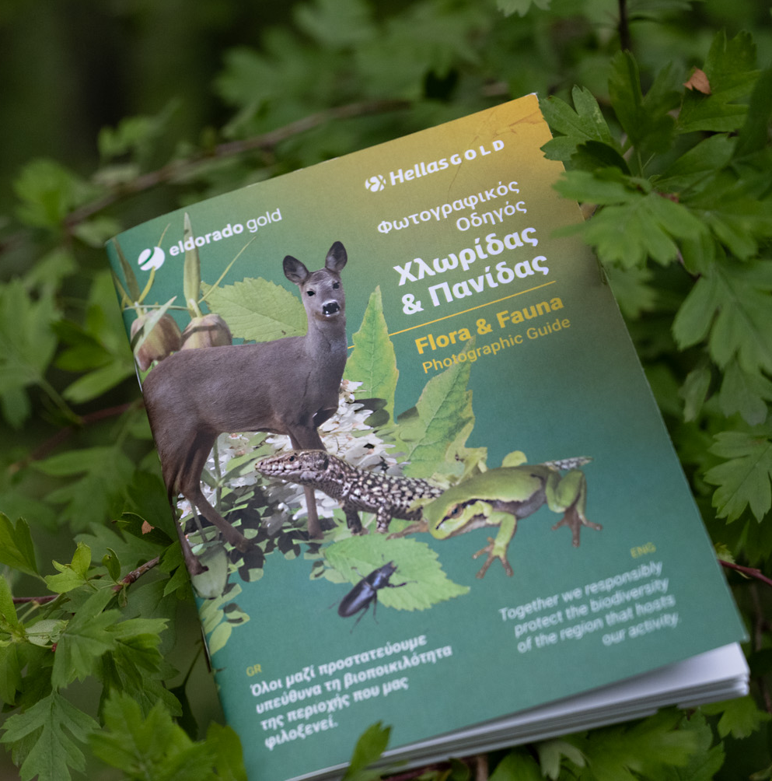
Innovative Environmental Practices & Biodiversity Protection
Comprehensive Biodiversity Management Plan
Detailed ecosystem mapping and assessment
Biodiversity Offset strategy and Plan
Continuous monitoring and reporting
Notes:
Biodiversity protection is integral to our approach; we conduct thorough biodiversity assessments under the Environmental Impact Assessment process and implement conservation programs in collaboration with local communities. This ensures that we not only comply with regulations but also contribute positively to the ecosystems we impact.

Slide 12
Mathieu Vallart
Sustainability Director, Greece

Slide 13

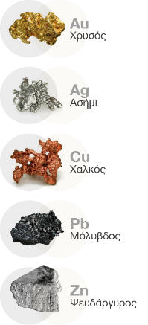
About Hellas Gold
The Company
100% subsidiary of Eldorado Gold, headquart in Athens, Greece Operating in the Northeast Halkidiki region since 2004
We produce: gold, silver, lead and zinc (copper in the near future when Skouries enters commercial production)
Established operator with 20 years of history that has reclaimed a social license to operate, and has a meticulously planned transformation agenda and a strategy to be the growth engine for Eldorado
Olympias mine facilities
Port & Warehousing
Facilities at
Stratoni
Skouries Project
Sustainability Performance
SKOURIES PROJECT
PROJECT CONSTRUCTION PROGRESS
79%
OLYMPIAS
MODERNIZED POLYMETALLIC UNDERGROUND MINE (in operation)
MAVRES PETRES - STRATONI
MINE IN CARE & MAINTENANCE
Further exploration in progress
Successful history in rehabilitation (“principle of parallel rehabilitation”)
500 environmental checkpoints under the company’s comprehensive Environmental Monitoring System
State-of-the-art tailings management facility (Kokkinolakkas) employing dry stacking, the most sustainable tailings deposition method available

Slide 14

CREATING VALUE FOR THE LOCAL COMMUNITIES
By prioritizing CSR actions that benefit local communities, Hellas Gold demonstrates its commitment to sustainable development, fostering positive relationships, improving the quality of life for residents, and ensuring long-term mutual prosperity in the operating regions.
2021-2024
More than 500 total Community Investment projects & activities
> €5,5 million total Investment, of which
€4,4 million invested in the Aristotle Municipality

Slide 15

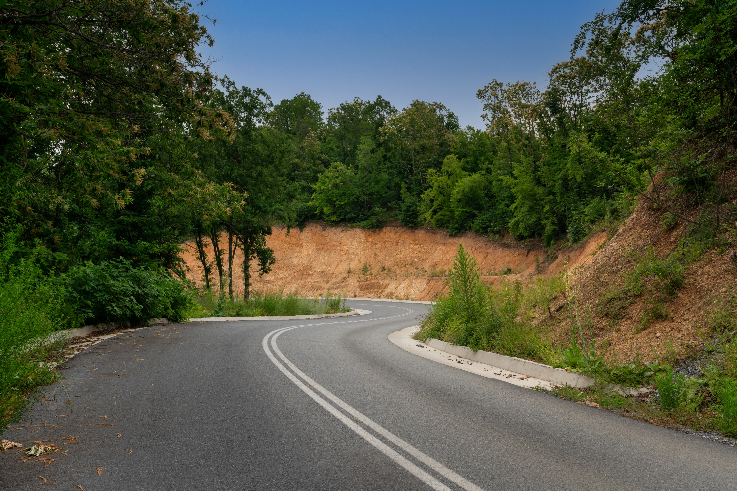
MINING ROYALTIES FOR 2021, 2022 & 2023
 | Total Mining Royalties to the Greek Government* | Hellas Gold royalties to the Greek Government (percentage)** | Royalties to Aristotle Municipality (percentage)***
2021 | 12.230.000 € | 6.732.125,60 € | 2.414.981,29 € (40%)
2022 | 15.460.000 € | 8.766.754,87 € | 3.506.692 € (40%)
2023 | Not published yet | 12.755.241 € | 5.102.096 € (40%)
*According to the Ministry’s annual reports.
**According to the New Investment Agreement the mining royalties paid to the Greek State are increased by 10% on contented metal not on payable.
***The percentage of total royalties that is transferred to Aristotle Municipality has been doubled (from 20% to 40%).

