Slide 1
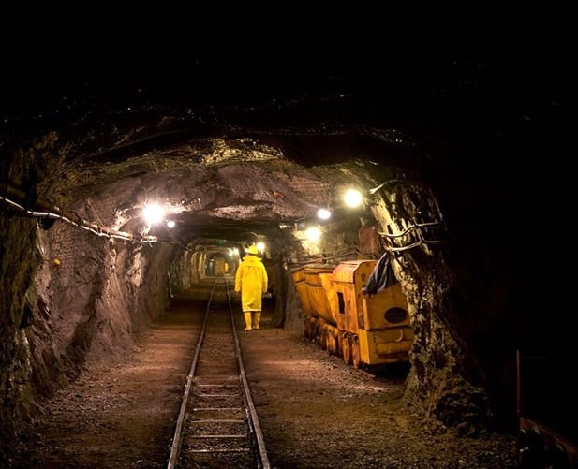
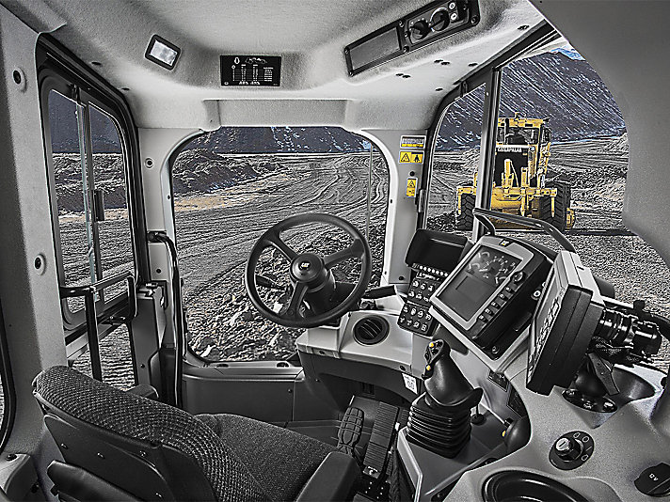
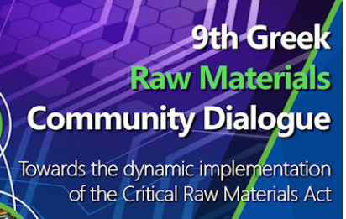
Social license to operate. - From whom? - For whom?
K. Yazitzoglou, Chairman
Greek Mining Enterprises
Association

Slide 2
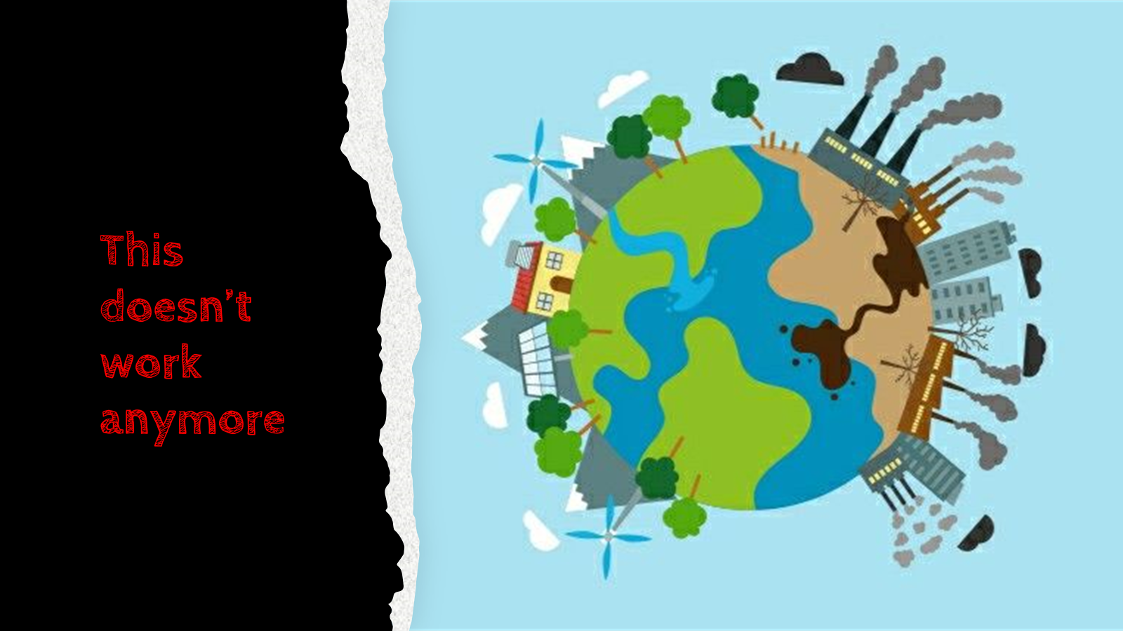

Slide 3
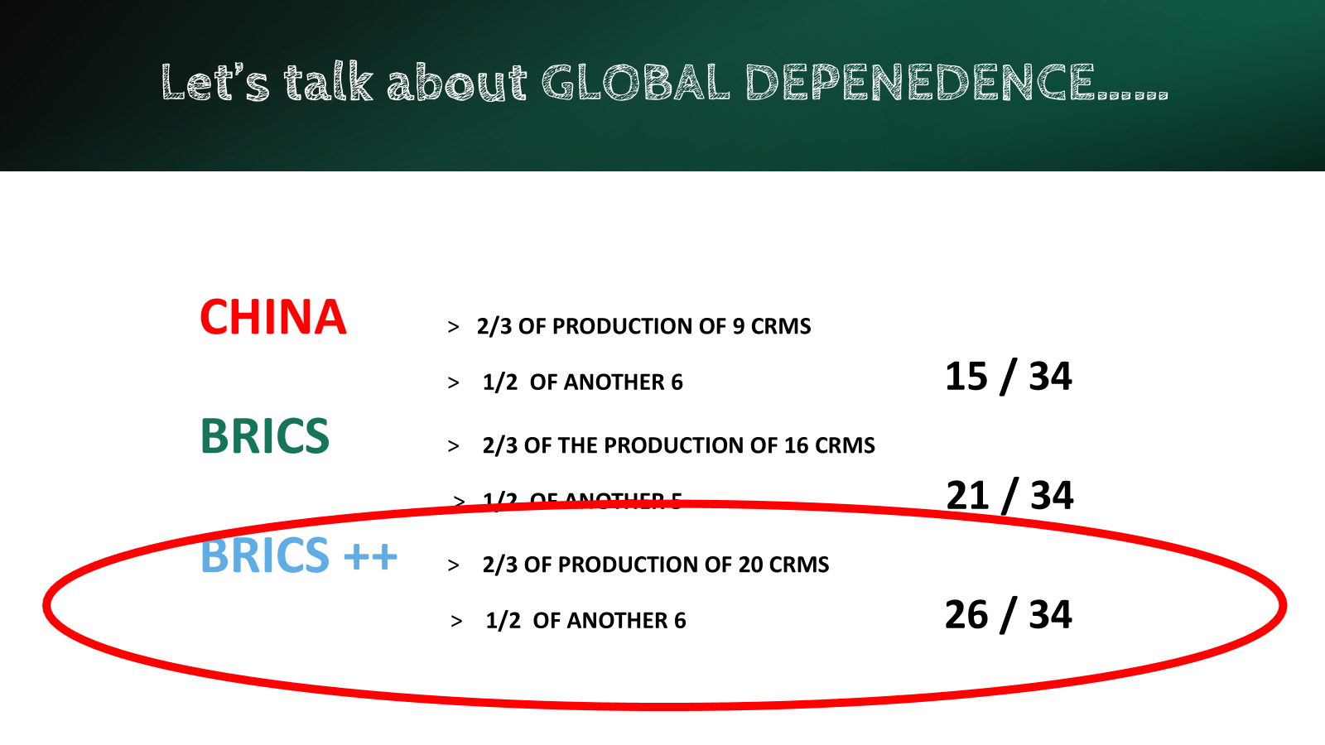

Slide 4
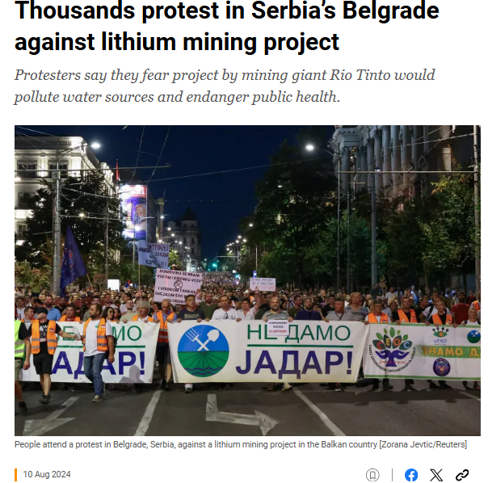
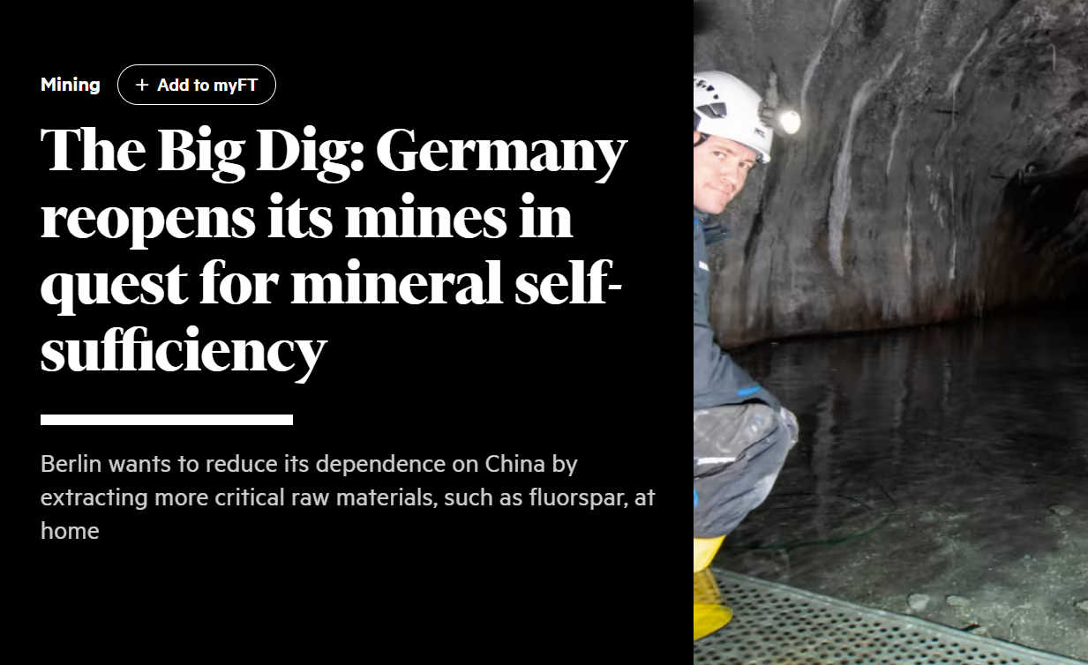
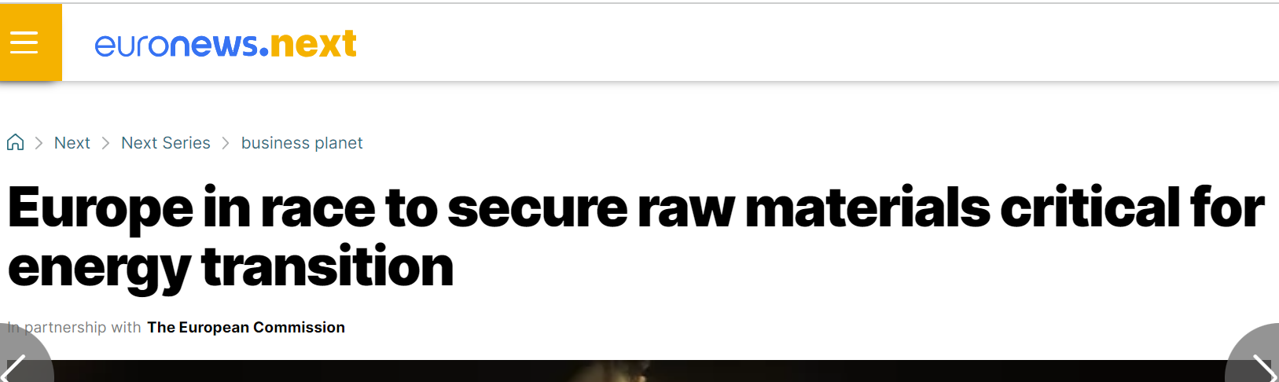
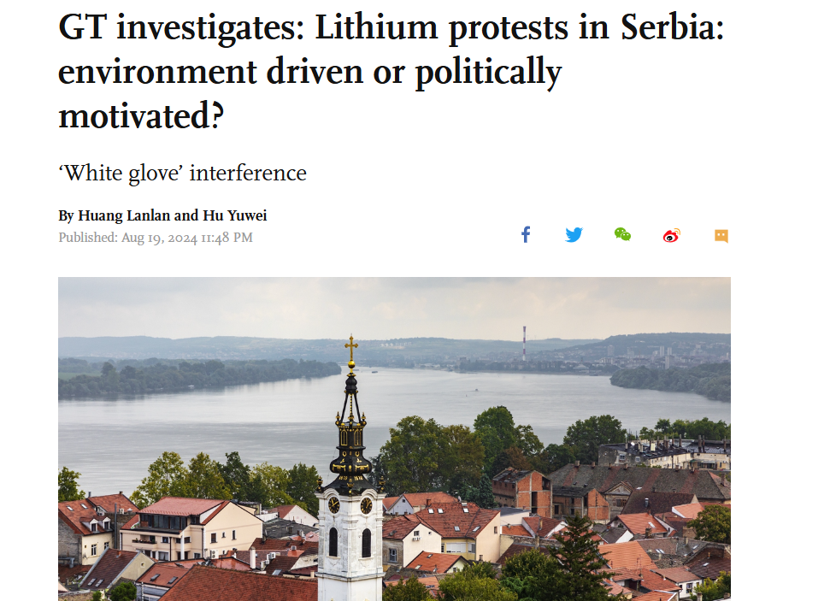
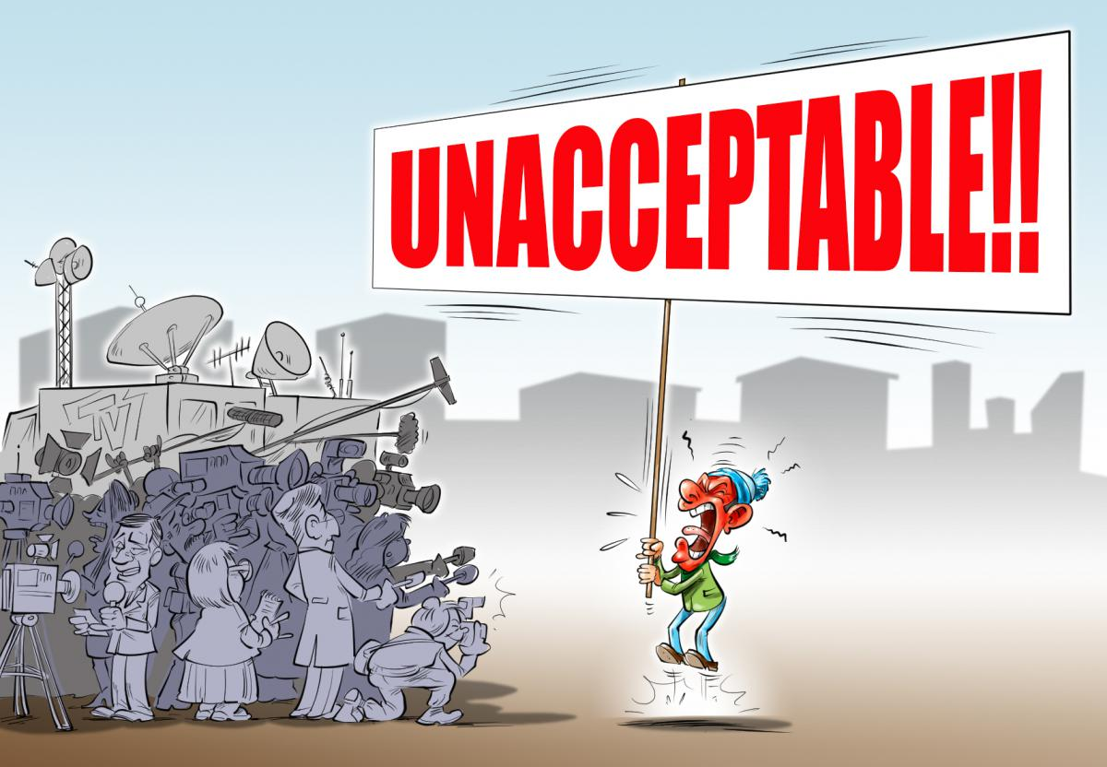

Slide 5
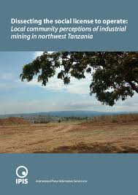
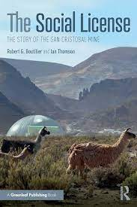

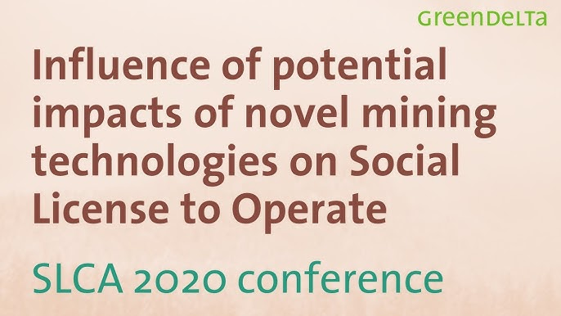

Slide 6
If you don’t agree about the definition, there is no point in discussing the topic.

Slide 7
Definitions of SLO
the perceptions of local stakeholders that a project, a company, or an industry that operates in a given area or region is socially acceptable or legitimate.
A social license is an agreement between a business and its stakeholders and the wider public
The social license requires any business to ensure its activities respect the rights of all those in any community.

Slide 8
Terminology – what do we mean…..
SOCIAL LICENCE TO OPERATE
I will ask the questions. You can answer them or ignore them, but you can’t say you have never considered them!

Slide 9
Social
Which part of the society
The whole of the local society or a part – which part
How many km in radius from the project
Represented by whom and how
Elected representatives
Ad hoc organization – which decision form
What about the “rest” of the society
Those who might benefit from the operation
Those who need the certain operation

Slide 10
License
A license is given following a specific process
What is the process
Who confirms that it is followed
How can it be changed if deemed wrong
A license cannot be denied or revoked unless there is a breach of specific rules
What are these rules

Slide 11
To operate …
To operate in a society, one must do it within a specific framework. Is the proposed framework for the SLO
the same as the legal one
another one – and which?
Which operations are falling under the SLO?
All of them
some of them – by what criteria

Slide 12
Social license to operate
Is a license given by an undefined authority
It is a license given through an arbitrary process
It applies to an operation for which the rules must be to the liking of the undefined authority

Slide 13
SLO involves a “conflict”
 | By a “professional” provocateur | Spontaneously
By an “incident”
By a project

Slide 14
If the worries of people are ..
Spontaneous
Concerning things (technology, processes, materials) that they are not expected to know
Enhanced by our natural risk aversion for a potentially negative outcome.

Slide 15
Then it is OUR DUTY to ….
Address the matter with full transparency, offering all necessary information
Listen and explain in plain language
Setup commonly acceptable checkpoints

Slide 16
It is also our duty, as a society, to ….
Educate people not only about the need for raw materials but also about the available technologies for sustainable and safe mining.
Ascertain that the laws are there for everybody and will be respected.

Slide 17

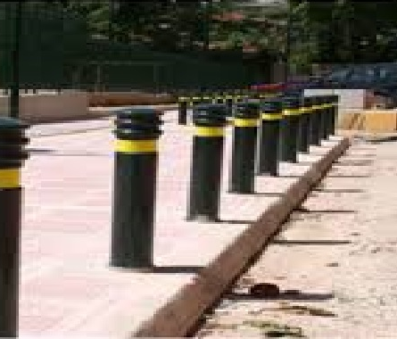
When addressing SLO don’t forget that …
if you need this…..
…….To enforce this
The “society” is right to be suspicious….

