Slide 1
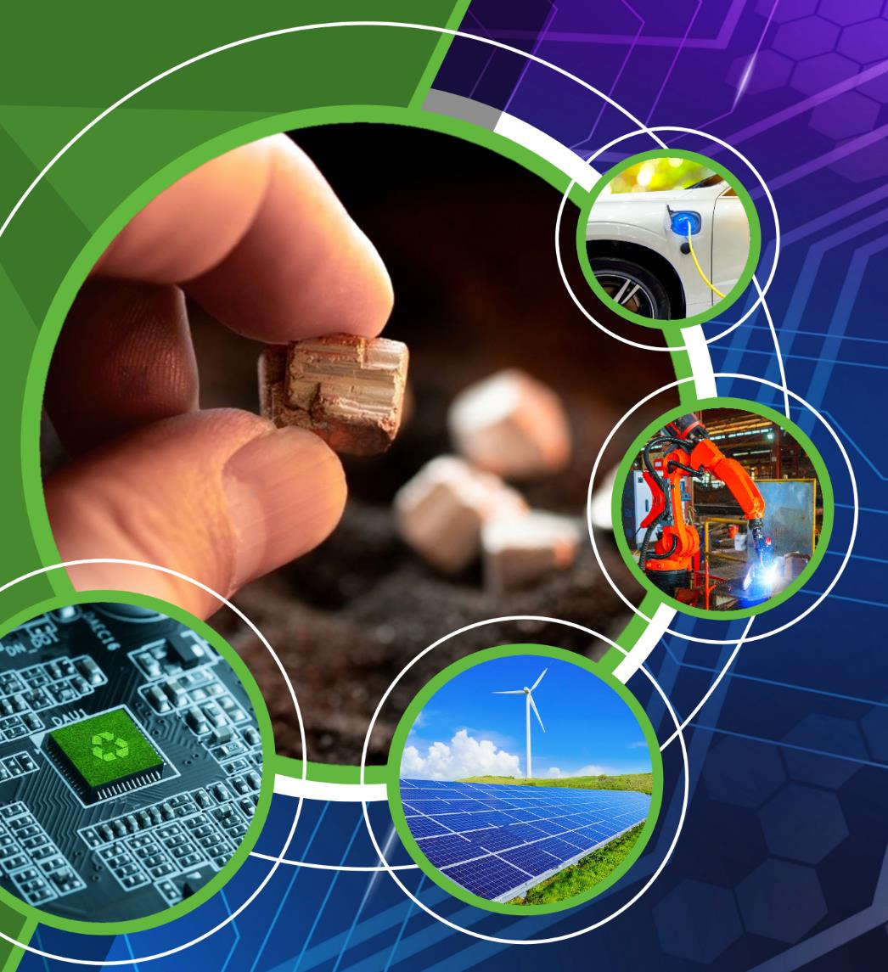
How to Cross a Valley
Efthymios Balomenos, Ass. Prof Laboratory of Metallurgy, NTUA

Slide 2
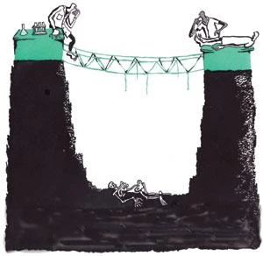
The Infamous Valley of Death…
Researchers
Industry
“We have new solutions and ideas that would revolutionize the industry”
“Don’t you care about the twin transition goals?”
They do not understand!
“Have you produced a commercial product?”
“What is the NPV of the investment?”
They don’t even have a CAPEX estimate!
….is just the Valley of miscommunication

Slide 3
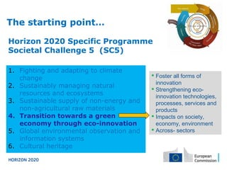

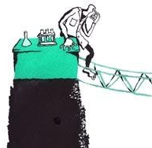
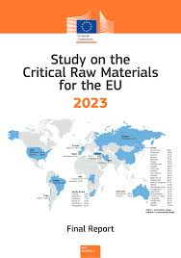
Research Side
Decarbonize metallurgy
Utilize low grade ores and industrial by-products
Near zero waste process
But most importantly
Attract funding (European, National, Private)
Sustain research teams
Achieve excellence

Slide 4
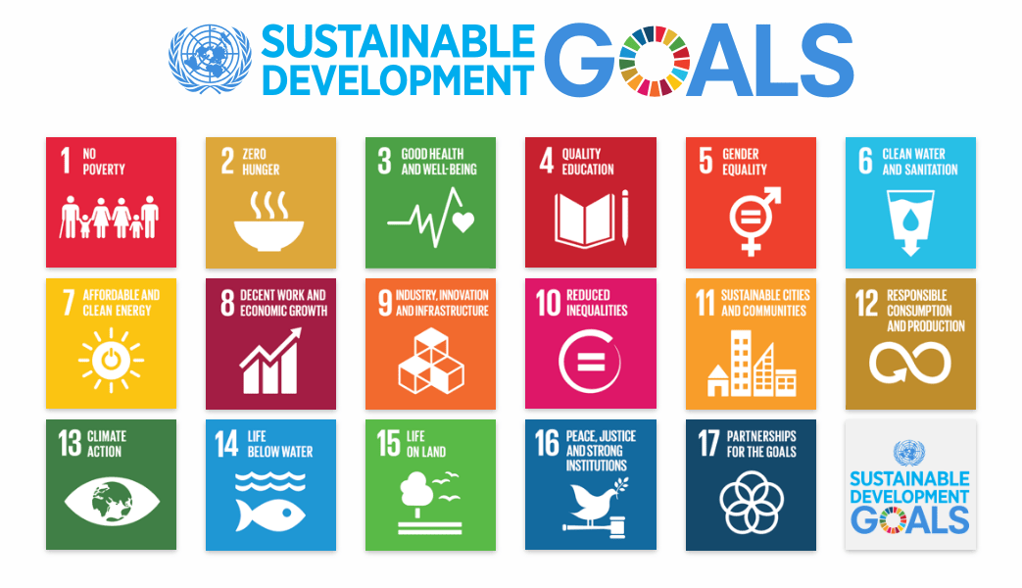
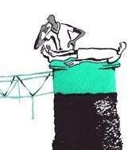
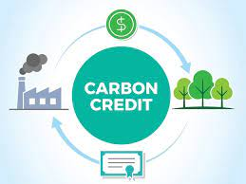
Industry Side
Reduce waste streams
Increase efficiency
Demonstrate a green and innovative portfolio to the society / market
But most importantly
Maintain or reduce production cost
Deal with every-day production problems
Achieve an incremental increase in efficiency or decrease in emissions

Slide 5

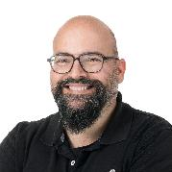

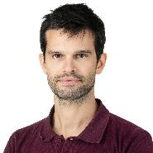
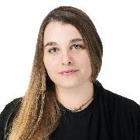

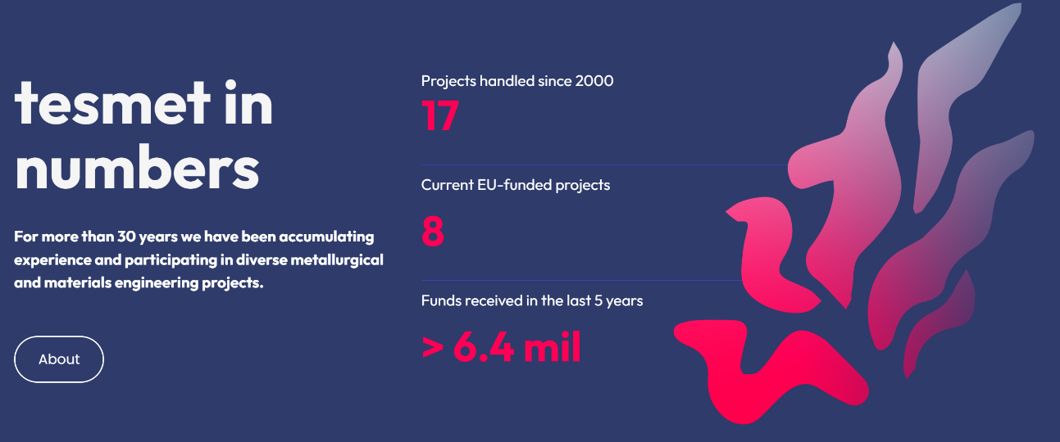



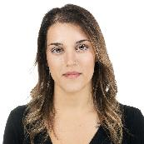
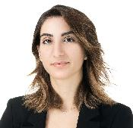
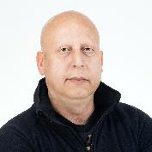



The TESMET Research group
A group within NTUA’s Laboratory of Metallurgy, headed by Prof Dimitrios Panias, with more than 15 researchers surviving exclusively from Research projects, public and private.
https://tesmet.gr/

Slide 6
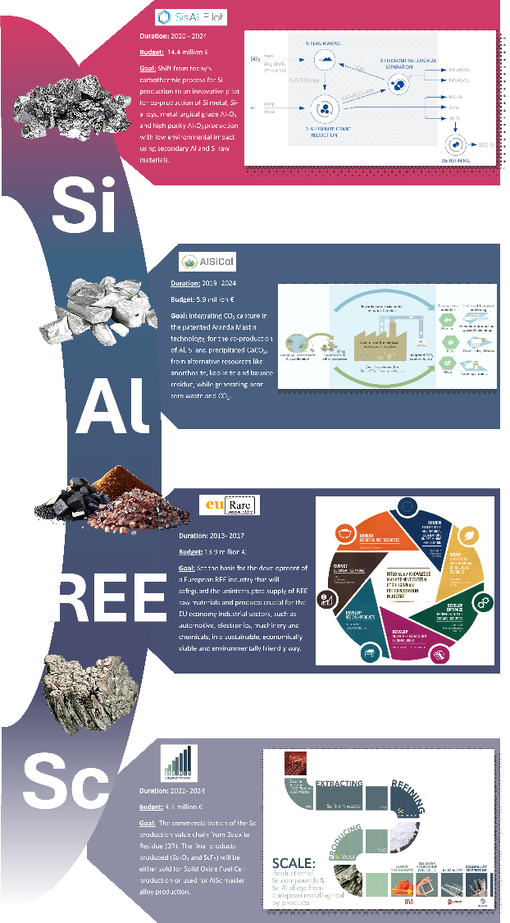
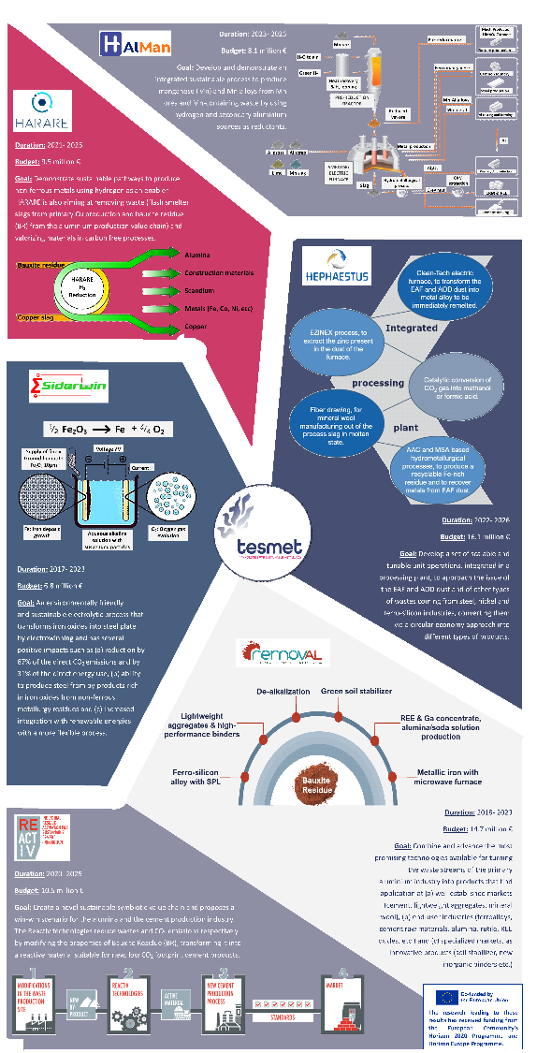
Research Side
The TESMET Research group
Novel sustainable routes for production of base metals like Fe, Al, Si and CRMs like REE, Sc, Ga and others
Decarbonization
Electrometallurgy
H2 Metallurgy
Aluminothermic reduction
Low grade ores (bauxites, Manganese, REEs)
Industrial by-product valorization like Bauxite Residue, EAF dusts, Copper slags
Metal / CRM extraction
SCM production

Slide 7
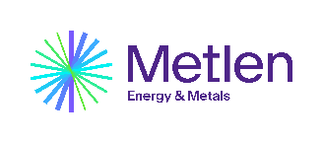
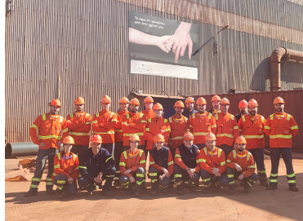
METLEN’s Industrial pilots
METLEN Energy & Metals, developed the Research and Sustainable Development Activity to perform industrial pilots for EU-funded and own projects

Slide 8
METLEN’s Industrial pilots
Technologies developed at TESMET and other labs were piloted within the premises of METLEN, producing products and reliable mass & energy data.

Slide 9
Are we out of the valley yet? - not really
TRL 7 is not an acronym for investment decision!
the next steps are :
Process Flow diagrams
Mass and Energy balance
High level equipment list
leading to:
Revenues Estimation
Product acceptance/standards
OPEX Estimation
CAPEX Estimation
Initial interest for investment
Most R&D projects do not provide such data but instead focus on LCA
Detailed Engineering
CAPEX funding opportunities
Some R&D projects will do Revenues and OPEX (internet pricing) but very few will perform a serious CAPEX study
Plant construction

Slide 10

How to cross the valley
Researchers and Industry do not often speak the same language
One must find goals that appeal to both
Build trust…
…and then build pilots!
Pilot results are only meaningful if they are translated into a feasibility study

Slide 11
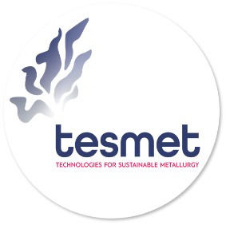

Thank you!
Efthymios Balomenos
thymis@metal.ntua.gr
Company logo placement

