Slide 1

A presentation on KAVA Call 12
Informative WebCast Event
20 December 2023
Dr. Anastasia Alexandratou, RCG Project Manager
Prof. Katerina Adam, RCG Education Advisor

Slide 2

Contents
EIT RawMaterials
KAVA Call 12 – KIC Added Value Activity
KAVA Call 12 – Call Categories
EIT RawMaterials HUB – Regional Center Greece
Q&A

Slide 3
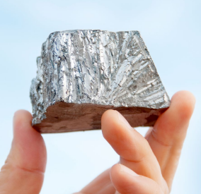

EIT RawMaterials
Innovation Communities
Vision & Mission
EIT RawMaterials in Numbers
Innovation Themes
Activities
KAVA 11 Results
Partnership
Community

Slide 4
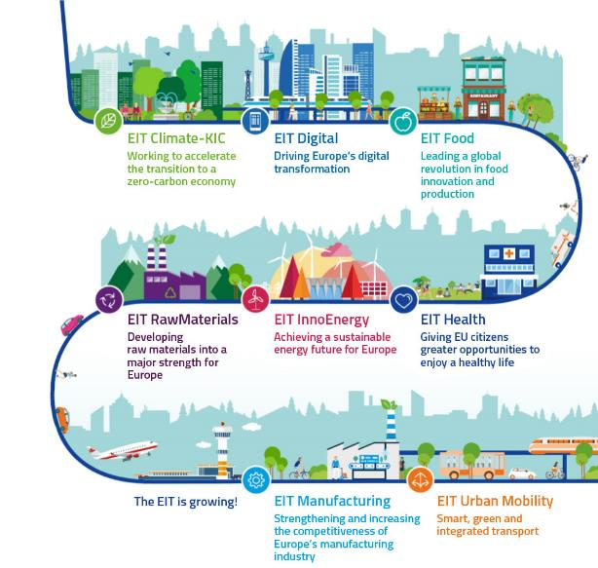
EIT Innovation Communities
Leading European initiatives that empower innovators and entrepreneurs to develop world class solutions to societal challenges and create growth and scaled jobs.
Notes:
EIT (European Institute of Innovation and Technology), is a European organization established back in 2008 and linked to Horizon Europe, the EU’s framework programme for research and innovation.
ΕΙΤ has supported the creation of 8 (soon to be more) Knowledge Innovation Communities , the so-called KICs, each one targeting a specific sector and EIT RawMaterials, to which the EIT RM HUB – RGC belongs, is one of them.
EIT innovation communities are leading European initiatives aiming to empower innovators and entrepreneurs to develop solutions targeting societal challenges and growth.
Apart from EIT RM, the other established KICs are: EIT Climate, Digital, Food, Health, InnoEnergy, Manufacturing, Urban Mobility.

Slide 5

To make the Raw Materials sector a major strength for Europe.
The Vision
To enable the sustainable competitiveness of the European minerals, metals, and materials sector across their whole value chain by driving innovation, education, and entrepreneurship.
The Mission
Notes:
Focusing on EIT RM…its vision is to make the RM sectors a significant strength in Europe and its mission is to enable the sustainable competitiveness of European minerals, metals and materials sector across their while value chain, by enhancing innovation, education and entrepreneurship.

Slide 6
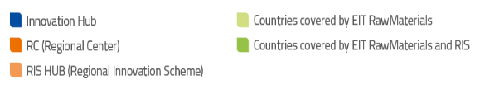
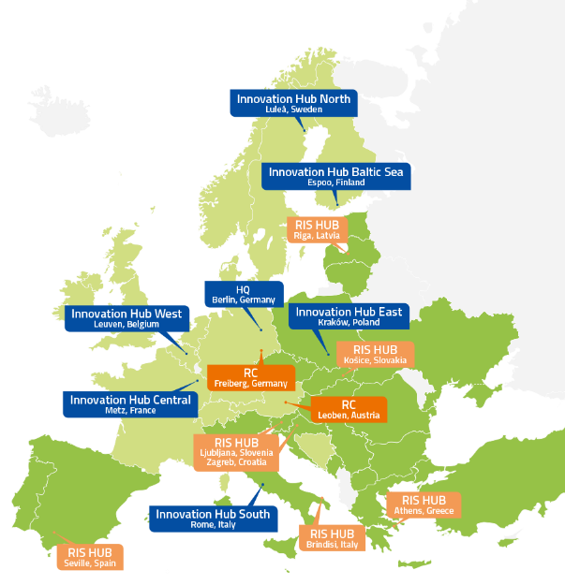
EIT RawMaterials in Numbers
World’s largest community in the Raw Μaterials sector, established in 2015
Headquarters in Berlin, Germany
Divided into 6 Co-location Centres (CLCs)
22+ countries
Over 300 partners
Over 220 innovations launched to the market
Over 600 start-ups supported (€330Κ+ investment)
Over 400 graduates from EIT-Labelled Master’s Programmes
6
Notes:
EIT RawMaterials is the world’s largest community in the RM sector, established in 2015. The heart of EIT RM beats in Berlin, although it involves more than 22 countries, over 300 partners and its activities have contributed to more than 220 innovation solutions launched to the market, to the support of more than 600 start-ups and 400 graduates from EIT-labelled master’s programmes. The EIT RM community is divided into 6 Co-Location Centers, in Sweden, Finland, Poland, Belgium, France and Italy, with the Greek Hub belonging to the East CLC. The established CLCs are in constant communication and cooperation with the regional hubs, aiming to outreach the local RM network.

Slide 7
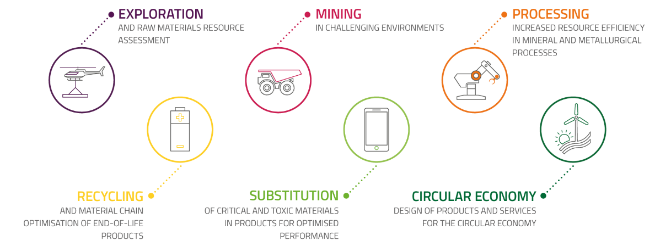
EIT RawMaterials - Innovation Themes
7
Notes:
EIT RawMaterials promotes activities with the objective to
Secure raw materials supply
Design solutions that provide innovative products and processes
Close materials loops so as to realize the transition from linear to circular economy
EIT RM is active across the entire value chain of raw materials; from exploration, mining, and mineral processing to substitution, recycling and circular economy.

Slide 8
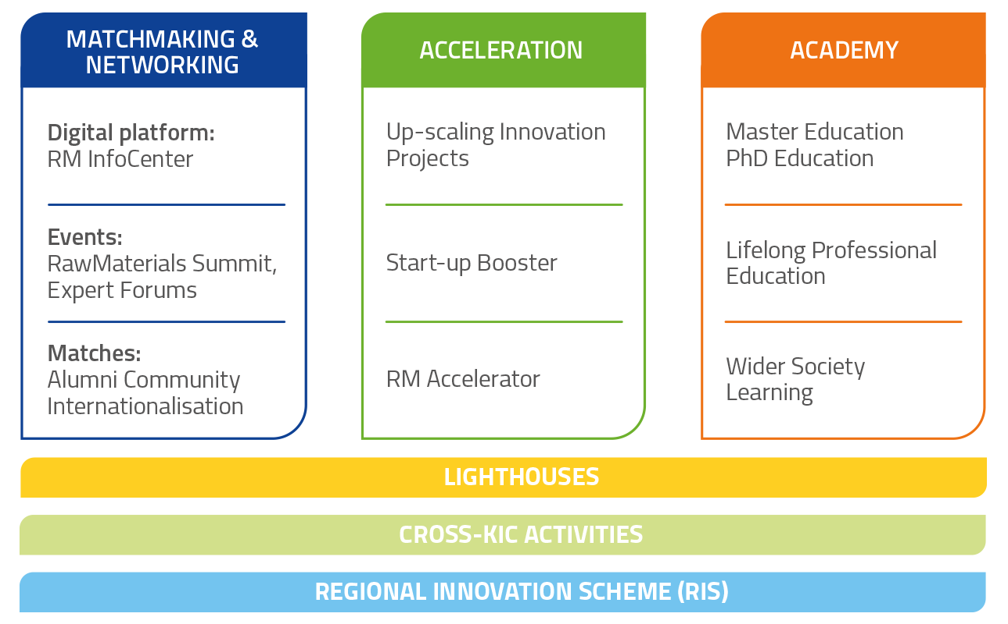
EIT RawMaterials - Overview of Activities
Innovation
Education
Entrepreneurship
8
Notes:
EIT RM activities revolve around 3 Pillars, namely Matchmaking & Networking, Acceleration and Academy and all activities are deployed in three horizontal operational schemes: Lighthouses , Cross KIC activities that empower synergies between different KICs and finally, the EIT Regional Innovation Scheme, which will be presented and explained later.
Shortly presenting each pillar:
Through Matchmaking and Networking, collaboration and idea sharing can be promoted. The most important event is the RM Summit.
Through Accaleration an innovative environment is secured aiming to deliver, processes, technologies and products to meet the market needs.
And through the Academy, the EIT RM aims to educate and support young scientists and engineers to obtain the skills that the industry needs. This can be realized through Master’sand PhD programmes, LLL and wider societal learning.

Slide 9
A look into Call for Projects KAVA11 Results
Education
RIS
Capacity
RIS Capacity
Upscaling
SUCCESS RATE
82%
53%
41%
Education
Upscaling
RIS Capacity building
Notes:
Moving on to the next slide, you may see the KAVA 11 results. The majority of the proposals submitted were Upscaling followed by the RIS Capacity building and education. More than 80% of the education, 50% of the upscaling and 40% of the capacity-building proposals were evaluated positively in the 1st submission stage and invited to Stage 2. This can underline the great advantage of EIT RM calls for projects, which is the high success rate compared to other funding schemes such as Horizon Europe.

Slide 10
EIT RawMaterials - Partners and Membership
support of innovation and education projects
access to networking and matchmaking events to meet experts
Why become a partner?
access to the digital collaboration and networking platform
benefit from preferred access to the network and servicing components
Partner levels
Core Partner
Associate Partner
Project
Partner
Over 120 core and associate partners
Over 190 project partners
10
Notes:
EIT RawMaterials comprises of more than 120 core and associate partners and over 180 project partners of leading businesses, universities, research & technology organisations from over 20 EU countries.
By becoming an EIT RM partner, there are a lot of advantages, including: support of innovation and education projects, getting access to networking and matchmaking events, having the opportunity to meet with experts, as well as getting access to digital collaboration and networking platforms, and benefit from preferred access to the network and servicing components,
There are 3 levels of partnership:
Core partner: full access to strategy and governance, amount of membership fees: 100.000 euros/year and no funding limit
Associate partner: shared access to strategy and governance, amount of membership fees: 30.000 euros/year and up to 300.000 euros of EIT funding
Project partner: shared access to strategy and governance, amount of membership fees: 10.000 euros/year and up to 100.000 euros of EIT funding
Non-members can be included in consortia, although in the case of positive evaluation and funding of the proposal, by the time the project starts they should have become members.

Slide 11
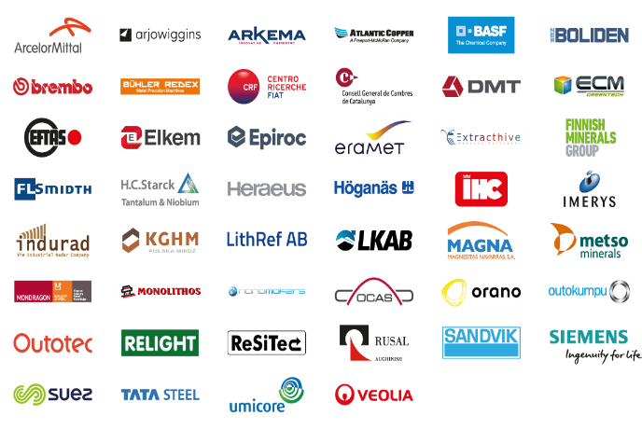
World’s largest Innovation Community in the Raw Materials Sector
Industry
237 members
9 Greek partners
Notes:
Over 200 industries are members of the EIT RM Community and among them the biggest around Europe. 9 Greek industrial partners, with Mytilineos, Hellas Gold and Sunlight being among them.

Slide 12
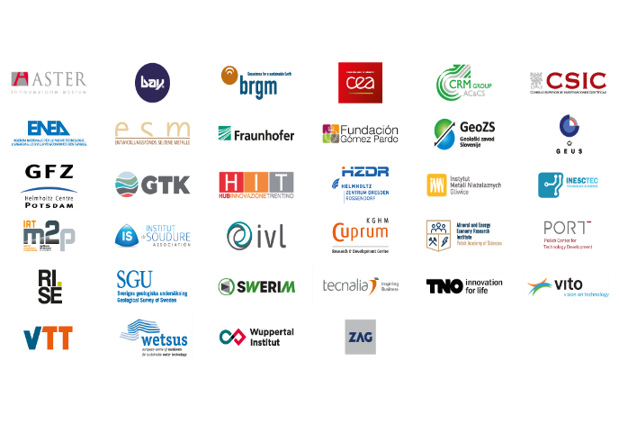
World’s largest Innovation Community in the Raw Materials Sector
Research & Technology
64 members
5 Greek partners
Notes:
64 Research organisations with 5 Greek partners

Slide 13
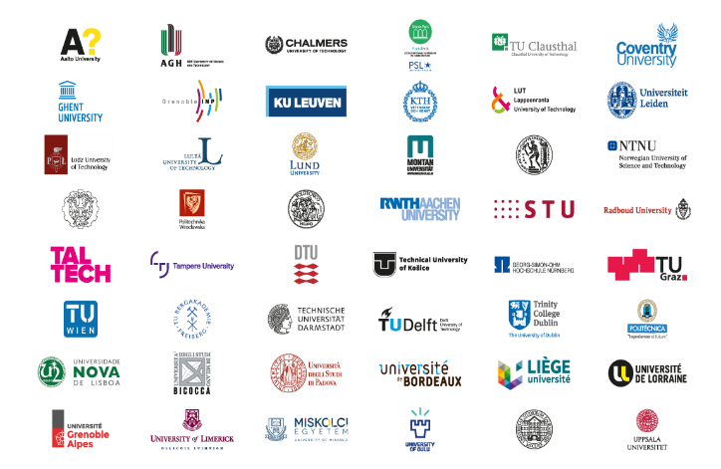
World’s largest Innovation Community in the Raw Materials Sector
Higher Education
78 members
1 Greek partner
Notes:
78 Universities are members of EIT RM Community, with NTUA being one of them.

Slide 14

KAVA CALL 12
KIC Added Value Activity
EIT RawMaterials Lighthouses
Responsible Sourcing
Sustainable Materials
Circular Societies

Slide 15
EIT RawMaterials - Lighthouses
Lighthouses are high-impact, long-term innovation activities that address the economic, societal and environmental challenges in Europe.
Responsible sourcing
Lighthouses are implemented through actions such as:
Innovation and Education Projects,
Matchmaking events, and
Business creation activities.
Sustainable materials
Circular societies
Notes:
Lighthouses are large-scale and long-term coordinated innovation initiatives that address critical and specific raw materials challenges for Europe. They are mission approaches to innovation and education challenges and target to generate solutions for societal challenges related to raw materials. In doing so, they will raise awareness about their role and importance and create a positive perception about raw materials and their associated industries.
Those key thematics for 2024 projects are: Responsible Sourcing, Sustainable Materials and Circular Societies and are implemented though guided activities and funding tools of EIT RM such as call for innovation and Education proposals

Slide 16

Lighthouse: Responsible Sourcing
Topics to follow under KAVA 12
Aim: To provide access to raw materials for a carbon-neutral Europe
Exploration: data-driven decision-making in the extractive sector
Mining and processing: responsible sourcing of materials
Future exploration, mining, and processing technologies:
Advanced and fully integrated exploration - smart targeting of ore deposits
Future mining - Increase safety and reduce the environmental footprint of mining operations (whole cycle)
Mineral and metallurgical processing - Improve efficiency and reduce emissions & CO₂- footprint
Key innovation topics also supported: batteries, magnets and motors, hydrogen technologies, photovoltaics, electronics
16
Notes:
Responsible Sourcing Lighthouse leads the innovation in mineral exploration, responsible sourcing and processing of raw materials for Europe’s green future.
The first lighthouse, aims at boosting the responsible sourcing of critical and strategic raw materials in Europe. Three approaches are at the core of the Lighthouse Responsible Sourcing: i) achieving a more targeted and cost-effective exploration and quicker transition to operation; ii) reducing the environmental footprint of mining and processing; and iii) improving the efficiency of mineral and metallurgical processing by smart targeting of ore deposits and always having the environmental footprint in mind as well.

Slide 17
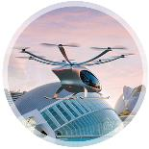
Lighthouse: Sustainable Materials
Topics to follow under KAVA 12
Aim: To power our future, green energy, transport, and mobility
Innovation in the substitution of critical, toxic, and low-performance materials
Advanced materials’ processing, including Additive manufacturing of materials (i.e., powder development and microstructure engineering)
Resource-efficient design of materials
Key innovation topics also supported: batteries, magnets and motors, photovoltaics, electronics
Notes:
Sustainable Materials Lighthouse guides innovation in the making, using, and recycling of sustainable and cost-efficient raw materials for future green mobility and energy.
The second Lighthouse, sustainable materials, focusses on the substitution of critical, toxic, and low-performance materials, that is, at the elemental, materials, and processing levels. Key technological approaches include the modelling of materials and processes, alloy development, microstructure engineering, and resource efficient materials design and processing, including near-net-shape processing

Slide 18

Lighthouse: Circular Societies
Topics to follow under KAVA 12
Aim: To enable economic growth and carbon-neutrality
Industrial symbiosis: turning waste resources into valuable industrial input materials
Products’ design optimisation to create a so-called design for recycling and lifetime extension, increasing the impact on raw materials and energy efficiency.
Innovation in end-of-life product recycling
Chain of custody: innovation to improve traceability, sustainability, and transparency across raw materials value chains
Key innovation topics also supported: batteries, magnets and motors, photovoltaics, electronics
Notes:
Under the Circular Societies Lighthouse, EIT RawMaterials funds and supports innovation and education activities related to industrial symbiosis and end-of-life product recycling.
The Circular Societies Lighthouse, focusses on innovation and education related to industrial symbiosis, design for recycling and life-time extension, end-of-
life product recycling, as well as in the chain of custody (traceability, sustainability, transparency).

Slide 19

KAVA CALL 12
Call Categories
Upscaling
RIS Objectives & Conditions
RIS Capacity Building
RIS Innovation
Education (+ RIS Education)
Submission outline

Slide 20
Upscaling
RIS
RIS Capacity Building
RIS Innovation
Education (+ RIS Education)

Slide 21
Upscaling KAVA Projects (1/3) - Description
KAVA CALL 12
Upscaling KAVA projects are innovation projects based on validated technologies that need additional step(s) for testing, demonstration, proof of concept and up-scaling prior to commercialization. The purpose of these projects is to support good technologies, products, and services that are currently under development to reach market entry.
Consortium (No. of partners) | min. 2 - max. 4 (from min. 2 countries). Larger consortia can only be considered in exceptional cases
Lead project participant | Core or Associate Partner (or Linked Third Party to a Core or Associate Partner) of EIT RawMaterials by the time the project starts. Non-partners can apply and lead a proposal
TRL level at start/end | Min. 6 at start/ min. 8 at end
Budget Size | no less than 500,000€/year (including EIT funding and consortium co-funding) and not higher than 2,000,000€ for the total duration of the Project.
Min. Co-funding (% of Total project funding) | 30%, higher co-funding rates will be positively evaluated
Duration | max. 3 years, proposal of shorter duration will be evaluated favourably

Slide 22
Upscaling KAVA Projects (2/3) - Description
KAVA CALL 12
Market introduction and/or a commercial use | Must aim for market introduction during the funding period or within 2 years (or less) after the end of the Project; Proposals of shorter time to market introduction and/or commercial use will be evaluated favourably.
Value creation for EITRM – Financial Sustainability Mechanism (FSM) | EIT RawMaterials funds a project by obtaining a percentage of the share capital of the Project company or any alternative funding structures (only to be considered on an exceptional basis and for specific reasons). Potential ERMA investments are to be evaluated favourably.
Core KPI target mandatory | At least 1 core KPI, if it occurs during the project development will be positively evaluated. There are 2 possible core KPIs to be accomplished: the product/service developed is selling >10,000€ the latest 2 years after the end of the project (KPI EITHE02.4) a start-up is created to commercialise the product/service developed and it can prove sales >10,000€ the latest 2 years after the end of the project (KPI EITHE04.4)
Horizon Europe funding framework | Cost eligibility under general Horizon Europe principles (see Horizon Europe Annotated Model Grant Agreement for more information). Mandatory for all Candidates to register in the European Commission’s Funding and Tenders Portal and obtain a Participant Identification Code (PIC) number.

Slide 23
Upscaling KAVA Projects (3/3) - Submission
KAVA CALL 12
2–Stage submission and evaluation process
Only Proposals receiving “yes” to all of the 6 following criteria at Evaluation Stage 1 will be invited to submit a FINAL Proposal in Evaluation Stage 2.
Stage 1 Evaluation Criteria for “DRAFT Proposals”:
Alignment with Strategic Agenda of EIT RawMaterials 2021-2027. Preferably, at least impacting one of the Lighthouse focus topics.
Clear impact of the solution shown (also by) selection of appropriate KPIs, targeting a minimum of 1 of the two EIT Core KPIs (EITHE02.4 and/or EITHE04.4) and their achievement during the funding period.
Innovativeness of the solution clearly justified with a description of the state of the art and describing the competitive advantage. TRL levels clearly justified.
Commercial attractiveness: Clearly identified products and/or services. How will you produce, deliver, sell them? What is your business model?
Commercialization capacity to enter the market: Who will produce/commercialize what? Do you have access to the potential end user and future customers for validation and piloting?
Funding terms to be agreed upon with the commercialisation partners, in the form of an equity share for EIT RawMaterials in the Project company. Any alternative funding structures would only be considered on an exceptional basis and for specific reasons.

Slide 24
Upscaling
RIS
RIS Capacity Building
RIS Innovation
Education (+ RIS Education)

Slide 25
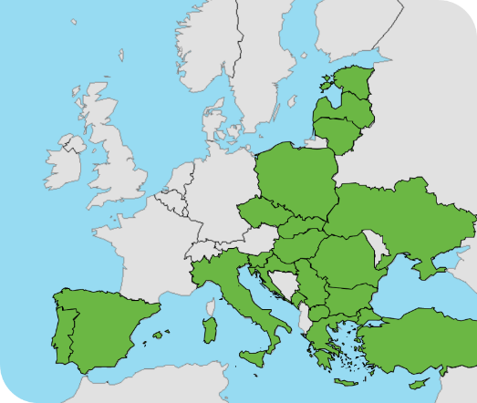
Regional Innovation Scheme (RIS) – objectives and purpose
The EIT Regional Innovation Scheme (EIT RIS) is designed for modest and moderate innovator countries, and where EIT Knowledge and Innovation Communities have few or no partners.
Objective and purpose of RIS:
Contribute to the advancement of the innovation performance of RIS countries
Help raise the capacity of local actors to apply to become full KIC partners
Promote KTI model
Used as a bridge towards relevant RISs & support additional private and public funding
Support the KIC’s FS
RIS Eligibility based on:
European Commission’s Innovation Scoreboard
Notes:
FS: financial sustainability
KTI: knowledge triangle integration

Slide 26
EIT RawMaterials RIS KAVA Projects Conditions
KAVA CALL 12
Proposals need to comply with the following conditions of Regional Innovation Scheme (RIS):
Majority of RIS Innovation Proposal's activities are executed in RIS countries
Activities need to provide benefits for RIS countries
Activities need to raise the innovation level of entities in RIS countries
Activities must be coordinated by a partner from a RIS eligible country
Activities contribute to at least a reasonable and preferably significant amount of EIT Core KPIs (reported as achieved in a RIS eligible country)
RIS eligible countries: a) EU Member States: Bulgaria, Croatia, Czechia, Estonia, Greece, Spain, Italy, Cyprus, Latvia, Lithuania, Hungary, Malta, Poland, Portugal, Romania, Slovenia, Slovakia; b) Horizon Europe Associated Countries: Montenegro, North Macedonia, Serbia, Türkiye, Ukraine and c) Outermost Regions: Guadeloupe, French Guiana, Réunion, Martinique, Mayotte and Saint- Martin (France), the Azores and Madeira (Portugal), and the Canary Islands (Spain) + Albania and Bosnia and Herzegovina from 2025
26

Slide 27
Upscaling
RIS
RIS Capacity Building
RIS Innovation
Education (+ RIS Education)
27

Slide 28
RIS Capacity Building KAVA Projects (1/3) - Description
KAVA CALL 12
Can be defined on a case-by-case basis.
For Example: Cooperation with innovative groups that work on and have developed tools and technologies that can be tested in RIS regions with the aim to solve raw materials value chain related challenges.
Consortium (No. of partners) | min. 2 Project participants (at the time of proposal submission), min. 3 KIC Core, Associate or Project Partners (at the time of the Project’s start), coming from a minimum of 2 countries
Lead project participant | must be a Core or Associate Partner (or Linked Third Party to a Core or Associate Partner) of EIT RawMaterials by the time the project starts
TRL level at start/end | min. 4 at start of the project
RIS Task Partners | Yes, can have (but must be selected via open call)
Budget Size | Not defined in the Call text
Min. Co-funding (% of Total project funding) | 10% (Co-funding above the mandatory minimum will be evaluated positively)
Duration | 1 - 2 years
Core KPI target mandatory | Yes (EIT core KPIs)
28

Slide 29
RIS Capacity Building KAVA Projects (2/3) - Description
KAVA CALL 12
 | More than 70% of EIT funding requested by the Consortium must be allocated to RIS partners.
FSM | Not defined in the call text, but Financial sustainability mechanism potential/ or even indicated will be evaluated positively.
Market Analysis | Not defined in the Call text, but a basic market analysis should be part of the Final proposal
29

Slide 30
RIS Capacity Building KAVA Projects (3/3) - Submission
KAVA CALL 12
2–Stage submission and evaluation process
Only Proposals receiving “yes” to all of the 5 following criteria at Evaluation Stage 1 will be invited to submit a FINAL Proposal in Evaluation Stage 2.
Stage 1 Evaluation Criteria for “DRAFT Proposals”:
Alignment with the Strategic Agenda of EIT RawMaterials 2021-2027, RIS objectives, and EIT RawMaterials strategy for delivering maximum impact in the RIS regions as described in the call text.
High impact: the Proposal aims at actively integrating new RIS partners and achieving EIT Core KPIs (in a RIS-eligible country).
Proposal is proving/demonstrating an existing RIS challenge, quantifying it and is presenting a solution to be provided by the Proposal Consortium, and demonstrating the potential to bring in additional national/regional funding.
Project coordinator and Consortium have a solid track record in executing Projects and clear roles assigned.
Potential for Project continuation: The Proposal is building a strong community (KTI) and has a clear plan for continuation after the duration of the proposed KAVA Project (including tentative timeline, next steps, funding sources and future activities).
30

Slide 31
Upscaling
RIS
RIS Capacity Building
RIS Innovation
Education (+ RIS Education)
31

Slide 32
RIS Innovation KAVA Projects (1/3) - Description
KAVA CALL 12
RIS Innovation Projects based on validated technologies that need additional step(s) for testing, demonstration, proof of concept and up-scaling prior to commercialization. The purpose of these Projects is to support good technologies, products, and services that are currently under development in RIS countries to reach market entry.
Consortium (No. of partners) | min. 2 - max. 4 (from min. 2 countries)
Lead project participant | must be a Core or Associate Partner (or Linked Third Party to a Core or Associate Partner) of EIT RawMaterials by the time the project starts
TRL level at start/end | min. 6 at start/ min. 8 at end
RIS Task Partners | Yes, can have (but must be selected via open call)
Budget Size | Up to 500,000€ of EIT Funding (Phase 1) and in case of successful interim evaluation and continuation to Phase 2 additional 300,000-500,000€ οf EIT Funding.
Min. Co-funding (% of Total project funding) | 20%
Duration | 2 years (will be implemented in 2 phases, but the consortium applies only once for both phases (Phase 1= 1 year - review and go/no-go decision - Phase 2=1 year)
Core KPI target mandatory | Yes (EIT core KPIs)
32

Slide 33
RIS Innovation KAVA Projects (2/3) - Description
KAVA CALL 12
 | More than 50% of EIT funding requested by the Consortium must be allocated to RIS partners.
Commercialisation | Must aim for market introduction and/or a commercial use within 2 years (or less) after the end of Phase 2 of the Project, and Proposal of shorter duration for market introduction and/or commercial use will be favourably evaluated.
FSM | EIT RawMaterials funds a project by obtaining a percentage of the share capital of the Project company or any alternative funding structures (only be considered on an exceptional basis and for specific reasons)
Market Analysis | Preliminary Market analysis must be included in the Proposal.
GTM Strategy | All Proposals must include in their activities plan a Go-to-market Strategy as a mandatory Deliverable at the end of Phase 1 of the Project (M12)
Market introduction and/or a commercial use | Within 2 years (or less) after the end of Phase 2 of the Project, and Proposal of shorter duration for market introduction and/or commercial use will be favourably evaluated.
33

Slide 34
RIS Innovation KAVA Projects (3/3) – Submission
KAVA CALL 12
2–Stage submission and evaluation process
Only Proposals receiving “yes” to all of the 6 following criteria at Evaluation Stage 1 will be invited to submit a FINAL Proposal in Evaluation Stage 2.
Stage 1 Evaluation Criteria for “DRAFT Proposals”:
Alignment with Strategic Agenda of EIT RawMaterials 2021-2027.
Clear impact of the solution shown (also by) selection of appropriate KPIs, targeting a minimum of 1 of the two EIT Core KPIs (EITHE02.4 and/or EITHE04.4) and their achievement during the funding period.
Innovativeness of the solution clearly justified with a description of the state of the art and describing the competitive advantage.
Commercial attractiveness: Clearly identified products and/or services. How will you produce, deliver, sell them? What is your business model?
Commercialization capacity to enter the market: Who will produce/commercialize what? Do you have access to the potential end user and future customers for validation and piloting?
Funding terms to be agreed upon with the commercialisation partners, in the form of an equity share for EIT RawMaterials in the Project company. Any alternative funding structures would only be considered on an exceptional basis and for specific reasons.
34

Slide 35
Upscaling
RIS
RIS Capacity Building
RIS Innovation
Education (+ RIS Education)

Slide 36

Overview of EIT Education Opportunities
RM University Days
X-KIC Edu- EIT Youth
X-KIC Edu - Human Capital & Entrepreneurial skills
EIT labeled Master programmes
Summer schools
HEI Capacity Building
Lifelong learning
X-KIC Edu – Alumni & virtual camps
To develop transversal Entrepreneurial & Innovation skills at institutional level
To bring talents to the RM sector
For upskilling and re-skilling
ENTREPRENEURSHIP
36

Slide 37
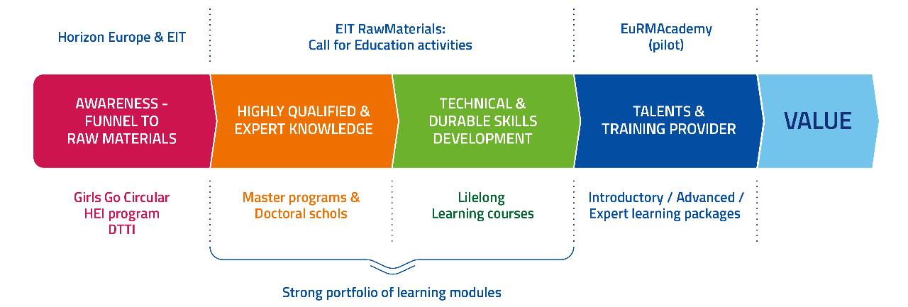
OPEN CALLS TO provide talents to the RAW MATERIALS INDUSTRY
Open Calls to Provide Talents to the Raw Materials Industry

Slide 38
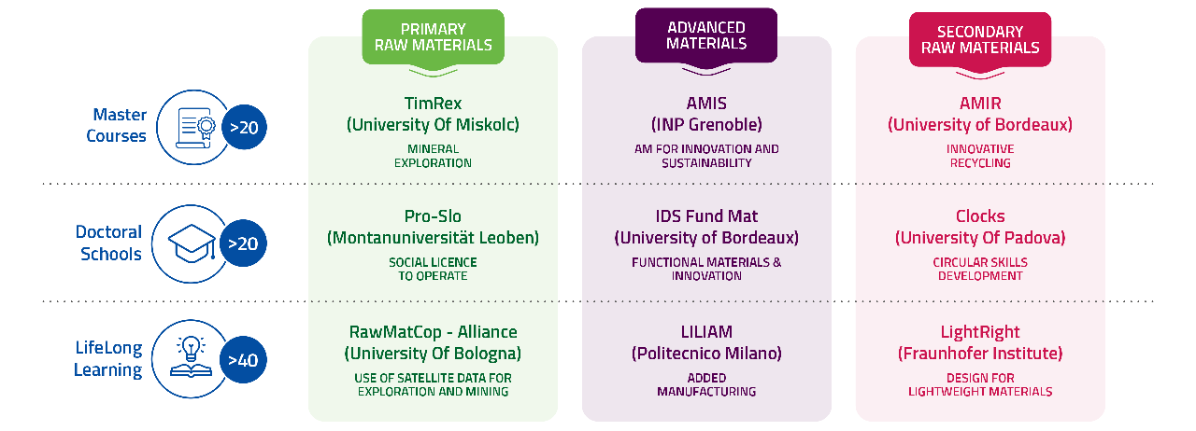
A Strong Portfolio of Learning Modules
A strong portfolio of Learning Modules

Slide 39
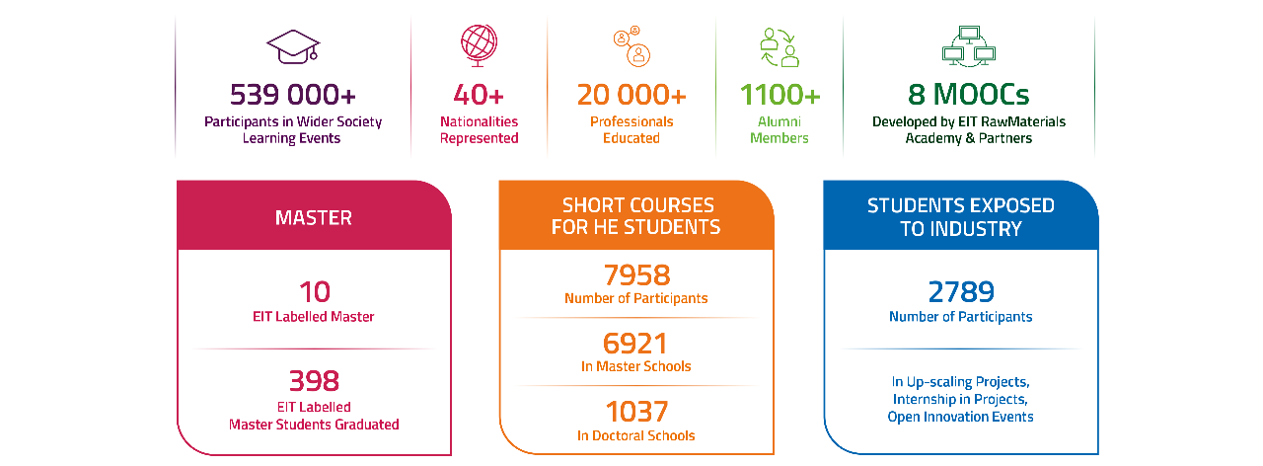
Talents & Training Provider for the Raw Materials Value Chain (2016-2022)

Slide 40
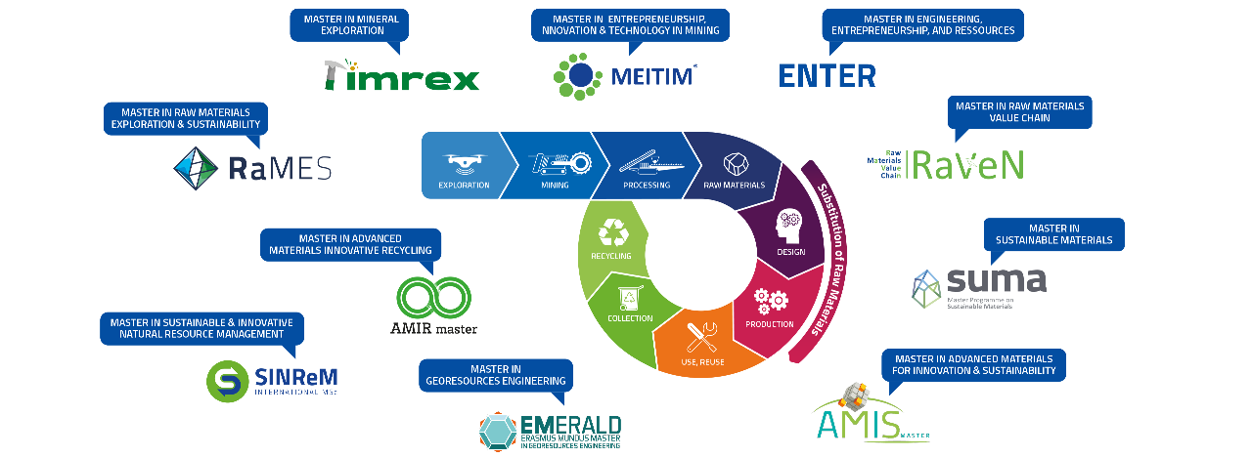
EIT LABELED MASTERS PROGRAMMES providing TALENTS
EIT Labeled Masters Programmes Providing Talents

Slide 41
Education KAVA Projects
KAVA CALL 12
Proposals for EIT-labelled activities within the Master Education segment
5 Master’s degree programmes fulfilling the criteria of Pillars 1 and 2
Pillar 1: Thematic Orientation
Pillar 2: Programme Development
1. Master in Advanced Materials: Innovative Recycling
4. Master in Sustainable Materials
2. Master in Advanced Materials for Innovation and Sustainability
5. Master in Mineral Exploration
3. Master in Resource Engineering (Innovative Education in Geometallurgy and Circular Economy)
6. Further development and improvement of existing master’s programmes with EIT Label
Notes:
Pillar 1 applies to 1-5 master programmes
Pillar 2 – applies to 6

Slide 42
Education & RIS Education KAVA Projects (1/3) - Description
KAVA CALL 12
Consortium (No. of partners) | min. 2 - max. 4 (from min. 2 countries)
Lead project partner | Core or Associate Partner of EIT RM by the time the project starts
Project Partners | Non-members: application for membership by early July 2024 KIC partners from at least 2 sides of the knowledge triangle (education, research, industry/ business)
Cost eligibility (EIT RM membership) | Non-members who receive funding, or who incur costs as a result of a KAVA need to become partners Non-members who participate in a KAVA but receive no funding and incur no costs in the Project do not need to become partners.
Budget Size | 15,000€ per eligible student enrolled in an EIT-Labelled Master programme for the entire programme duration (AVSA grant) For all WPs the requested total budget must be maximum 200,000€/year (max. planned non-AVSA budget) Projects shall aim to increase graduate targets,whilst reducing the amount of AVSA grants by 25%
Co-funding (% of Total project funding) | 5-10% contributed by the Consortium will be evaluated positively
Duration | 1-3 years

Slide 43
Education & RIS Education KAVA Projects (2/3) - Description
KAVA CALL 12
Core KPI targets mandatory | Yes - EIT core KPIs on Education: sum of graduates from EIT labelled master’s, PhD programmes and other education activities awarded the EIT Label (EITHE07.1/EITHE07.2-EITRIS) start-ups created by students enrolled and graduates from EIT-labelled programmes (EITHE05.1/EITHE05.2-EITRIS)
RIS conditions (for RIS-Education Proposals) | Majority of the Proposal’s activities to be executed in RIS countries Provide benefits for RIS countries Raise the innovation level of entities in RIS countries Coordinator from a RIS-eligible country

Slide 44

Education & RIS Education KAVA Projects (3/3) - Submission
KAVA CALL 12
1–Stage submission (Final Proposal Submission)
The Final Proposals will be evaluated according to 3 sets of criteria:
1. Eligibility criteria (additional):
Alignment with HE and EIT rules, the EIT RM Strategic Agenda and EIT RM Lighthouses.
Structure a detailed workplan, including a Project Management WP, a Dissemination & Communication Plan WP and a GTM strategy (WP0) , only in case of LLL projects
Meeting all eligibility criteria: precondition for evaluating quality & strategy of submitted proposals
2. Quality criteria (50% of the final score)
Innovation capacity
Quality of the project definition and scope
Quality of the consortium
Business potential
3. Strategy criteria (50% of the final score):
Strategic importance for the KIC
Expected impact for the KIC (return on KAVA investment)
Completeness and compliance
Notes:
Apart from the conditions discussed earlier during the description of Education & RIS Education Proposals there are some additional eligibility criteria that should be met in order for a proposal to be eligible and go to the evaluation stage: these eligibility criteria are: … (what is described on the slide under the eligibility criteria bullet point)

Slide 45

Coming Call for New Higher Education projects in 2024
INSTRUCTIONS
Strengthen the Master programs portfolio
EIT label, with an entrepreneurial dimension
At least 2 new cohorts
Co-funding
CALL TIMELINE
Launch: of KAVA 12 on November 16th & Master labeling on April 2024
Deadline for Final proposal submission: January 31st, 2024
Selection Committee: March 2024
Start of KAVA projects: end of 2024
New Master labeling: November 2024
All information, Call text and guidance at: https://eitrawmaterials.eu/call-for-projects/
45

Slide 46
NTUA-SMME: EIT RawMaterials Education Projects
Project type |  | Project Name
RM Academy | Lifelong Learning | HydroMetEC, SkiComCu
 | Wider Society Learning | CEMOOC, VIRTUAL MINE, RM@Schools-ESEE, SISTEM RIS-BRIEFCASE
 | Master’s | SETI, VR Lab, EIT RM Master School (RMUD)
 | PhD | TOPSTARS, PRO-SLO
 | Regional Innovation Scheme (RIS) | TrainESEE v2, EnAct-SDGs, RIS Education & Entrepreneurship, RMs Manager, RIS Internship, DIM ESEE-2
2017-today:
Participation in 18 Projects: 13 completed & 5 ongoing
Cooperation with more than 80 Partners from 30 European Countries (EU & non-EU)
Till 2022:
420 students, young professionals, and researchers were trained in these Education Projects
140 (33%) from NTUA
80 Trainers – 9 (11%) from NTUA
* Ongoing

Slide 47

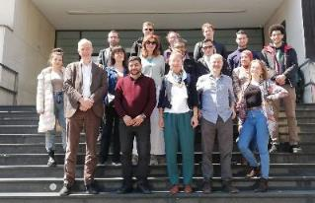

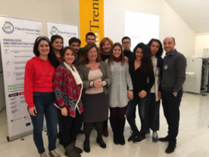

NTUA-SMME: EIT RawMaterials Education Projects
EIT RM Academy activities
Raise awareness among secondary school students and the wider society about the critical role of Raw Materials in the common prospect of a sustainable future, ensuring the availability of professionals in the future.
Strengthens grad students’ technical expertise while and problem-solving mindset, fostering entrepreneurial and innovation skills.
TrainESEE v.2
Capacity building - focused on improving specific generic skills
RIS-INTERNSHIP Sustainable and structured Internship Programme for MSc students
DIMESEE v.2
LLL project focused on the increase of innovativeness among RM professionals

Slide 48


NTUA-SMME: EIT RawMaterials Education Projects
New Education Projects started in 2023
PRO-SLO, Ph.D Course, 2023-2026, funded by EIT RawMaterials
SkiComCu, 2023-2026, funded by EIT RawMaterials
An alliance of SLO experts from research, universities and industry will design and deliver a tailored PhD school. It will be based around challenges provided by the industry, facilitated by innovative teaching/learning methods. NTUA leads the design of Educational material, implementing a pilot school in Greece.
A LLL Project aiming to provide skills for sustainable practices, communication, problem solving, and new technologies in the Cu Industry. The course (including off- & online curriculum and XR tools) is directed to current & future staff in the roles of Foremen & Operational Staff, Professionals & Office Staff, Managers & Senior Professionals and HR Personnel. NTUA leads the Design and Development of Educational & Training Curriculum and Tools.

Slide 49


KAVA 12 Call Opening
16 November 2023
1st Stage Submission Deadline
31 January 2024
13:00 CET
2nd Stage Submission Deadline
29 May 2024
13:00 CET
EIT RawMaterials KAVA 12 Proposal Submission Timeline
For Upscaling/ RIS Capacity Building / RIS Innovation:
Draft Proposals (max. 5 pages)
Final Proposals
1-stage submission: Final Proposals
For Education / RIS Education:
The Proposal template must be completed and uploaded on the SeedBook online platform by the abovementioned deadlines.
https://seedbook.eitrawmaterials.eu
Notes:
EIT RM encourages the submission of proposals for projects that will create an impact on the raw materials sector. Our today’s main topic is how this call named KAVA10 that is now running, is separated in 3 categories and the main characteristics of each of them. According to the calendar, all interested parties are to submit a 1st stage of 5 pages of the proposal until 31st of May and then the proposals that will take the green light will go to the second stage which has a submission deadline until the 14th of September. As you may see from the date-line results are announced within a month after the submission deadlines.

Slide 50

EIT RawMaterials HUB – Regional Center Greece
Role and Activities

Slide 51

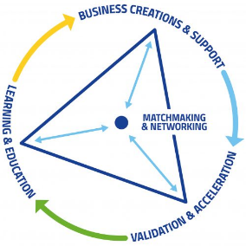
EIT RawMaterials HUB – Regional Center Greece (RCG)
Established in May 2018 by the NTUA with the support of EIT RawMaterials.
The operational activities of this center fall under the oversight of NTUA's School of Mining and Metallurgical Engineering.
EIT RM HUB-RCG Objectives:
to engage and mobilize all key stakeholders in the Knowledge Triangle (comprising research and technology, education, and business)
to support the local innovation ecosystem, in alignment with European strategies, fostering a culture of innovation within the country

Slide 52
EIT RawMaterials HUB – Regional Center Greece (RCG)
EIT HUB - RCG’s Role
Build a strong and extensive network within the Greek RM Sector, actively participating in the EIT RM activities since 2018 (over 500 contacts from more than 100 organizations)
5 Core Partners, with NTUA being one of them, and 10 more organizations in lower levels of partnership
Encourage institutional interactions between actors belonging to the EIT’s Knowledge Triangle
Support existing and new members of the Regional EIT RawMaterials Community
Development and implementation of collaborative innovation and educational initiatives
Acting as EIT RM Ambassador and one-stop-shop for EIT RM programme calls
Support and guidance provided upon agreement for KAVA project proposal preparation and implementation
Support and guidance for applications for entrepreneurship-related programmes (Accelerator, Booster, Jumpstarter)
Notes:
Regional Centre Greece in alignment with EIT RM principles, has set as top priority the innovation transferability from EIT RM to the Greek, Cypriot and Bulgarian Community. To achieve this, the HUB outreaches the regional ecosystem to assist in developing three-dimensional opportunities for innovation, based on education (which is the substrate of all industrial activity), the research and technology vision and, the interconnection of the latter to the industrial activity. It works as an interface for EIT RM interaction with local players in the RM sector , assists in identifying funding and project opportunities providing advice, and is the connection with other existing information channels to ensure efficient exchange of information and best practices.

Slide 53
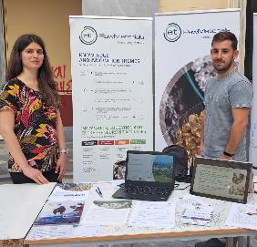
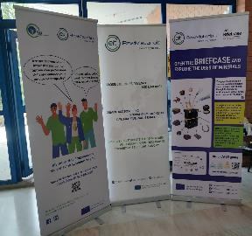
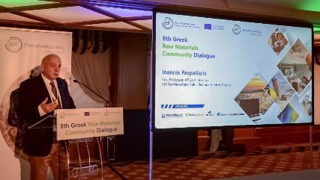
EIT RawMaterials HUB – Regional Center Greece (RCG)
EIT RM HUB – RCG’s activities so far:
8 Greek Raw Materials Community Dialogues
Informative events and workshops (entrepreneurship, education, wider society learning)
Representation in major RM sector events in the EU and the ESEE region (Greece, Cyprus, Balkans)
NTUA Researcher’s Night 2023
NTUA UNIque Days 2023
8th Greek Raw Materials Community Dialogue
53
Notes:
Regional Centre Greece in alignment with EIT RM principles, has set as top priority the innovation transferability from EIT RM to the Greek, Cypriot and Bulgarian Community. To achieve this, the HUB outreaches the regional ecosystem to assist in developing three-dimensional opportunities for innovation, based on education (which is the substrate of all industrial activity), the research and technology vision and, the interconnection of the latter to the industrial activity. It works as an interface for EIT RM interaction with local players in the RM sector , assists in identifying funding and project opportunities providing advice, and is the connection with other existing information channels to ensure efficient exchange of information and best practices.

Slide 54

EIT RawMaterials Call
for KAVA Projects 12
Webinar
THURSDAY 21 DECEMBER 2023, 12:00-13:15 CET
MS TEAMS
REGISTRATIONS: here
Notes:
Closing the presentation we would like to inform you that there is also a Webinar hosted by the EIT RM, tomorrow at 12.00 pm CET, This webinar is to provide you with more detailed information about the Call conditions and the opportunity to ask questions directly to the EIT RM team. You are highly motivated to join the webinar. We will share the registration link with you in the chat.

Slide 55






Connect with us!
https://rcgreece.labmet.ntua.gr/
EIT RawMaterials
Regional Center Greece
rcgreece@metal.ntua.gr
RCGREECE
Notes:
Follow us on the Linkedin and subscribe to our newsletter to be informed of EIT HUB RCG’s future events and outstanding news from the EIT RM community.

Slide 56

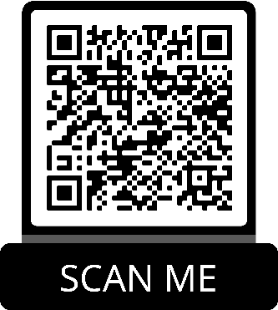
Q & A Session
Further information and call documents:
https://eitrawmaterials.eu/call-for-projects/
Notes:
If you have any questions that you would like to address directly to the EIT you can scan the QR code on the screen and complete the Google form. RCG will send the questions to the EIT RM team of East CLC in order to be answered.

